Slide 1
Ch. 10
The Cell Growth and Division

Slide 2
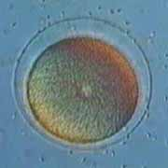
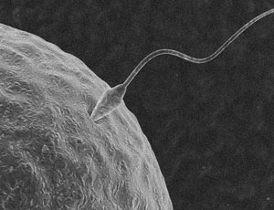
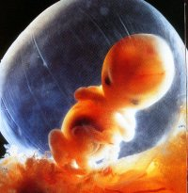
How do you grow?
Remember….you started out as a single cell (a zygote) made from the fusing of your dad’s sperm and your mom’s egg.
So, How did you get bigger?
Do cells just get bigger?
Do your cells make more cells?

Slide 3
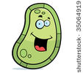
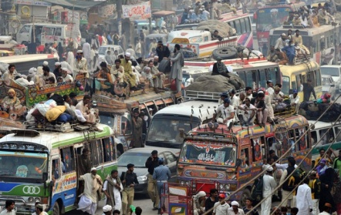
Cells just get bigger?
Problems:
1. You would just be one giant cell.
2. DNA Overload: high demand
Ex. Small town library
3. Exchange of nutrients and wastes can’t occur fast enough.
As the cell gets larger (volume), the surface area increases at a slower rate. It becomes more difficult to transport in and out fast enough.
Ex. Growing city.

Slide 4
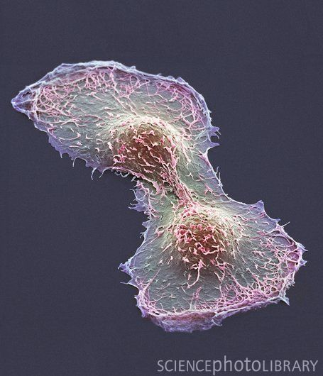
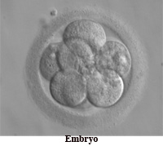
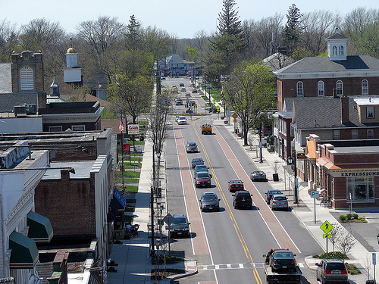
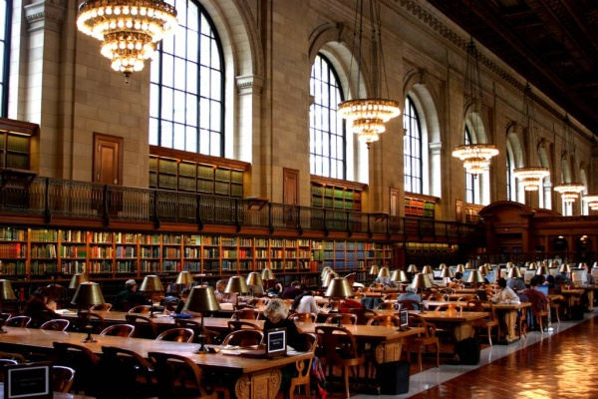
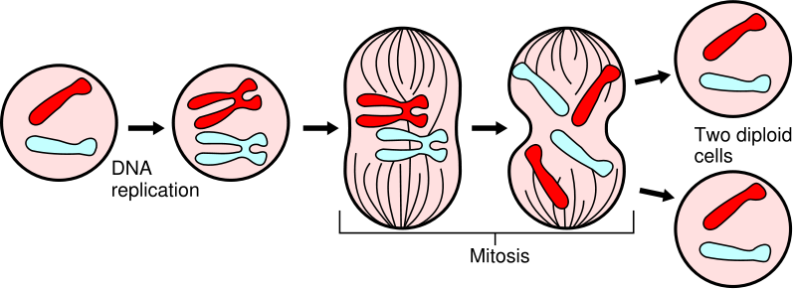
Answer to Problems
Cell division: the process by which a cell divides into two new daughter cells.
Each Daughter cell is genetically identical to the parent cell.
Reduces cell volume : surface area ratio
Efficient exchange can occur once again.
DNA overload solved.
Each daughter cell gets an exact copy of genetic info.
DNA replication

Slide 5
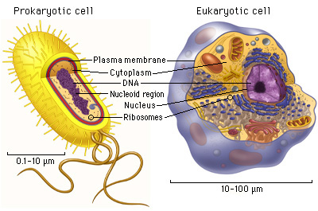
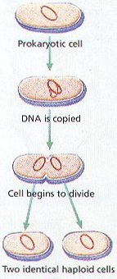
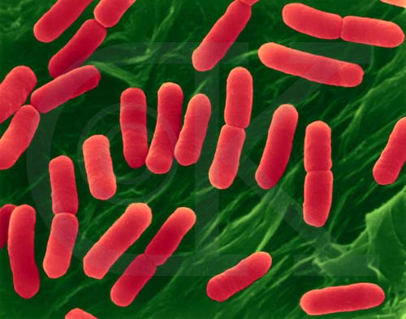
Prokaryotes
Prokaryotic cell: cells without a nucleus.
Bacteria
Binary Fission: Simple process of replicating DNA and dividing in two.

Slide 6
In Eukaryotes
Eukaryotic cell: has a membrane bound nucleus.
Plants, animals, fungi, and protista.
More complex: two stages
Mitosis: division of the cell’s nucleus
Cytokinesis: division of the cell’s cytoplasm

Slide 7
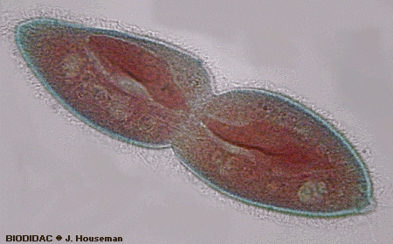
Reproduction
Mitosis is considered Asexual reproduction.
1 set of DNA produces offspring
Offspring is genetically identical to the parent.
1 paramecium ➔ 2 paramecium
1 skin cell ➔ 2 skin cells
Necessary for:
Growth
Repair
Replacement

Slide 8
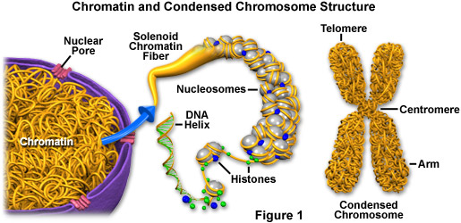
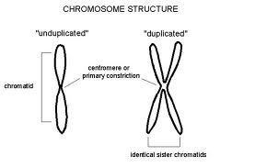
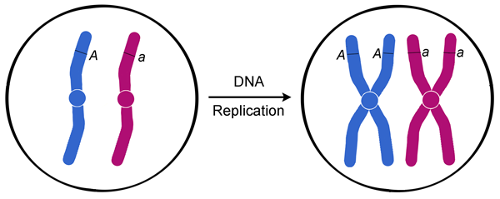
Chromosomes
Chromosomes
Carries the genetic information, the blueprint.
Made of DNA
Condensed Chromatin = Chromosome
1 Chromosome =
Before replication = 1 chromatid
When replicated = 2 “sister” chromatids held together by a centromere.

Slide 9
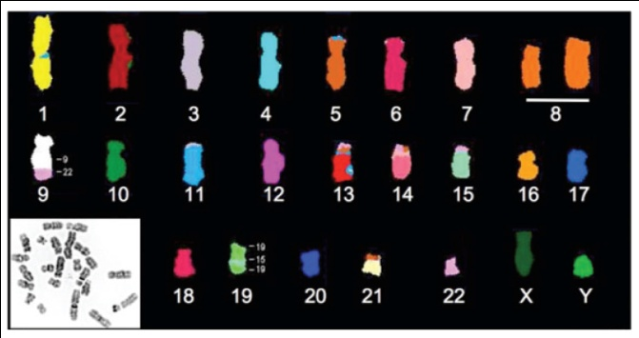
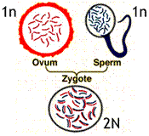
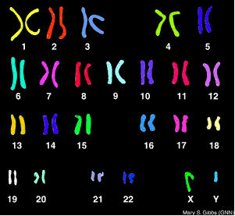
Number of Chromosomes
Every organism has a specific number
Humans = 46
Fruit flies = 8
Carrots = 18
They are only visible during cell division.
Haploid (N): contains 1 set (half the number of parent).
Found in gametes (sex cells) = sperm, egg.
Human: N = 23, fruit fly: N = 4, carrot: N = 9
Diploid (2N): contains full set (complete code)
Found in somatic (body) cells

Slide 10
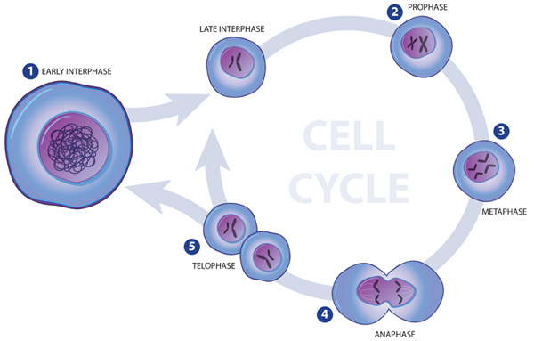
Cell Cycle
A cell grows, prepares for division, and divides to form two daughter cells, each of which then begins the cycle again.

Slide 11
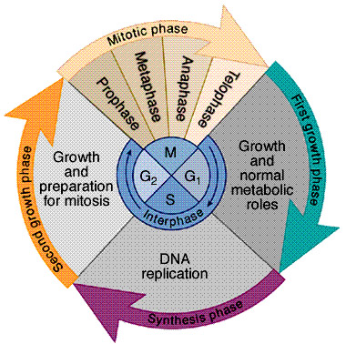
Cell cycle
2 phases
Interphase: name given to the phases of growth and replication
G₁ phase
S phase
G₂ phase
M (Mitotic) Phase: division phases
Mitosis
Cytokinesis

Slide 12
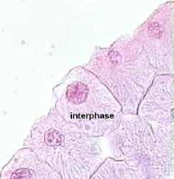
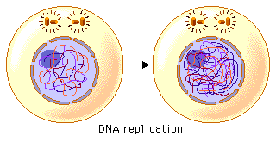
Interphase: Growth and Prep!
“between” divisions.
G₁ = Gap 1 phase
Cell increases in size and makes new proteins and organelles.
S = Synthesis phase
DNA replication
G₂ = Gap 2 phase
Shortest phase of interphase
Production of organelles and molecules needed for mitosis.

Slide 13
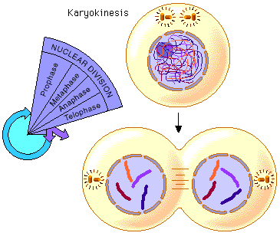
M Phase: Division!
Fast Phase of the cell cycle:
Mitosis:
Prophase
Metaphase
Anaphase
Telophase
Cytokinesis

Slide 14
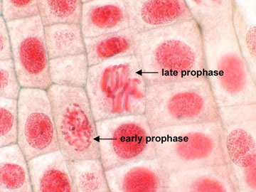
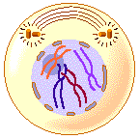
Prophase
Longest phase (50-60% of mitosis)
Chromatin condenses = chromosomes
Nuclear envelope and nucleolus disappear
Centrioles begin moving to opposite poles
Spindle fibers appear and start to attach to centromeres

Slide 15
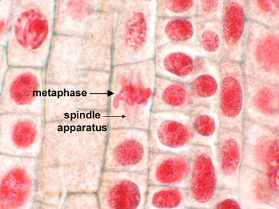
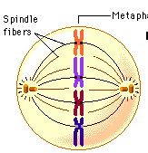
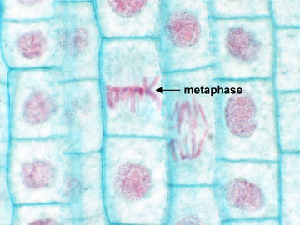
Metaphase (middle)
Only lasts a few minutes.
Spindle fibers move chromosomes to line up across the center (middle) of cell.
Must line them up to split them evenly so each daughter cell gets a full set.

Slide 16
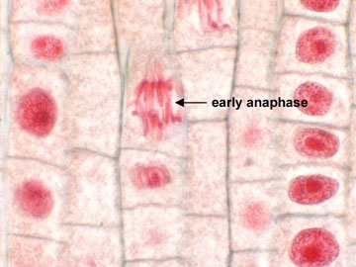
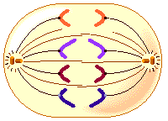
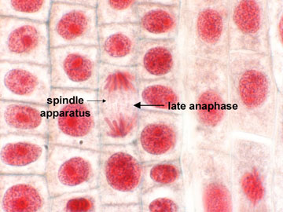
Anaphase
Centromeres between sister chromatids split.
Sister chromatids ➔ individual chromosomes
Spindle fibers begin to pull sister chromatids apart and continue to pull them towards opposite poles.
Like fishing.

Slide 17
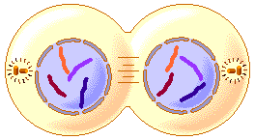
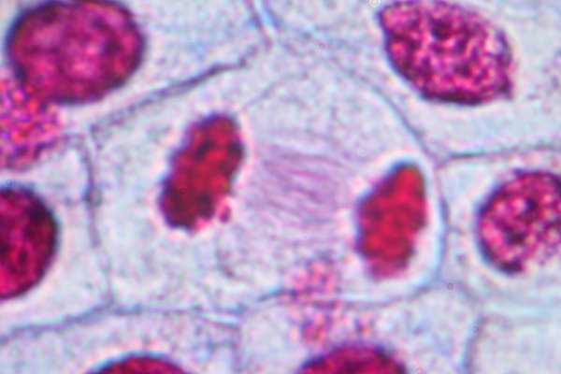
Telophase
Begins once chromosomes have reached the poles and have stopped moving.
Spindle fibers break apart.
Chromosomes uncoil and become chromatin.
Nuclear envelope and nucleolus redevelops around and in each daughter nucleus.

Slide 18
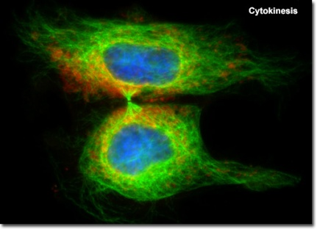
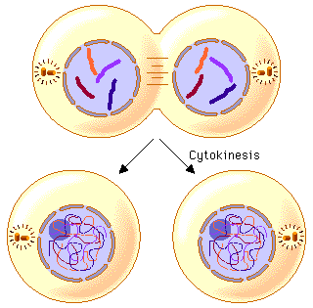
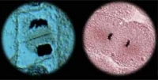
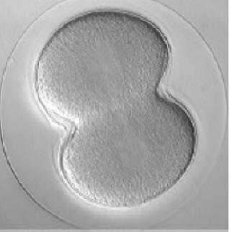
We aren’t done yet.
Cytokinesis: usually occurs at the same time as telophase.
Division of cytoplasm.
Cell membrane pinches inward (in animals)
Cell plate forms ➔ cell wall (in plants)

Slide 19
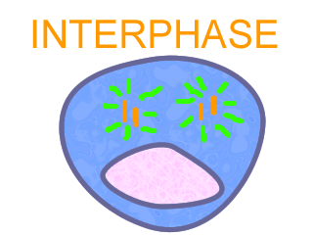
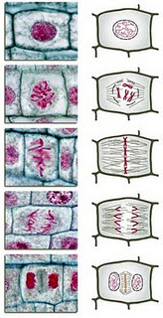
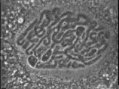

Slide 20
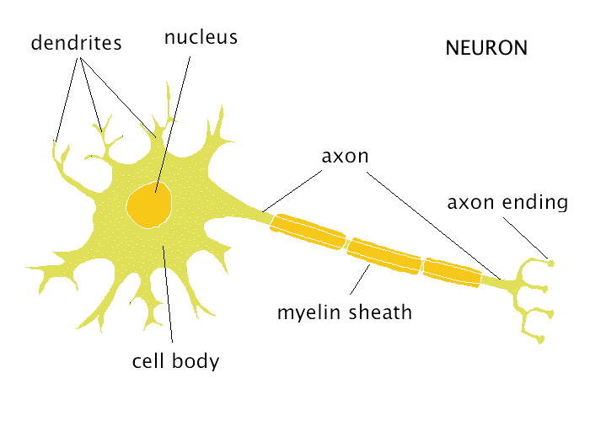
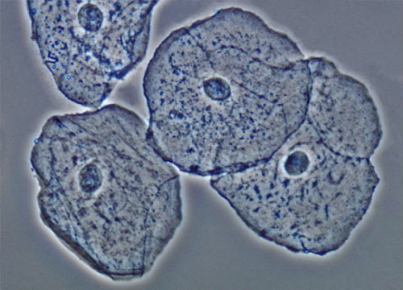
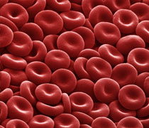
How often?
Some cells never divide once they develop.
What you have is all you get.
Muscle, cardiac, and nerve cells.
Some grow and divide rapidly throughout life.
Constantly losing and replacing.
Skin, blood cells, and digestive tract.

Slide 21
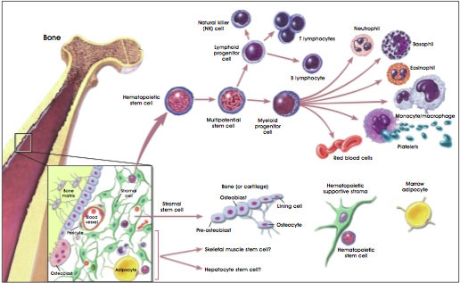
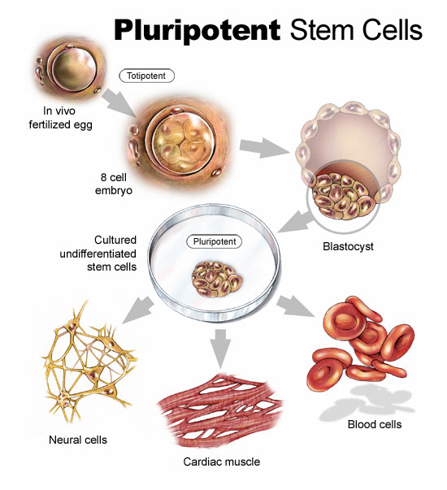
Stem Cells
Unspecialized cells in the body that can regenerate themselves indefinitely. The internal repair system.
After Mitosis:
Remain a stem cell undergoing mitosis.
Undergo cell differentiation and become a tissue or organ specific cell with a specific function.

Slide 22
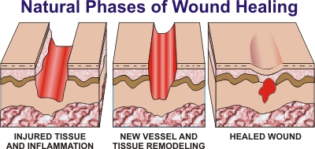
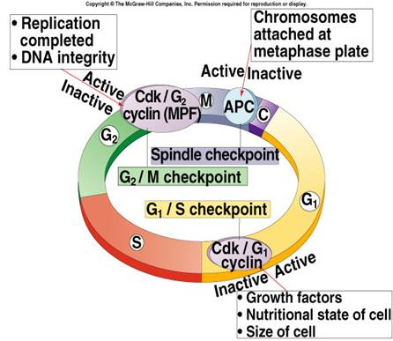
Controls of cell cycle
Controls for the cell cycle can be turned on when needed and turned of when not.
During the healing process:
Injury stimulate cells to divide rapidly.
As injury heals, cells come into closer contact, rate of division slows.
When cells touch, division stops.
Cyclins: a protein found in cells that regulates the timing of the cell cycle.

Slide 23
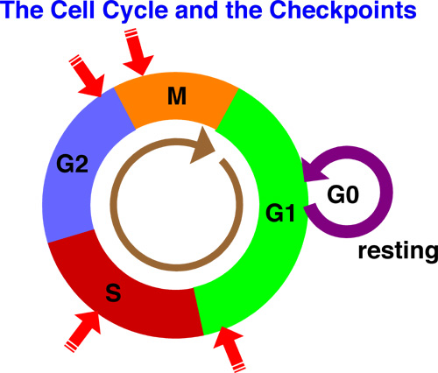
Regulatory proteins
Internal Regulators: proteins that respond to events within the cell.
Checkpoints between cell cycle phases.
External Regulators: proteins that respond to events outside the cell.
Speed up or slow down division.
Growth factors: stimulate growth and division.
Molecules (sensors) on cells: slow down or stop division when within close proximity to another cell.

Slide 24
When things go wrong.
Internal regulators:
Can cause daughter cells to be incomplete….not enough or too many chromosomes = genetic disorders.
Cells that fail to produce internal regulators fail to have orderly growth. ➔ cancer.
External regulators:
Cells do not respond to the signals that regulate growth…continue to grow even when they touch. ➔ cancer.
Form masses called tumors that damage surrounding tissue.
Can break free and spread to other parts of the body.
Causes: Carcinogens: radiation, smoking, viral infections

Slide 25
P53 gene
Gene p53 halts the cell cycle if DNA is damaged or chromosomes haven’t been replicated correctly, etc..
Defect in this gene causes the cell to lose information needed to respond to signals that would normally control their growth.
A large number of cancers are caused by this defect.

Slide 27
SUMMARY
Normal Cell Division
DNA is replicated properly.
2. Chemical signals start and stop the cell cycle.
3. Cells communicate with each other so they don’t become overcrowded.
Cancer Cells
Mutations occur in the DNA when it is replicated.
2. Chemical signals that start and stop the cell cycle are ignored.
3. Cells do not communicate with each other and tumors form.

Slide 28
Treating Cancers
Cancer treatments include drugs that can stop cancer cells from dividing.

Slide 29
Reflect and Review
1. In mitosis, how many cells are formed from each dividing cell?
2. What is copied in the nucleus before the cells divide?
3. If a cell has 46 chromosomes and divides by mitosis, how many chromosomes will each new cell have?
TWO
DNA (Chromosomes)
46 (always the same number)

