Slide 1
DNA and RNA
Transcription and Translation
Notes:
http://academy.d20.co.edu/kadets/lundberg/images/biology/dna21.gif – DNA image

Slide 2
What do all of these organisms have in common?
They all share a universal genetic code.
Notes:
The answer – Universal genetic code

Slide 3
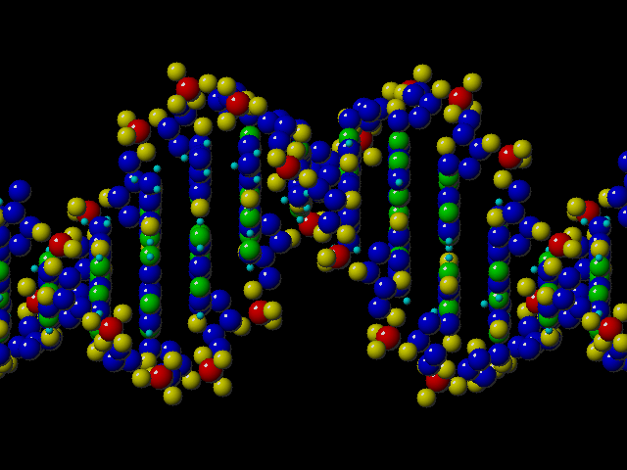
DNA and RNA are Nucleic Acids
What is a nucleic acid?
  Nucleic acids are one of the major organic biomolecules.

Slide 4
Nucleic Acids
They contain C, H, N, O, P
They are made of nucleotide monomers
sugar
nitrogen base
phosphate
They store information
  The instructions makes proteins
Examples: DNA & RNA
Notes:
NUCLEIC ACIDS
very large linear molecules
made up of nucleotides containing C, H, N, O, P
store genetic information, help to make proteins
examples: DNA and RNA

Slide 5
DNA Structure
What does DNA stand for?
What is the monomer for nucleic acids?
What is the structure of this monomer?
DeoxyriboNucleic Acid
nucleotide
PO₄
PO₄
(the 5’ end)
N base
5
N base
The numbers are the positions of the carbons on the sugar.
4
Sugar
1
Sugar
3
2
(the 3’ end)

Slide 6
A DNA NUCLEOTIDE
1. Phosphate Group
2. 5-Carbon Sugar (Dexoyribose)
3. Nitrogen Base
1. Phosphate Group
2. 5-Carbon Sugar
(Dexoyribose)
3.
1.
3. Nitrogen Base
2.
3.
O
1.
2.
C
H₃
O
O
P
O
C
H₂
C
C
O
O
C
H
N
H
C
H
H
C
N
C
C
H
C
H
O
H
O
H
O

Slide 7
DNA Nucleotides
There are four nitrogen bases making up four different nucleotides.
Adenine
A
Purines
Guanine
G
N base
Thymine
T
Pyrimidines
Cytosine
C

Slide 8
Chargaff’s Base Pair Rules
Adenine always bonds with thymine.
A
T
The lines between the bases represent hydrogen bonds
G
C
Guanine always bonds with Cytosine.

Slide 9
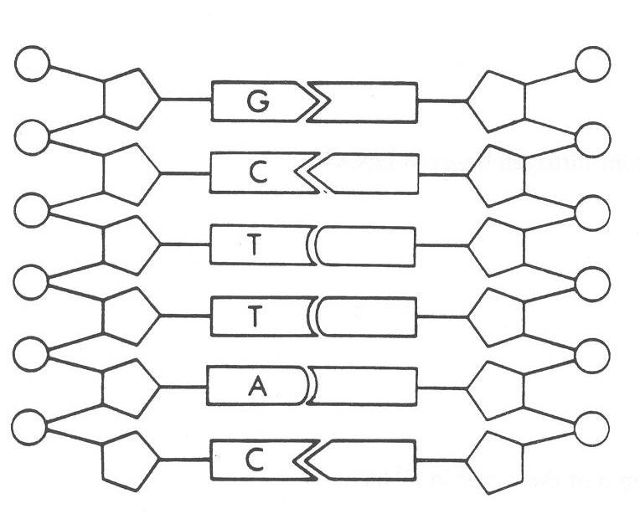

Pairing DNA Nucleotides
What is a nucleotide?
What is the base pairing rule?
What would be the complementary nucleotide pairing?
P
N-b
Nucleotide
S
C
G
Rule
A
A to
T
A
C to
G
T
G
Notes:
Review slide. Make sure students can pick out the sugar, phosphate group, and nitrogen bases as well as know how the bases pair up (have them tell you the what the answers are before you animate it)

Slide 10
DNA DOUBLE HELIX
5’End
3’End
ladder shaped molecule
3’End
5’End

Slide 11

Purpose of DNA
  DNA contains our genetic code which codes for proteins.
  It is our “blueprint”…all cells have the same blueprint, but only certain parts are looked at when building different cells

Slide 12
What is RNA?
RNA stands for RiboNucleic Acid
  DNA must have a “helper” molecule. (DNA is too fat)
nitrogen base
sugar
phosphate
RNA is a single stranded nucleic acid
  made up of monomers called nucleotides

Slide 13
RNA Nucleotides
A - Sugar (ribose)
B - Phosphate
C - Nitrogen base
nitrogen base
sugar
phosphate
B
A
C
Notes:
RNA is made of nucleotide subunits arranged in a single strand
Ask students which molecules are which (before you animate the answers)

Slide 14
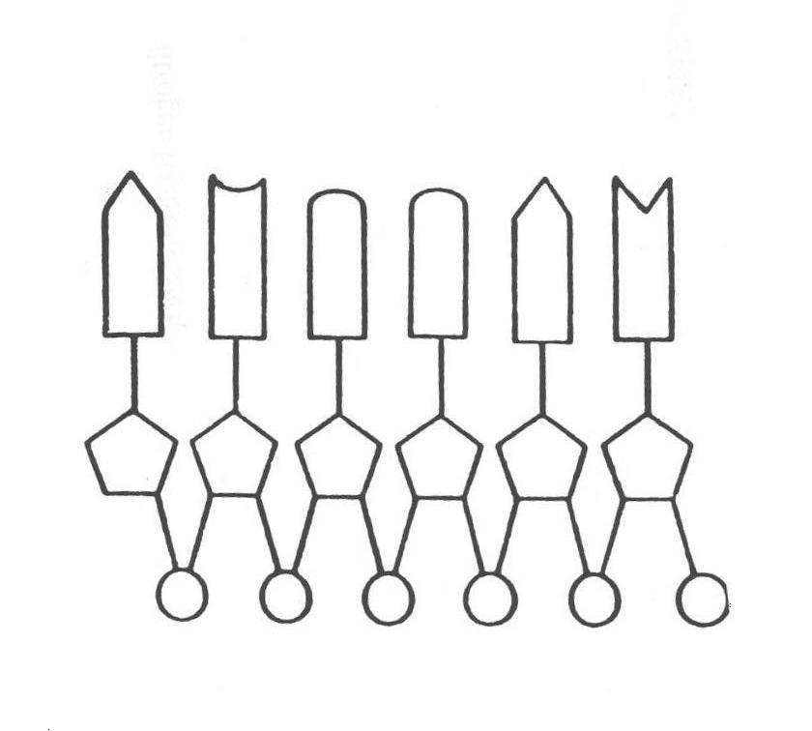
RNA
Identify the parts of the RNA strand.
Nitrogen Base
Sugar
(ribose)
Phosphate Group
Notes:
Make sure students know the molecules located in RNA. Have the students notice that RNA is single stranded whereas DNA is a double helix.

Slide 15
Rules for Base Pairing
Adenine bonds with Uracil.
A
U
G
C
Guanine bonds with Cytosine.

Slide 16
DNA makes RNA
3’ DNA strand
C = G
C
G
A = U
A
U
G
C
T
A
RNA strand
5’ DNA strand
Notes:
Teacher FYI – the transcription process moves from the 3’ end of DNA to the 5’ end and synthesizes an RNA strand of opposite polarity

Slide 17
What is the function of RNA?
Carries the coded “message” of DNA.
Translates the “message” into proteins
3 Types of RNA
  Messenger RNA (mRNA)
  Transfer RNA (tRNA)
  Ribosomal RNA (rRNA)
Notes:
Ask students the function of RNA; they should recall this from the organic molecules unit.
Introduce the three types of RNA; you don’t need to give their functions here.
Messenger (mRNA)
Transfer (tRNA)
Ribosomal (rRNA)

Slide 18
Comparing DNA & RNA
 | DNA | RNA
Sugar is deoxyribose
Sugar is ribose
Adenine base is present
Cytosine base is present
√
√
√
√
√
√
Notes:
Review the differences between DNA & RNA
Have them tell you the answers to each before you animate the answers

Slide 19
Comparing DNA & RNA
 | DNA | RNA
Guanine base is present
Thymine base is present
Uracil base is present
Shape is double helix
√
√
√
√
√
Notes:
Review the differences between DNA & RNA
Have them tell you the answers to each before you animate the answers

Slide 20
Comparing DNA & RNA
 | DNA | RNA
Shape is single stranded
Located in nucleus
Located in cytoplasm
Stores genetic information
√
√
√
√
√
Notes:
Review the differences between DNA & RNA
Have them tell you the answers to each before you animate the answers

Slide 21
Comparing DNA & RNA
 | DNA | RNA
Functions in protein synthesis
Composed of nucleotides
Instructions (template) for synthesis of proteins
Transcribes and Translates the template
More than one type
√
√
√
√
√
√
√
Notes:
Review the differences between DNA & RNA
Have them tell you the answers to each before you animate the answers
You will probably have to tell them the answers to the 1st, 3rd & 4th question on this slide since they don’t know about protein synthesis yet; it will be a good review at the end of the chapter though.

Slide 22
Why does a cell need proteins to function properly?
DNA provides the instructions to build proteins.
➔ Blueprint
RNA builds the proteins
➔ Construction crew
Time to make the
proteins...
Notes:
Remind students that proteins are important molecules in our body because some serve as enzymes, hormones, and provide structure (muscles, hair, cartilage).

Slide 23
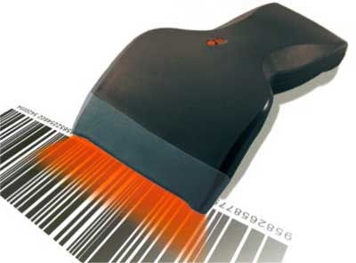
Remember there are three types of RNA
mRNA: messenger RNA.
  Carries DNA message to cytoplasm where ribosomes are.
mRNA
rRNA: ribosomal RNA
  “scans & reads” the mRNA
tRNA: transfer RNA.
  Carries the amino acids to the ribosomes to make the proteins. “Translates” the “message”.
Amino acid
tRNA
towing
Notes:
Remind students that there are three different RNA molecules that are involved with protein synthesis and briefly go over their function.
mRNA: messenger RNA. It carries the DNA message from the nucleus to the ribosomes. rRNA: ribosomal RNA. A large and small subunit make up the ribosome. tRNA: transfer RNA. It carries amino acids from the cytoplasm to the ribosomes. Like a tow truck

Slide 24
Overall process of protein synthesis
transcription
translation
DNA
RNA
Protein
Notes:
During gene expression, the information in DNA is first transcribed in the nucleus as a molecule of mRNA and then translated in the cytoplasm and used to build a protein.

Slide 25
Let’s explore this in a little more detail...

Slide 26
DNA’s tragedy
DNA contains the blueprint about making proteins.
DNA is in the nucleus, ribosomes are out in the cytoplasm.
ribosomes
nucleus
Notes:
Remind students that DNA holds the instructions for making the protein but it cannot leave the nucleus. However, the proteins are made in the ribosomes.

Slide 27
How does the cell solve this problem….
Transcription
That’s where mRNA comes in.
mRNA helps get DNA’s message out to the ribosomes...
How do I tell
those guys what
I want them
to do?
I can help!
Notes:
A mRNA copy of DNA is transcribed (made) because mRNA can leave the nucleus and take the message to the ribosomes.

Slide 28

First, DNA unzips itself...
DNA unzips itself, exposing free nitrogen bases.
TACACGATT
ATGTGCTAA
Notes:
The slide is animated; the DNA unzips automatically

Slide 29
First, DNA unzips itself...
DNA unzips itself, exposing free nitrogen bases.
TACACGATT
ATGTGCTAA
Notes:
The slide is animated; the DNA unzips automatically

Slide 30
First, DNA unzips itself...
DNA unzips itself, exposing free nitrogen bases.
TACACGATT
ATGTGCTAA
Notes:
The slide is animated; the DNA unzips automatically

Slide 31
First, DNA unzips itself...
DNA unzips itself, exposing free nitrogen bases.
TACACGATT
ATGTGCTAA
Notes:
The slide is animated; the DNA unzips automatically

Slide 32
First, DNA unzips itself...
DNA unzips itself, exposing free nitrogen bases.
TACACGATT
ATGTGCTAA
Notes:
The slide is animated; the DNA unzips automatically

Slide 33
Then, mRNA is made...
mRNA is made from the DNA template
mRNA matches with free DNA nitrogen bases in a complimentary fashion
  A = U
  T = A
  G = C
  C = G
TACACGATT
ATGTGCTAA
Notes:
Have students notice that the mRNA is made from ONE side of the DNA molecule
The slide is animated; the DNA unzips automatically

Slide 34
Next, mRNA is made...
A
mRNA is made from the DNA template
mRNA matches with free DNA nitrogen bases in a complimentary fashion
  A = U
  T = A
  G = C
  C = G
TACACGATT
ATGTGCTAA
Notes:
The slide is animated; the RNA bases automatically pair up with DNA

Slide 35
Next, mRNA is made...
A
mRNA is made from the DNA template
mRNA matches with free DNA nitrogen bases in a complimentary fashion
  A = U
  T = A
  G = C
  C = G
TACACGATT
ATGTGCTAA
Notes:
The slide is animated; the RNA bases automatically pair up with DNA

Slide 36
Next, mRNA is made...
AU
mRNA is made from the DNA template
mRNA matches with free DNA nitrogen bases in a complimentary fashion
  A = U
  T = A
  G = C
  C = G
TACACGATT
ATGTGCTAA
Notes:
The slide is animated; the RNA bases automatically pair up with DNA

Slide 37
Next, mRNA is made...
mRNA is made from the DNA template
mRNA matches with free DNA nitrogen bases in a complimentary fashion
  A = U
  T = A
  G = C
  C = G
AU
TACACGATT
ATGTGCTAA
Notes:
The slide is animated; the RNA bases automatically pair up with DNA

Slide 38
Next, mRNA is made...
mRNA is made from the DNA template
mRNA matches with free DNA nitrogen bases in a complimentary fashion
  A = U
  T = A
  G = C
  C = G
AUG
TACACGATT
ATGTGCTAA
Notes:
The slide is animated; the RNA bases automatically pair up with DNA

Slide 39
Next, mRNA is made...
mRNA is made from the DNA template
mRNA matches with free DNA nitrogen bases in a complimentary fashion
  A = U
  T = A
  G = C
  C = G
AUG
TACACGATT
ATGTGCTAA
Notes:
The slide is animated; the RNA bases automatically pair up with DNA

Slide 40
Next, mRNA is made...
mRNA is made from the DNA template
mRNA matches with free DNA nitrogen bases in a complimentary fashion
  A = U
  T = A
  G = C
  C = G
AUGU
TACACGATT
ATGTGCTAA
Notes:
The slide is animated; the RNA bases automatically pair up with DNA

Slide 41
Next, mRNA is made...
mRNA is made from the DNA template
mRNA matches with free DNA nitrogen bases in a complimentary fashion
  A = U
  T = A
  G = C
  C = G
AUGU
TACACGATT
ATGTGCTAA
Notes:
The slide is animated; the RNA bases automatically pair up with DNA

Slide 42
Next, mRNA is made...
mRNA is made from the DNA template
mRNA matches with free DNA nitrogen bases in a complimentary fashion
  A = U
  T = A
  G = C
  C = G
AUGUG
TACACGATT
ATGTGCTAA
Notes:
The slide is animated; the RNA bases automatically pair up with DNA

Slide 43
Next, mRNA is made...
mRNA is made from the DNA template
mRNA matches with free DNA nitrogen bases in a complimentary fashion
  A = U
  T = A
  G = C
  C = G
AUGUG
TACACGATT
ATGTGCTAA
Notes:
The slide is animated; the RNA bases automatically pair up with DNA

Slide 44
Next, mRNA is made...
mRNA is made from the DNA template
mRNA matches with free DNA nitrogen bases in a complimentary fashion
  A = U
  T = A
  G = C
  C = G
AUGUGC
TACACGATT
ATGTGCTAA
Notes:
The slide is animated; the RNA bases automatically pair up with DNA

Slide 45
Next, mRNA is made...
mRNA is made from the DNA template
mRNA matches with free DNA nitrogen bases in a complimentary fashion
  A = U
  T = A
  G = C
  C = G
AUGUGC
TACACGATT
ATGTGCTAA
Notes:
The slide is animated; the RNA bases automatically pair up with DNA

Slide 46
Next, mRNA is made...
mRNA is made from the DNA template
mRNA matches with free DNA nitrogen bases in a complimentary fashion
  A = U
  T = A
  G = C
  C = G
AUGUGCU
TACACGATT
ATGTGCTAA
Notes:
The slide is animated; the RNA bases automatically pair up with DNA

Slide 47
Next, mRNA is made...
mRNA is made from the DNA template
mRNA matches with free DNA nitrogen bases in a complimentary fashion
  A = U
  T = A
  G = C
  C = G
AUGUGCU
TACACGATT
ATGTGCTAA
Notes:
The slide is animated; the RNA bases automatically pair up with DNA

Slide 48
Next, mRNA is made...
mRNA is made from the DNA template
mRNA matches with free DNA nitrogen bases in a complimentary fashion
  A = U
  T = A
  G = C
  C = G
AUGUGCUA
TACACGATT
ATGTGCTAA
Notes:
The slide is animated; the RNA bases automatically pair up with DNA

Slide 49
Next, mRNA is made...
mRNA is made from the DNA template
mRNA matches with free DNA nitrogen bases in a complimentary fashion
  A = U
  T = A
  G = C
  C = G
AUGUGCUA
TACACGATT
ATGTGCTAA
Notes:
The slide is animated; the RNA bases automatically pair up with DNA

Slide 50
Next, mRNA is made...
mRNA is made from the DNA template
mRNA matches with free DNA nitrogen bases in a complimentary fashion
  A = U
  T = A
  G = C
  C = G
TACACGATT
ATGTGCTAA
AUGUGCUAA
Notes:
Remind students that the RNA strand has Uracil instead of Thymine and that the Uracil pairs up with Adenine.

Slide 51
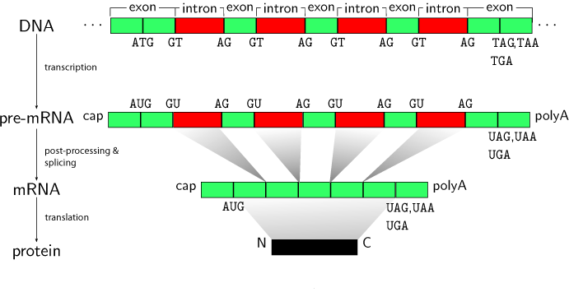
Some additional notes about making mRNA…
DNA contains many non-coding regions, also known as “junk DNA”
mRNA cuts out the “junk” (the introns) and keeps the “non-junk” (the exons).
The introns stay inside the nucleus…the exons exit…..
Notes:
DNA contains many regions that do not code for anything. These non-coding regions, also known as “junk DNA,” are unique to each organism within a species.
mRNA is not made from the junk DNA. mRNA simply skips over these non-coding regions when it copies DNA.

Slide 52
Finally, mRNA leaves the nucleus...
mRNA is “skinny”. It can fit through the nuclear pores.
mRNA carries the DNA code in three letter “words” called codons.
I hope he can
tell them what
to do!
AUGUGCUAA

Slide 53
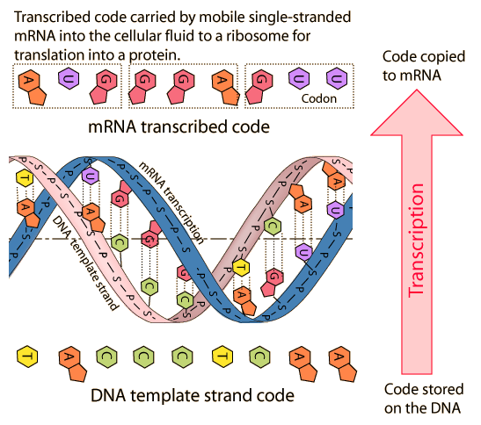
Closer look at transcription

Slide 54
The next step...
Translation
AUGUGCUAA
mRNA meets the Ribosomes!
(No, it’s not a new sitcom on Fox…)

Slide 55
mRNA tries to talk to the ribosomes…
I have a message
for you! It’s
from DNA!
What does
he want now?
Once out in the cytoplasm, mRNA is joined by the ribosomes.
  But…….
AUGUGCUAA
Notes:
mRNA leaves the nucleus and travels to the cytoplasm, where the ribosomes are located.
Once there, mRNA meets up with the ribosomes.

Slide 56
The message is written in code.
Why don’t they
get it???
@%$!!
Why can’t we tell
what he’s saying?
The ribosomes cannot understand the message mRNA is carrying.
The code needs to be translated.
AUGUGCUAA
We need a
translator!

Slide 57
tRNA Saves the Day!
We won’t work until
we know what to do!
Met (start)
Looks like trouble
…I’d better help!
The boss will NOT
be happy about
this...
UAC
AUGUGCUAA
Now the cell can make a protein!
Where is that
translator?

Slide 58
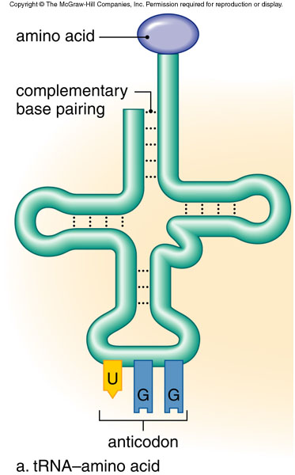
tRNA: Transfer RNA
Chemically, tRNA is clover-leaf shaped.
At one end, it carries an amino acid.
At the other end, it has a three letter code known as an anticodon.
Met/start
UAC

Slide 59
Anticodon? What’s that?
This anticodon is the complement to the codons contained within mRNA.
Can you find the mRNA codon that complements the anticodon on tRNA?
Met/Start
UAC
AUGUGCUAA

Slide 60
Some notes about Amino Acids
Remember: Amino acids are the monomers of proteins.
There are 20 different amino acids found in living things.
How is it possible to get a group of four letters (AUCG) to code for 20 things?
Put them into groups of three…
  4³ = 64 codes = THE GENETIC CODE
Number of members in a group of nitrogen bases
Number of nitrogen bases

Slide 61
How a “Translator” works…
1. The tRNA’s anticodons meets up with the mRNA start codon (AUG) at the ribosome
Start
AUGGCUUAA
UAC

Slide 62
How a Translator works…
2. mRNA moves through the ribosome and another tRNA meets up with it’s corresponding mRNA.
  A bond forms between the amino acids.
Start
Alanine
UAC
AUGGCUUAA
CGA

Slide 63
How a Translator works…
As the mRNA continues to move through the ribosome, another tRNA brings another amino acid.
  This continues until a stop codon is encountered.
start
Alanine
Stop
CGA
AUGGCUUAA
AUU

Slide 64
What now?
When a stop codon is reached, the ribosome breaks away and the polypeptide (amino acid) chain or protein is released.
start
Alanine
Stop
AUGUGCUUAA

Slide 65
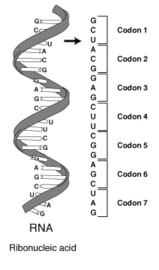
Which amino acid does the tRNA bring in?
Here is what a codon looks like on mRNA. It is a sequence of 3 bases.
We determine which amino acid each codon codes for by using the GENETIC CODE…
  A chart used to translate mRNA codons ➔ amino acids.
m
Notes:
Picture taken from www.accessexcellence.com

Slide 66
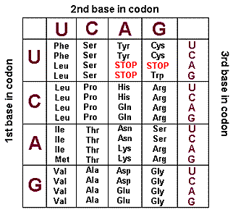
THE GENETIC CODE

Slide 67
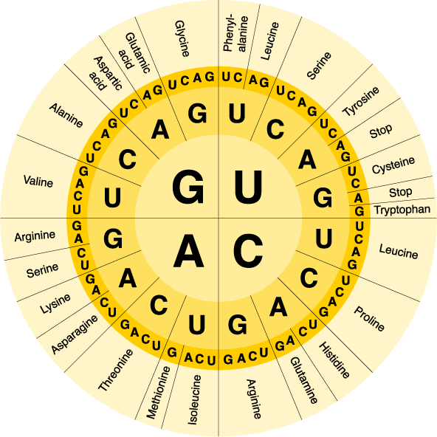
The Genetic Code

Slide 68
Here’s the process…animated!
UACUGCUAA
Note: this is a really basic representation of this process!
Notes:
The slide is animated; translation occurs automatically

Slide 69
Here’s the process…animated!
UACUGCUAA
Notes:
The slide is animated; translation occurs automatically

Slide 70
Here’s the process…animated!
UACUGCUAA
AUG
tyrosine
Notes:
The slide is animated; translation occurs automatically

Slide 71
Here’s the process…animated!
UACUGCUAA
AUG
tyrosine
Notes:
The slide is animated; translation occurs automatically

Slide 72
Here’s the process…animated!
UACUGCUAA
tyrosine
Notes:
The slide is animated; translation occurs automatically

Slide 73
Here’s the process…animated!
UACUGCUAA
ACG
tyrosine
threonine
Notes:
The slide is animated; translation occurs automatically

Slide 74
Here’s the process…animated!
UACUGCUAA
ACG
tyrosine
threonine
Notes:
The slide is animated; translation occurs automatically

Slide 75
Here’s the process…animated!
UACUGCUAA
tyrosine
threonine
Notes:
The slide is animated; translation occurs automatically

Slide 76
Here’s the process…animated!
UACUGCUAA
tyrosine
threonine
Notes:
The slide is animated; translation occurs automatically

Slide 77
Here’s the process…animated!
UACUGCUAA
AUU
tyrosine
threonine
isoleucine
Notes:
The slide is animated; translation occurs automatically

Slide 78
Here’s the process…animated!
UACUGCUAA
AUU
tyrosine
threonine
isoleucine
Notes:
The slide is animated; translation occurs automatically

Slide 79
Here’s the process…animated!
UACUGCUAA
tyrosine
threonine
isoleucine
Notes:
The slide is animated; translation occurs automatically

Slide 80
Here’s the process…animated!
UACUGCUAA
tyrosine
threonine
isoleucine
Notes:
The slide is animated; translation occurs automatically

Slide 81
Here’s the process…animated!
UACUGCUAA
tyrosine
threonine
isoleucine
Notes:
The slide is animated; translation occurs automatically

Slide 82
Here’s the process…animated!
UACUGCUAA
tyrosine
threonine
isoleucine
Notes:
The slide is animated; translation occurs automatically

Slide 83
Here’s the process…animated!
UACUGCUAA
tyrosine
threonine
isoleucine
Notes:
The slide is animated; translation occurs automatically

Slide 84
In summary…
DNA contains the information needed to make proteins.
DNA is too large to leave the nucleus.
RNA acts as a set of working instructions for ribosomes to make proteins.
This process is also known as gene expression.

Slide 85
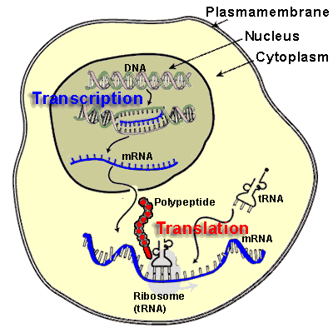
Let's see it all in motion

