Slide 1
Mendelian Genetics
Ch. 11-1, 11-2, 11-3 and 11-5

Slide 2
Part 1
Mendel
Vocabulary
Punnet squares
Monohybrid crosses

Slide 3
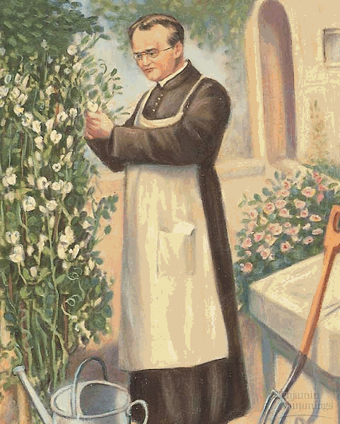
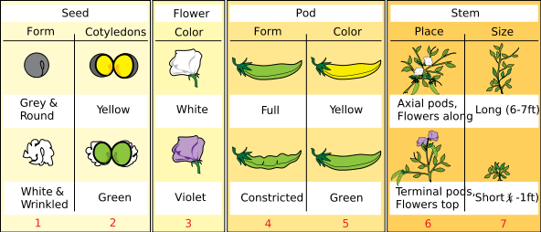
Gregor Mendel The Father of Heredity
Austrian monk in 1800’s
Experimented with pea plants to contribute to our understanding of genetics
Genetics = study of heredity
Heredity = passing of traits to offspring

Slide 4
Who was Gregor Mendel?

Slide 5
What is a trait?
Gene: Chemical factors that determines traits, found on DNA
Trait: A specific characteristic that varies from one individual to another. Ex. Height, eye color, earlobe attatchment
Alleles: The different form of a trait
Ex. Tall vs. short, blue vs brown, attached vs free

Slide 6
Principle of dominance: some alleles are dominant and others are recessive.
Dominant: form of trait that is exhibited (shown)
Tall = T Tt or TT
Recessive: form of trait that is only exhibited when dominant allele is not present.
Short = t tt

Slide 7
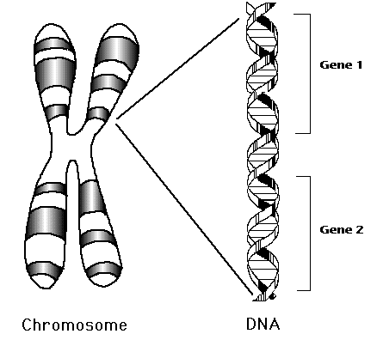
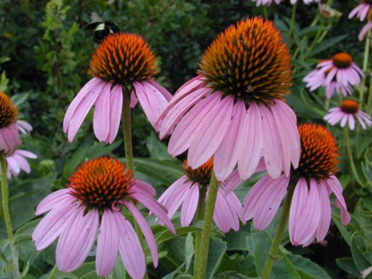
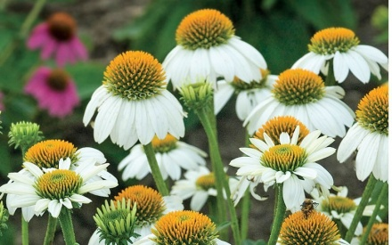
Genotype: genetic makeup
Heterozygous: hybrid, different
forms of traits.
Aa, Bb, Tt
Homozygous: true breeding, pure same form of traits.
Homozygous dominant (AA, BB, TT)
Homozygous recessive (aa,bb,tt)
Phenotype: physical appearance
Purple or white
Tall or short

Slide 8
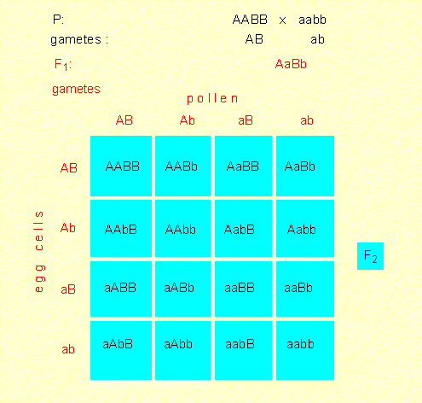
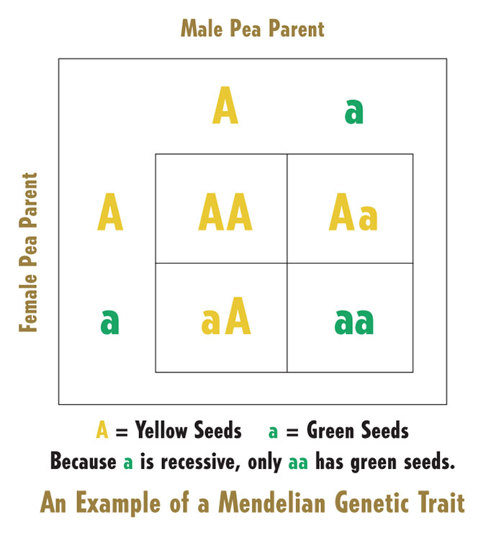
Punnet squares
Used to predict and compare the genetic variations that will result from a cross.
Monohybrid: one gene
Dihybrid: two genes

Slide 9
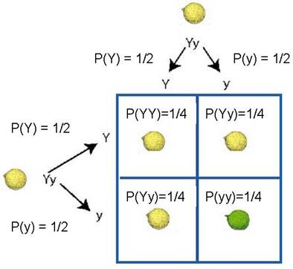
Monohybrid Cross
Single gene: ex. Seed color
Yellow is dominant over green
Parent (P)
Female: heterozygous yellow (Yy)
Male: heterozygous yellow (Yy)
F1: first generation
Phenotypic ratio:
3 yellow: 1 green
Genotypic ratio:
1YY:2Yy:1yy

Slide 10
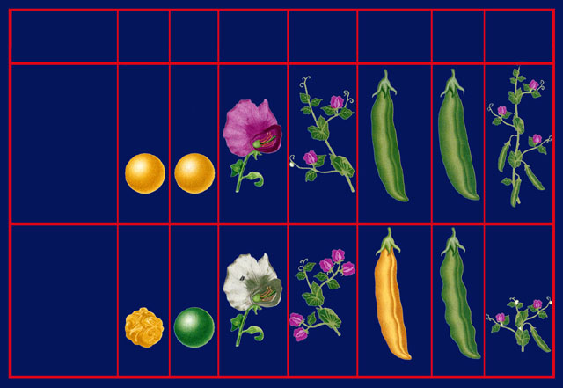
Dominant and recessive traits
Seed
shape
Seed
color
Flower
color
Flower
position
Pod
color
Pod
shape
Plant
height
Dominant
trait
axial
(side)
round
yellow
purple
green
inflated
tall
Recessive
trait
wrinkled
green
white
terminal
(tips)
yellow
short
constricted

Slide 11
Part 2
Dihybrid crosses
Principle of independent assortment

Slide 12
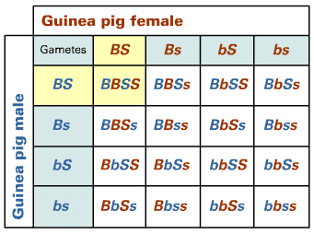
Dihybrid cross
(Male x female) BbSs x BbSs
B = black
b = brown
S = smooth
s = curly
BS
bS
BS
bS
Bs
bs
Bs
bs

Slide 13
B = black
b = brown
S = smooth
s = curly
Genotypic ratio:
1 BBSS : 2 BBSs : 1 BBss: 2 BbSS : 4 BbSs: 2 Bbss : 1 bbSS : 2 bbSs : 1 bbss
Phenotypic ratio:
9 Black and Smooth : 3 Black and curly : 3 brown and Smooth : 1 brown and curly

Slide 14
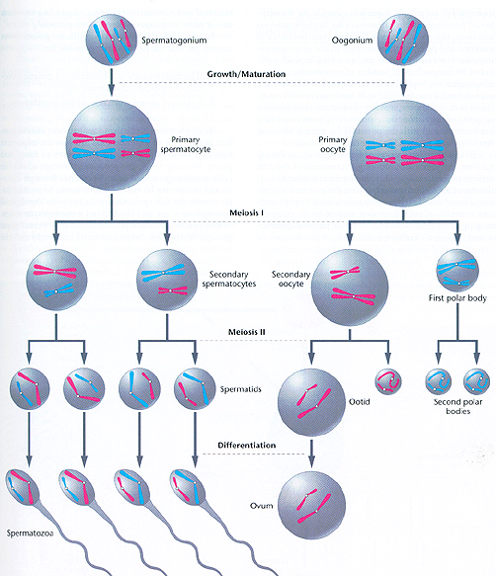
Remember
Meiosis?

Slide 15
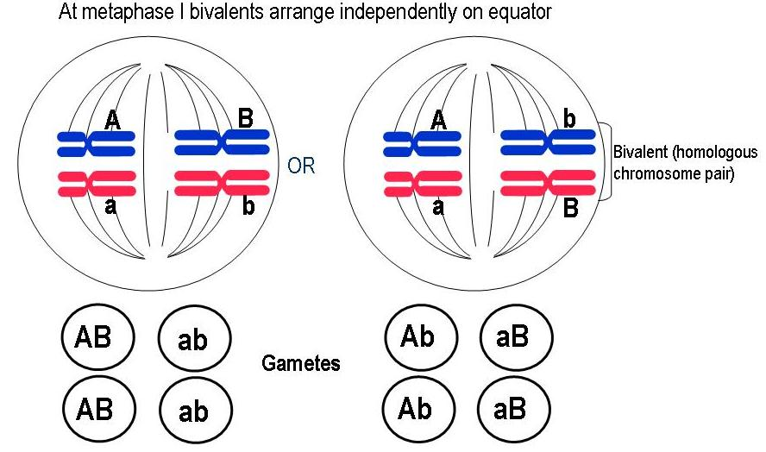
Mendel’s principles
Mendel’s Principle of Independent Assortment: Genes for different traits can segregate independently during the formation of gametes.
Used to predict
outcomes of genetic
crosses.
--Explains diversity

Slide 16
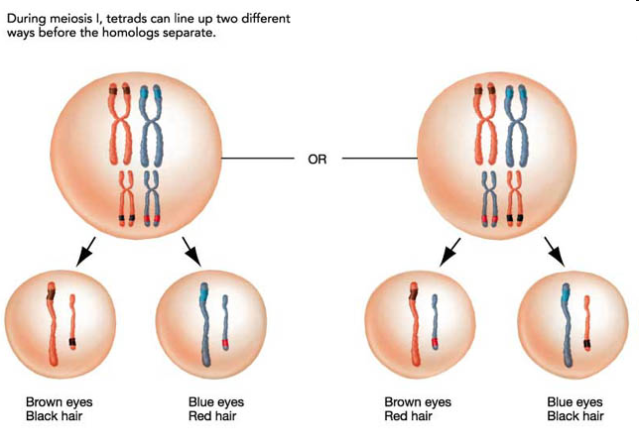
Segregation:
Separation: When gametes are formed, traits found on different chromosomes separate from each other, alleles separate from each other.

Slide 17
Summary of Mendel
Inheritance of biological characteristics is determined by genes.
If there is more than one form of a gene for a single trait, some forms (alleles) may be dominant, some may be recessive.
Each adult has two copies of a gene and these copies separate from each other during gamete production.
Alleles for different genes usually segregate independently from each other. (independent assortment)

Slide 18
Part 3:
Non-Mendelian genetics
Incomplete dominance
Codominance
Multiple alleles
Sex linked

Slide 19
Incomplete dominance
One allele is not completely dominant over other allele
Blending of allele
Homozygous–phenotype
Homozygous–phenotype
Heterozygous – blended phenotype
C = color trait R = red W = white

Slide 20
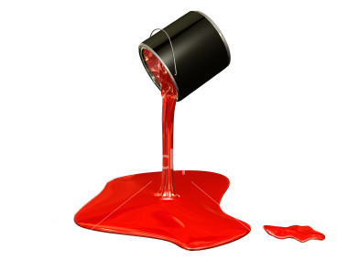
Incomplete Dominance
Red paint x red paint ➔ red paint
White paint x white paint ➔ white paint
Red paint x white paint ➔ pink paint
X

Slide 21
Codominance
Both alleles contribute to phenotype.
Homozygous –phenotype
Homozygous –phenotype
Heterozygous – mixture (not blending) phenotype
R = red r = white

Slide 22
Codominance
Red paint x red paint ➔ red paint
White paint x white paint ➔ white paint
Red paint x white paint ➔ Red and white paint (still see red and still see white)
X

Slide 23
Multiple alleles
Genes have more than two alleles.
Blood type
Each individual can only have two alleles but more than two do exist.
Blood type alleles: I^{A} and I^{B} are codominant, both are dominant over i(O is lacking the allele).

Slide 24
Single gene, dominant traits
A cleft chin
Widow’s peak hairline
Hitchhiker’s thumb
Almond shaped eyes
Thick lips
Hair on the middle section of your finger

Slide 25
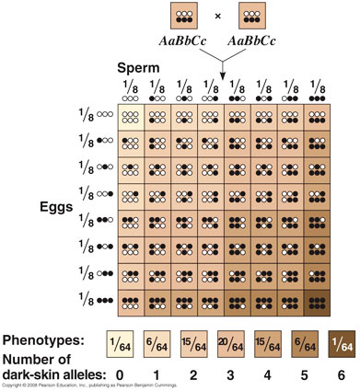
Polygenic traits
Two or more genes control a trait
Ex:
Skin color humans
Eye color

Slide 26
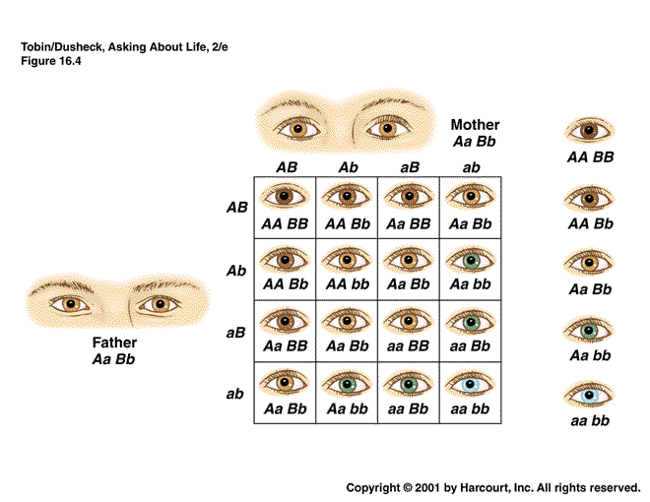

Slide 27
Sex determination
In humans 2n = 46, or 23 pairs.
There are 22 pairs of homologous chromosomes called autosomes.
These are the same for both male and female
The 23rd pair of chromosomes differs in males and females.
Determine the sex of an individual➔sex chromosomes
Indicated by the letters X and Y

Slide 28
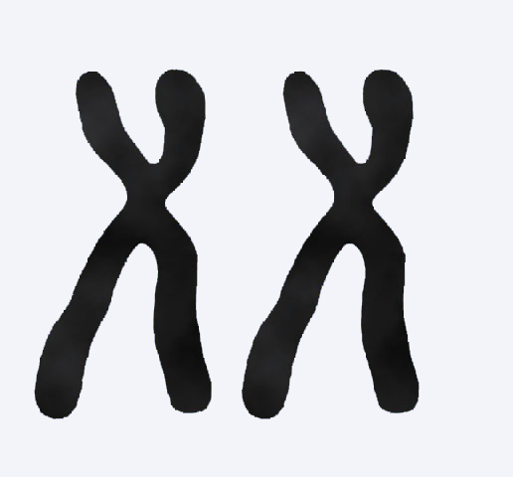
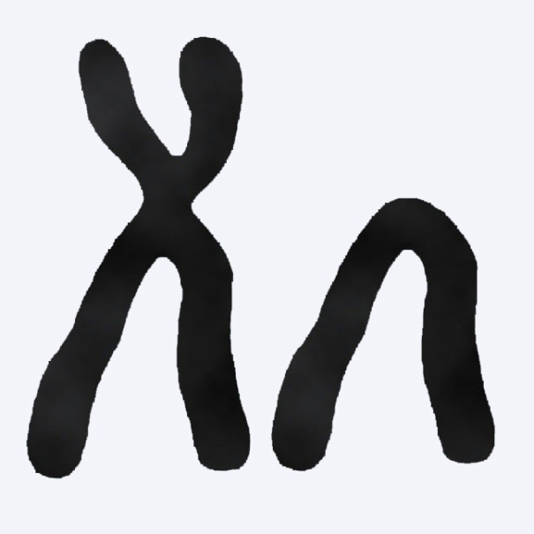
Sex determination
If you are female, your 23rd pair of chromosomes are homologous, XX.
X
X
Female
If you are male, your 23rd pair of chromosomes XY, look different.
X
Y
Male

Slide 29
Males determine the baby’s sex.
XY Male
XX Female

Slide 30
Sex-linked traits
Genes that are located on the sex chromosomes are called sex-linked traits.
Because the Y chromosome is small, it carries few genes, including the male sex-determinant gene.

Slide 31
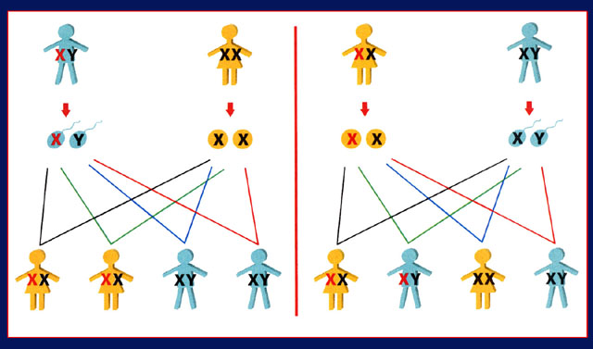
Sex-linked traits in humans
Male
Female
Female
Male
Sperm
Eggs
Eggs
Sperm
Female
Female
Male
Male
Female
Male
Female
Male

Slide 32
Sex-linked traits
If a son receives an X chromosome with a recessive allele, the recessive phenotype will be expressed because he does not inherit on the Y chromosome from his father a dominant allele that would mask the expression of the recessive allele.
Two traits that are governed by X-linked recessive inheritance in humans are red-green color blindness and hemophilia.

Slide 33
Red-green color blindness
People who have red-green color blindness can’t differentiate these two colors. Color blindness is caused by the inheritance of a recessive allele at either of two gene sites on the X chromosome.

Slide 34
Hemophilia
X-linked disorder that causes a problem with blood clotting
About one male in every 10 000 has hemophilia, but only about one in 100 million females inherits the same disorder.
X^{h}Y ➔ hemophiliac male
X^{H}X^{h} ➔normal female, carrier
X^{h}X^{h} ➔hemophiliac female

Slide 35
Environmental influences on gene expression
Temperature
Nutrition
Light
Chemicals
Infectious agents
Ex: In arctic foxes temperature has an effect on the expression of coat color.

Slide 36
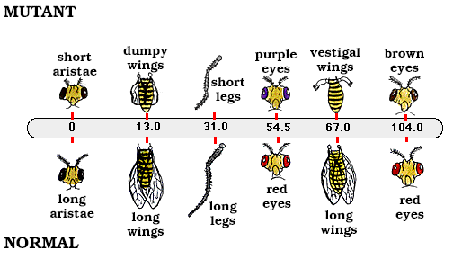
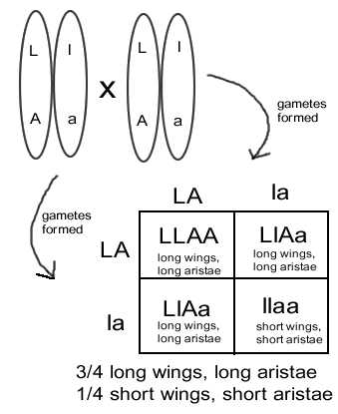
Gene linkage
Thomas Morgan
Fruit flies
Found that chromosomes assort independently, not the individual genes.
Some genes are almost always inherited together. If close together on same chromosome.

Slide 37
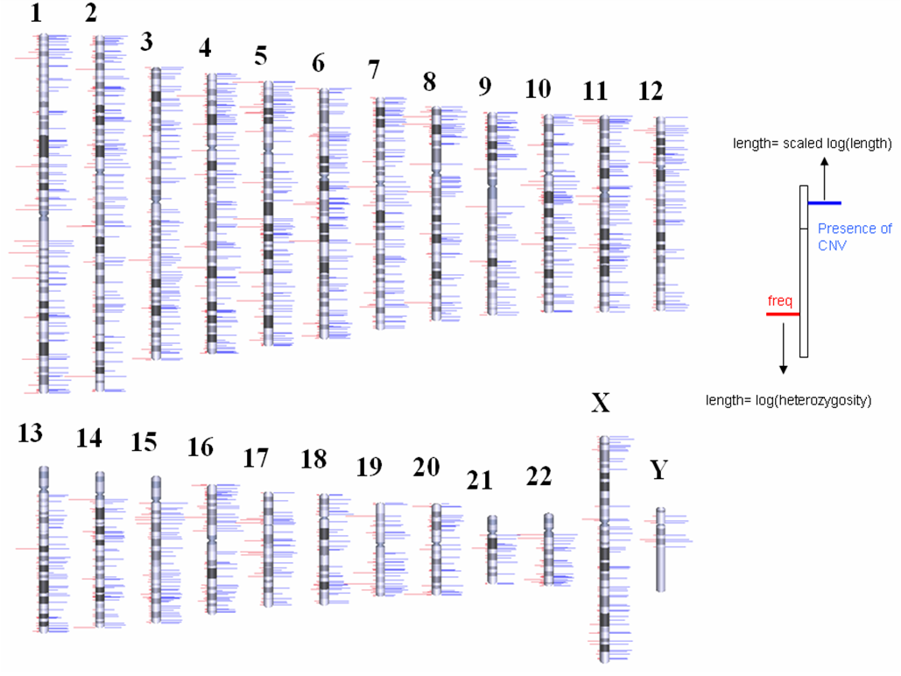
Gene maps
A map that shows the relative locations of known genes on a chromosome.
Helps in understanding crossing over and linked genes.

Slide 38
Part 4
Human genetic disorders
Pedigrees

Slide 39
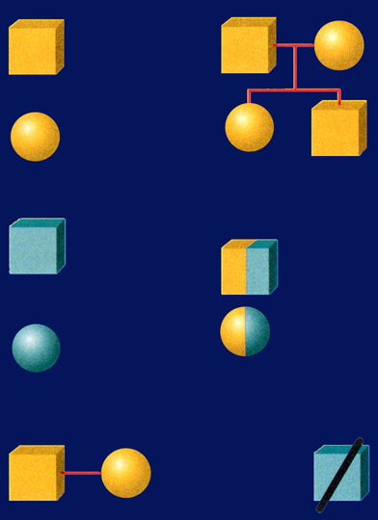
Pedigree
A family tree traces a family name and various family members through successive generations.
A pedigree is a graphic representation of genetic inheritance.
Male
Parents
Female
Siblings
Affected male
Known heterozygotes for recessive allele
Affected female
Mating
Death

Slide 40
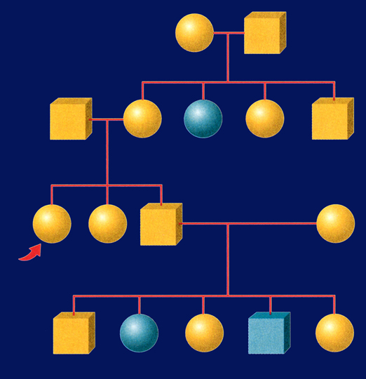
Pedigree
I
Female
Male
1
2
II
1
2
3
4
5
III
?
1
2
3
4
IV
1
2
3
4
5

Slide 41
Most genetic disorders are caused by recessive alleles.
Cystic fibrosis (CF) is a fairly common genetic disorder among white Americans.
Approximately one in 28 white Americans carries the recessive allele, and one in 2500 children born to white Americans inherits the disorder.
Due to a defective protein in the plasma membrane, cystic fibrosis results in the formation and accumulation of thick mucus in the lungs and digestive tract.

Slide 42
Tay-Sachs disease
Tay-Sachs (tay saks) disease is a recessive disorder of the central nervous system.
In this disorder, a recessive allele results in the absence of an enzyme that normally breaks down a lipid produced and stored in tissues of the central nervous system.
Because this lipid fails to break down properly, it accumulates in the cells.

Slide 43
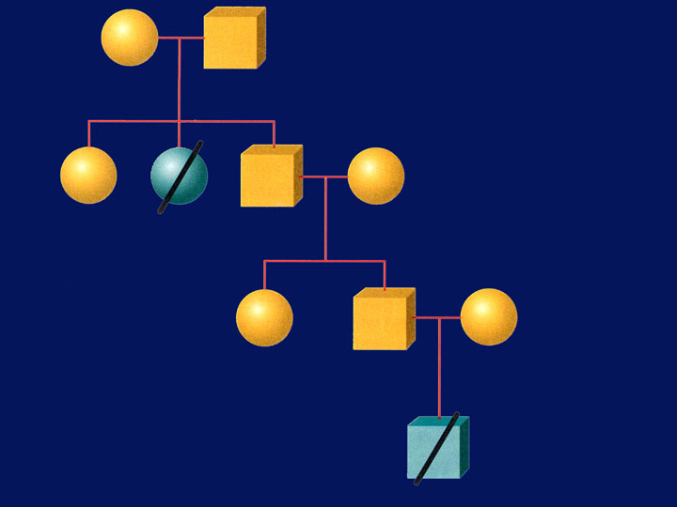
Typical Tay-Sachs pedigree

Slide 44
Phenylketonuria
Phenylketonuria (fen ul kee tun YOO ree uh), also called (PKU), is a recessive disorder that results from the absence of an enzyme that converts one amino acid, phenylalanine, to a different amino acid, tyrosine.
it and its by-products accumulate in the body and result in severe damage to the central nervous system.
Foods must have phenylalanine warning for people with PKU.

Slide 45
Phenylketonurics
Phenylketonurics: Contains Phenylalanine

Slide 46
Huntington’s disease
Huntington’s disease is a lethal genetic disorder caused by a rare dominant allele.
It results in a breakdown of certain areas of the brain.
Ordinarily, a dominant allele with such severe effects would result in death before the affected individual could have children and pass the allele on to the next generation.
But because the onset of Huntington’s disease usually occurs between the ages of 30 and 50, an individual may already have had children before knowing whether he or she is affected.

Slide 47
Typical Huntington’s pedigree

Slide 48
Understanding pedigrees
What does this pedigree tell you about those who show the recessive phenotype for the disease?

Slide 49
Question
The pedigree indicates that showing the recessive phenotype for the disease is fatal.

