Slide 1
Describing Motion: Acceleration

Slide 2
Acceleration To increase speed or change directions

Slide 3
Deceleration Occurs when change in speed, or acceleration, is in the negative direction

Slide 4
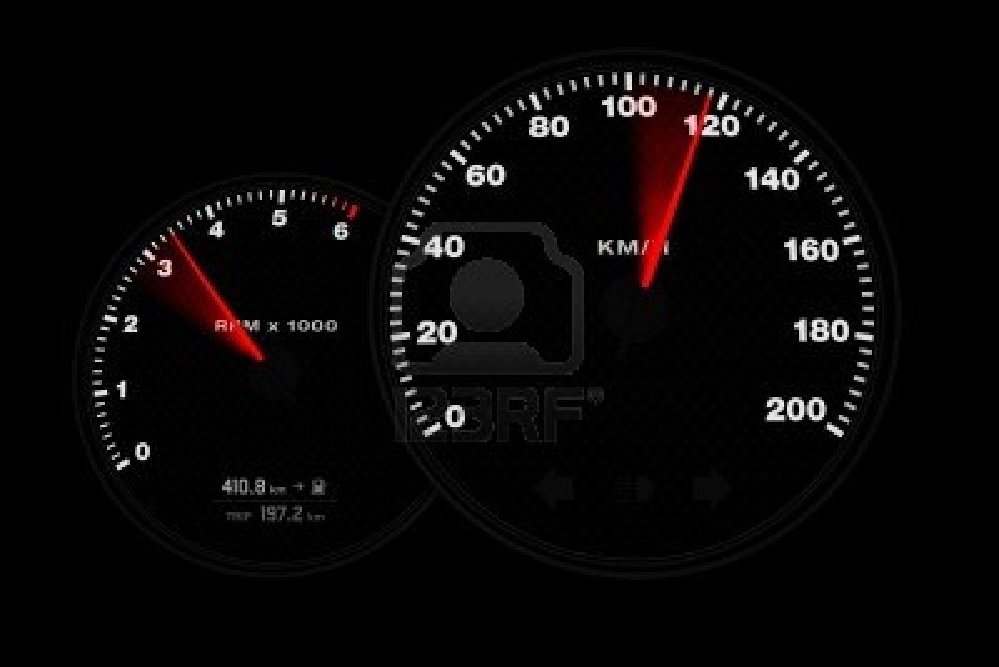
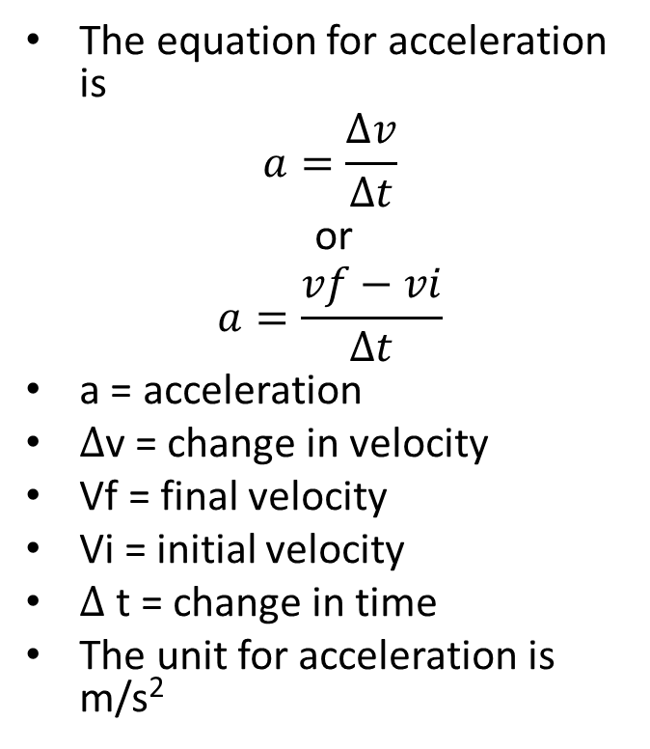
Calculating Acceleration
The equation for acceleration is
$$a=\frac{∆v}{∆t}$$
or
$$a=\frac{vf−vi}{∆t}$$
a = acceleration
$∆$v = change in velocity
Vf = final velocity
Vi = initial velocity
$∆$t = change in time
The unit for acceleration is m/s²

Slide 5

Acceleration and the Triangle Method
$$a=\frac{vf−vi}{∆t}$$
Divide
Change in speed
a
t
Multiply

Slide 6
I can derive 3 equations from this triangle…
$a=\frac{vf−vi}{t}$
$t=\frac{vf−vi}{a}$
$∆v=at$
BE CAREFUL!
Change in speed means Vf-Vi!
Change in speed
a
t

Slide 7
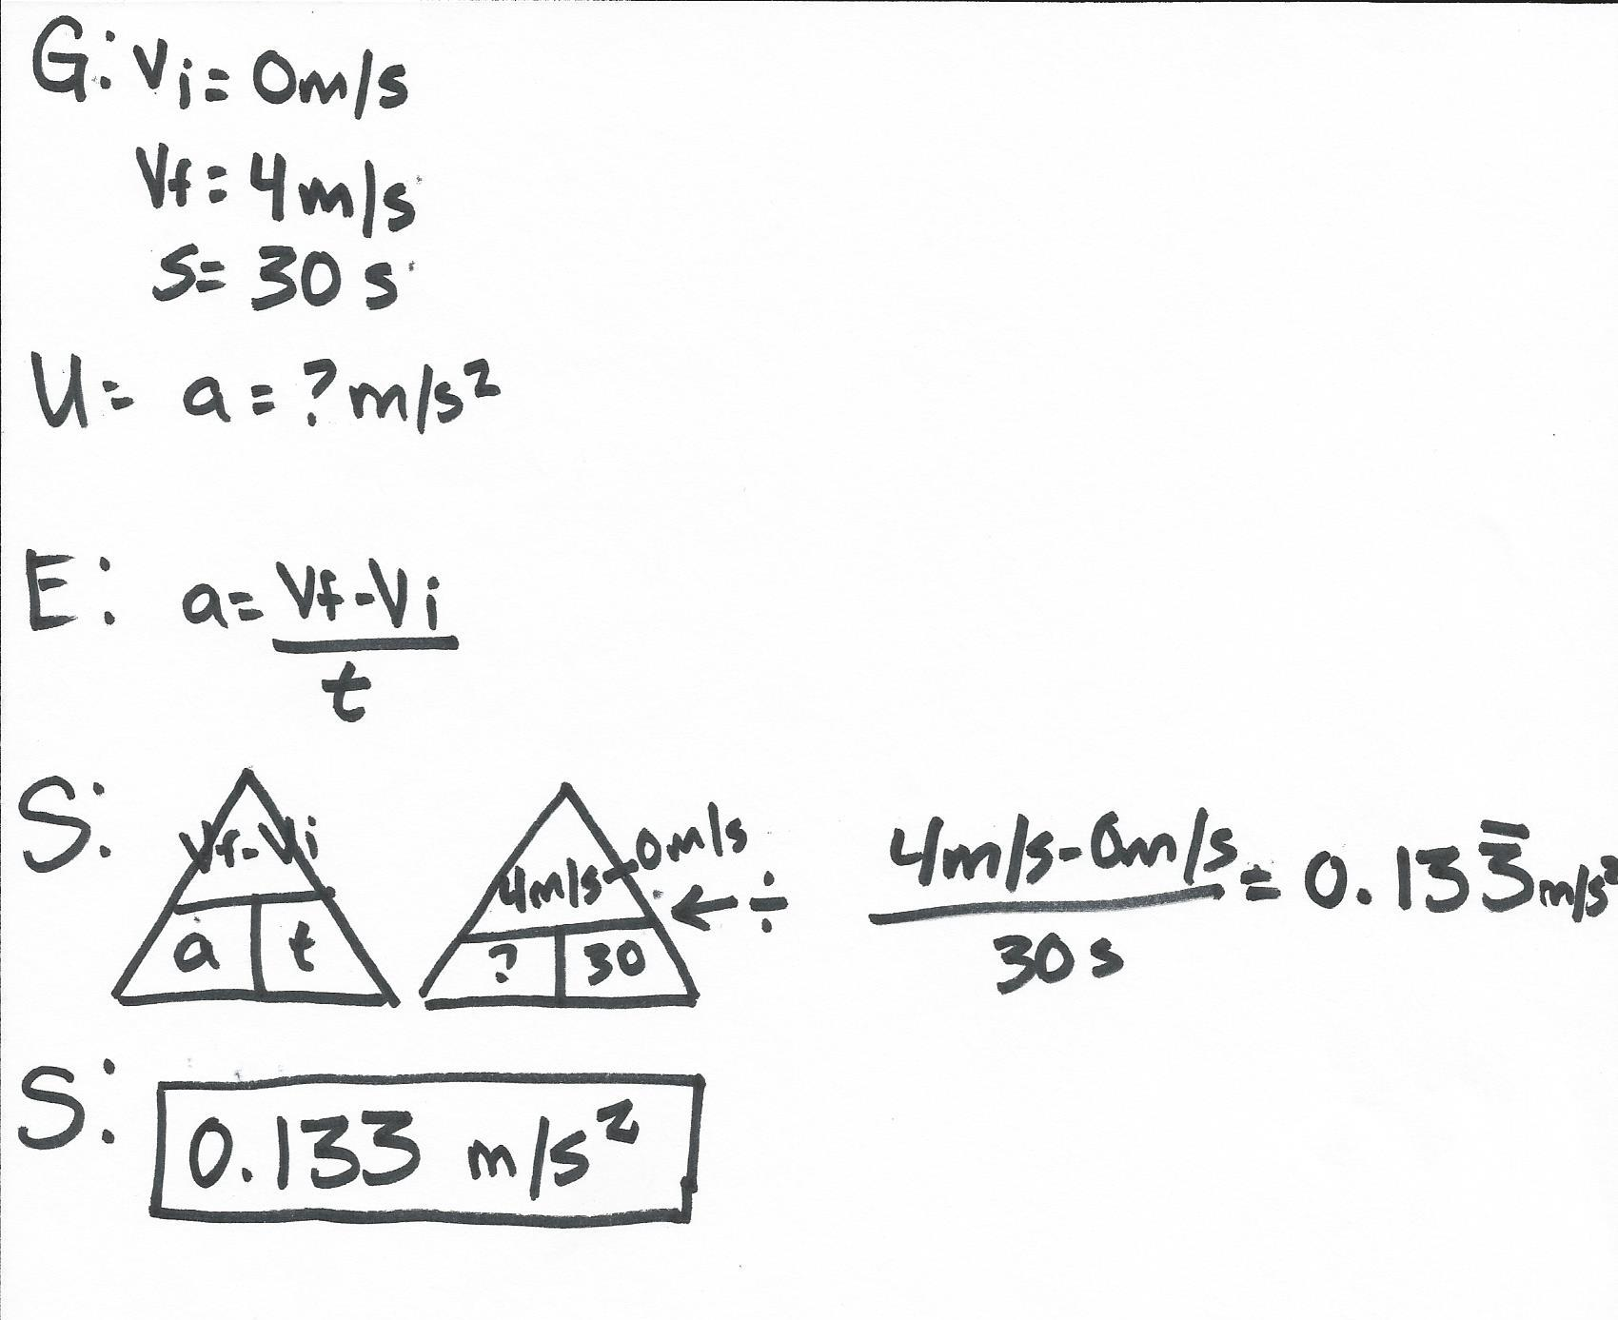
Starting from rest, it took me 30 seconds to reach a speed of 4 m/s. At what rate did I accelerate?

Slide 8
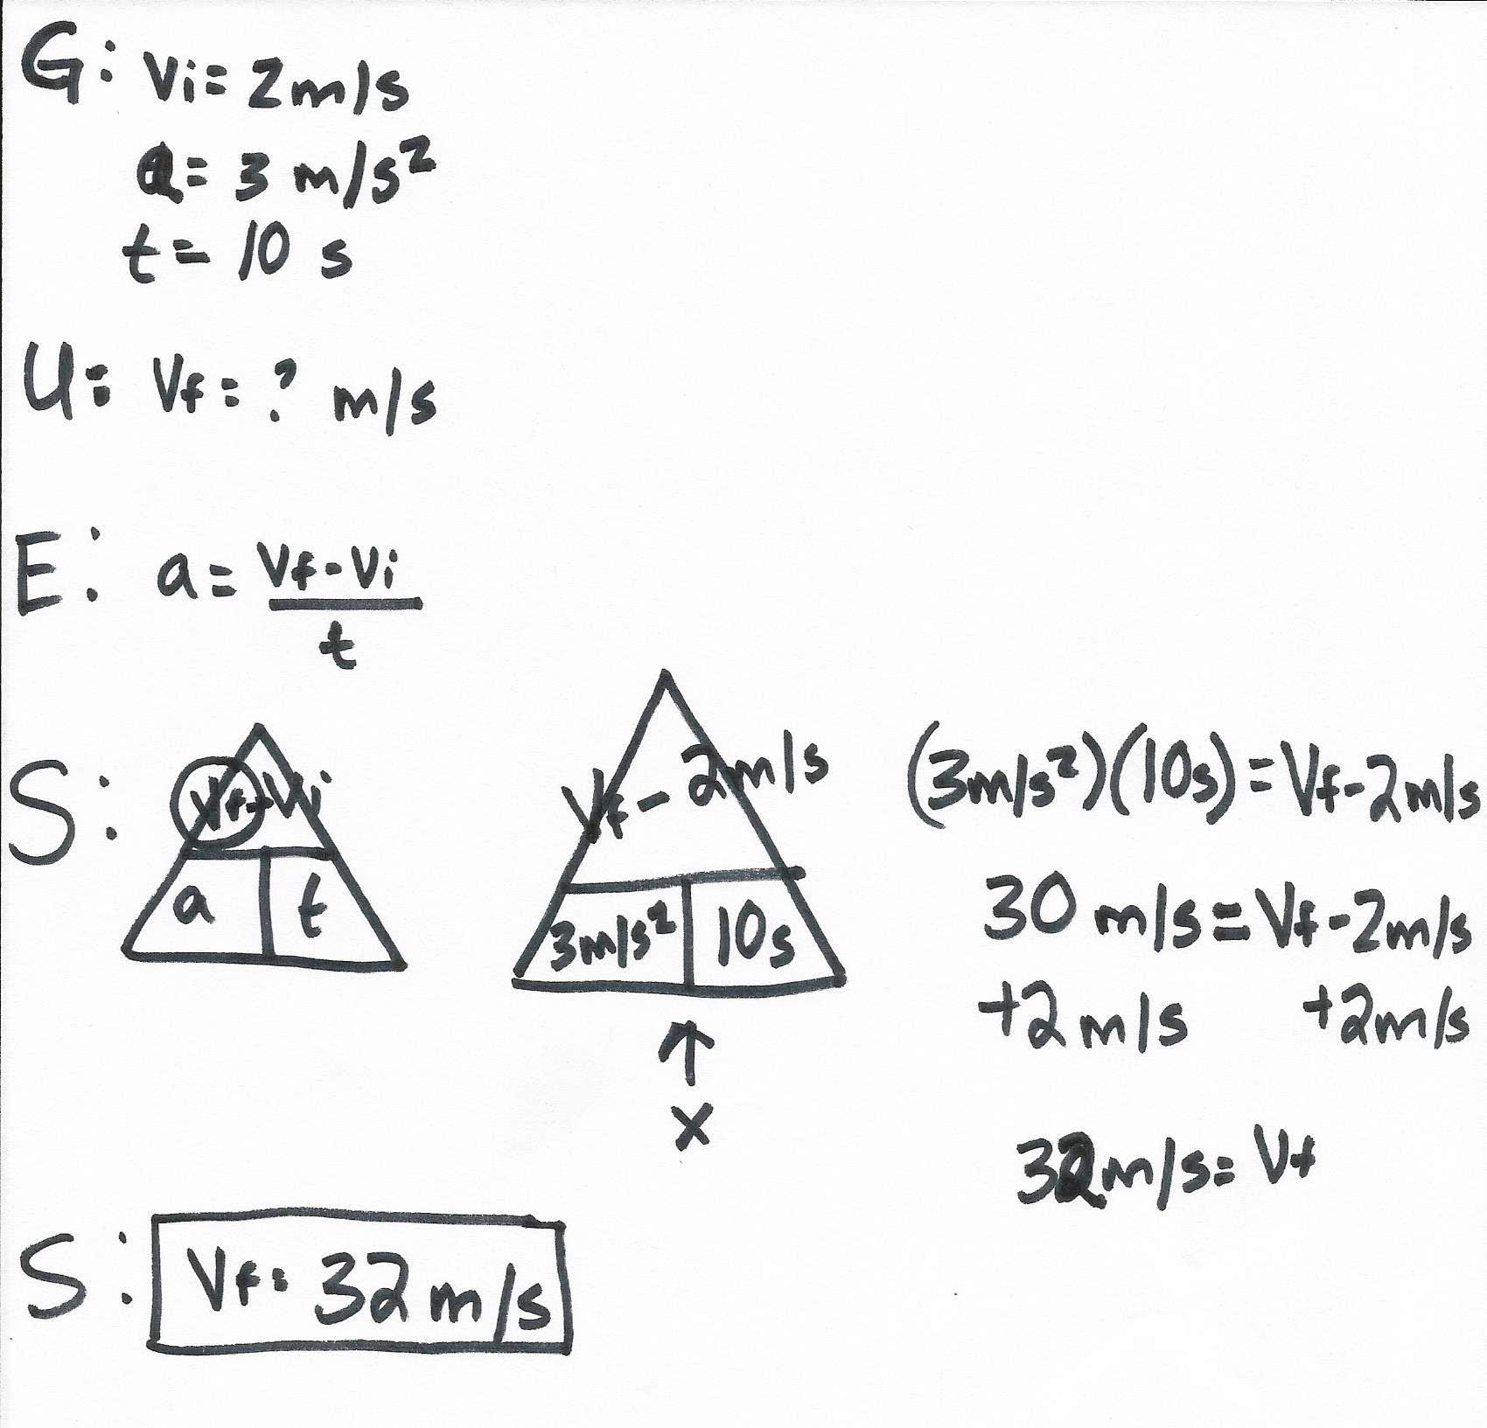
What was my final velocity if I started at a rate of 2m/s and accelerated at rate of 3m/s² for 10 seconds?

Slide 9
Speed/Time Graph
The slope of a speed vs. time graph is acceleration.
Time is on the x axis
Speed is on the y axis

Slide 10
Interpreting a speed time graph

