Slide 1
Acid Precipitation

Slide 2
What Causes Acid Precipitation
Acid precipitation is precipitation – rain, sleet, or snow – that contains a high concentration of acids.
Fossil fuels burned -> release oxides of sulfur and nitrogen -> oxides combine with water in the atmosphere -> sulfuric acid and nitric acid -> falls as precipitation.
This acidic water flows over and through the ground into rivers, lakes, and streams.

Slide 3
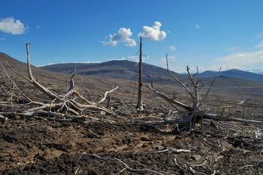
How Acid Precipitation Affects Soils and Plants
Lowers pH of soil and water
-> acidification
Can cause aluminum and other toxic metals to be absorbed by roots.

Slide 4
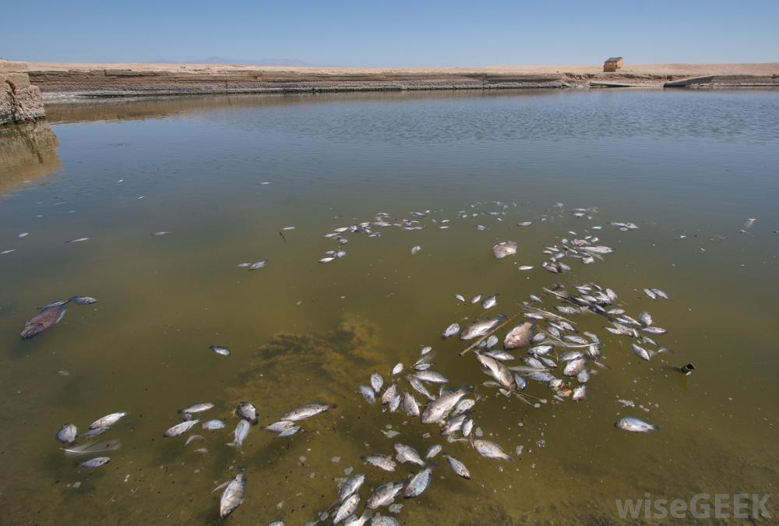
Acid Precipitation and Aquatic Ecosystems
Acidic water can kill fish and other aquatic animals.
Can cause aluminum to leach from the soil into the water, suffocating the fish.
Effects worsen in the spring:
Acidic snow melts and causes an influx of acidic water called acid shock.

Slide 5
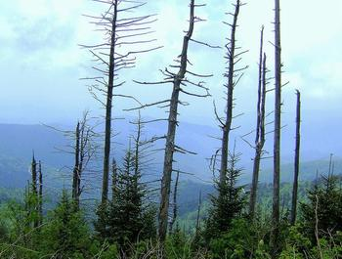
Acid Precipitation and Humans
Toxic metals can find their way into crops, water, and fish.
May cause respiratory problems.
Affects livelihood of commercial fishers, people who work in the sports fishing industry, and foresters.

Slide 6
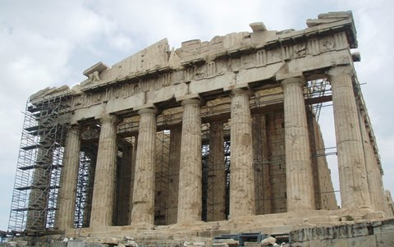
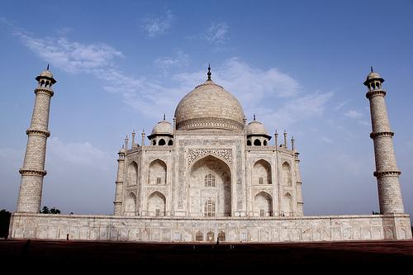
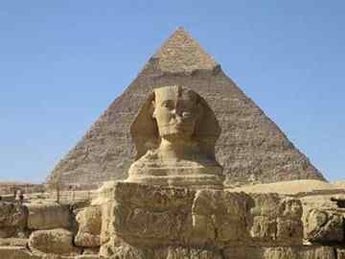
Acid Precipitation and Buildings
AP can dissolve calcium carbonate in common building materials such as concrete, marble, and limestone.
Some the world’s most important monuments are being dissolved by acid rain.

Slide 7
International Conflict and Cooperation
Controlling AP is difficult:
Pollutants may be released in one area and fall to the ground hundreds of kilometers away.
Thus AP is an international problem

