Slide 1
Review: What Causes Air Pollution?

Slide 2
Review: What Causes Air Pollution?
What is air pollution?

Slide 3
Review: What Causes Air Pollution?
What is air pollution?
What is the difference between a primary and a secondary pollutant?

Slide 4
Review: What Causes Air Pollution?
What is air pollution?
What is the difference between a primary and a secondary pollutant?
Can you list any of the pollutants we learned about?

Slide 5
Review: What Causes Air Pollution?
What is air pollution?
What is the difference between a primary and a secondary pollutant?
Can you list any of the pollutants we learned about?
Where do these pollutants come from?

Slide 6
Air, Noise, and Light Pollution

Slide 7
Short-term Effects of Air Pollution on Health
Many of the effects of AP on health are short term and reversible if exposure decreases.
Examples:
Headache
Nausea
Irritation to the eyes, nose, and throat
Tightness in the chest
Coughing
Upper Respiratory infections
Worsen asthma

Slide 8
Long-Term Health Effects on Air Pollution
Examples:
Emphysema
Lung Cancer
Heart disease
Long-term exposure may worsen medical conditions suffered by old people and may damage the lungs of children.

Slide 9
Indoor Air Pollution
The air quality inside a home or building can often be worse than outside.
Buildings that have very poor air quality have “Sick Building Syndrome”
The most effective way to maintain good air quality is to identify and remove sources of indoor air pollution.

Slide 10
CBS News: 60 Minutes
https://www.youtube.com/watch?v=adzMcfHr1q8

Slide 11
Air Quality at Home

Slide 12
Asbestos
Asbestos is a material commonly used as an insulator and a flame retardant.
Banned by US Gov’t in the 1970s.
Inhaling asbestos fibers can cut and scar the lungs.

Slide 13
Identifying Indoor Air Pollution
Observe
Smell
Feel
Listen
Notes:
Unfortunately, Indoor air pollution is often hard to
IMAGE: http://www.prota4u.org/protav8.asp?g=psk&p=Dracaena+fragrans+(L.)+Ker+Gawl.

Slide 14
Observe
Observe (look) at the cleanliness of a room.
Is their a lot of clutter or dust? Look for sources of pollutants such as animals, dirty carpets, evidence of leaks, blocked airflow, improperly stowed chemicals.

Slide 15
Smell
Smell for any unusual chemical or musty odors.
Try to find where they are coming from

Slide 16
Feel
Feel for uncomfortable temperatures, humidity, drafts, and air flowing in and out of air vents and around doors and windows.
Does the air feel thick? Dry? Moist?

Slide 17
Listen
Listen to the people in the room. Is anyone coughing or sniffling?
Is anyone complaining about anything? Temperature? Smells? Dirty carpets?
Everyone has different levels of sensitivities. Some people might be reacting to a toxic substance that doesn’t bother others.

Slide 18
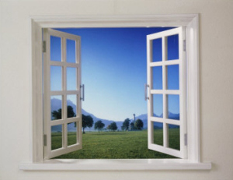
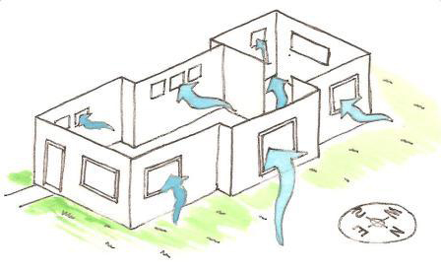
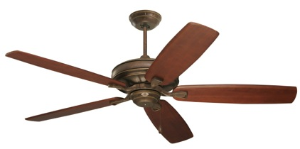
Ways to Improve Indoor Air Quality…
Increase Ventilation

Slide 19
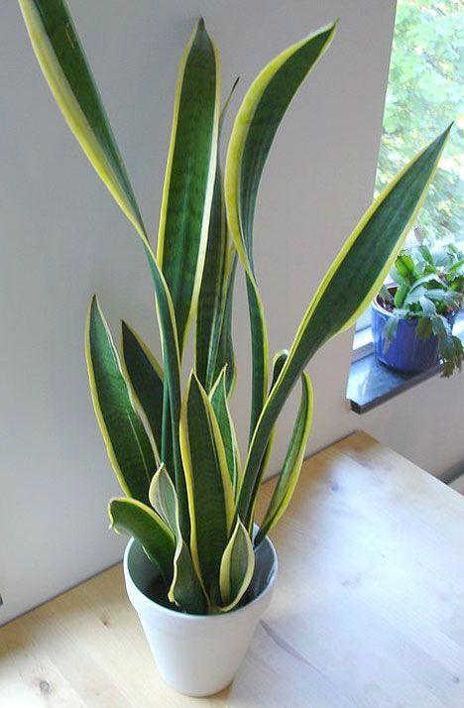
Ways to Improve Indoor Air Quality…
House Plants

Slide 20
Ways to Improve Indoor Air Quality…
Salt Lamps
natural ionic air purifier that pulls toxins from the environment and neutralizes them.
(see front of classroom!)

Slide 21
Ways to Improve Indoor Air Quality…
Burn beeswax candles instead of paraffin candles.

Slide 22
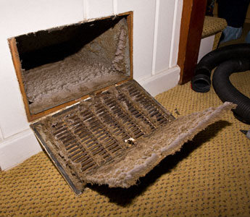
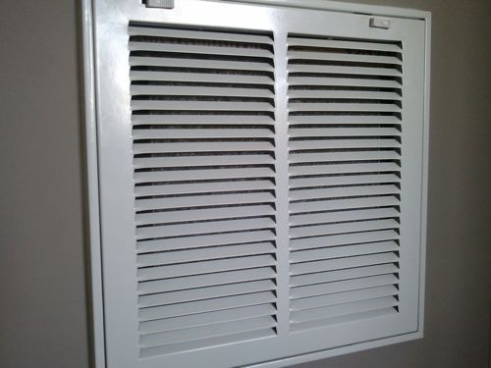
Ways to Improve Indoor Air Quality…
Change out the filter in your A/C

Slide 23
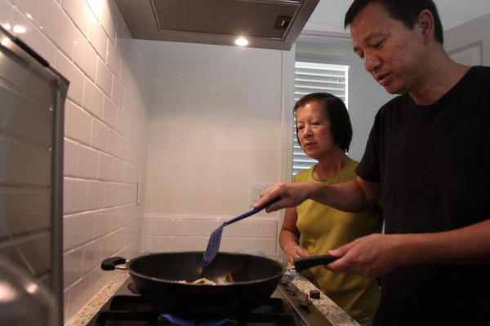
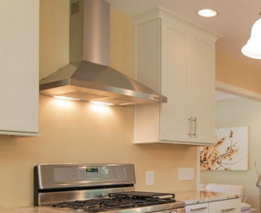
Ways to Improve Indoor Air Quality…
Use the kitchen vent when you cook
Use the Bathroom vent/fan when you shower

Slide 24
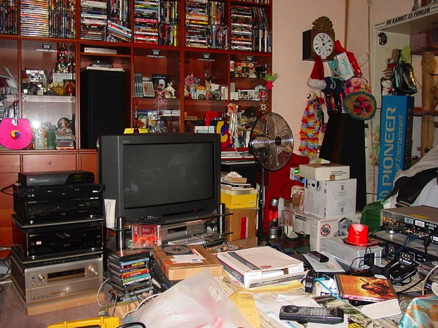
Ways to Improve Indoor Air Quality…
Vacuum often
Declutter

Slide 25
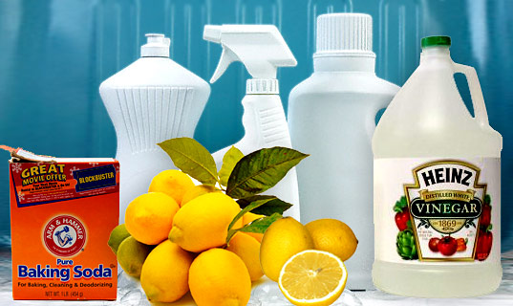
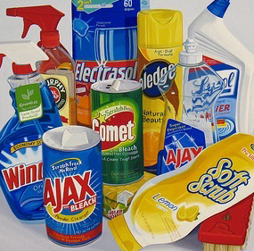
Ways to Improve Indoor Air Quality…
Open the windows when you use cleaners.
Choose natural cleaners instead of harsh chemical cleaners

Slide 26
NOISE POLLUTION

Slide 27
Noise Pollution
Harmful or annoying levels of noise.
It is irritating and damages our hearing by destroying cells in our ears.
Examples:
Airplanes
Industry
Music
Loud sounds have caused whales and dolphins to strand on beaches.
MP3s and other personal listening devices are not regulated in the US.

Slide 28
Noise Pollution Solution: (rhyme intended☺)
Mufflers on cars and lawn mowers
Insulation
Ear plugs

Slide 29
LIGHT POLLUTION

Slide 30
Light Pollution: Hidden Costs
https://www.youtube.com/watch?v=P2JQFyFcbRU

Slide 31
Light Pollution
LP is the brightening of the night sky caused by street lights and other man-made sources
Has a disruptive effect on natural cycles and inhibits the observation of stars and planets.
LP can mislead baby sea turtles away from the ocean.
LP can cause problems for birds that migrate at night.

Slide 32
Light Pollution Solution: (rhyme intended☺)
Dim street lights/porch lights during migration/hatching seasons.
Shielding light so it is directed downward

Slide 33
Out of Breath! Intro to Design Solution
You work for the EPA and you have been asked to create a new PSA campaign to advocate for clean air.
Your goal is to get people to change their behavior to more environmentally and air friendly activities.
You may need to do some background research!

