Slide 1
Biomolecules

Slide 2
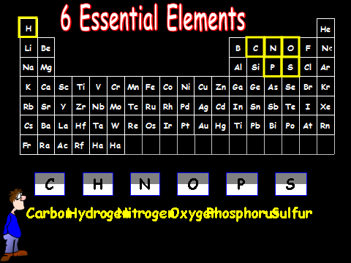
Carbon Hydrogen Nitrogen Oxygen Phosphorus Sulfur

Slide 3
The Chemistry of Carbon: Organic Chemistry
Why is carbon so important that is has it’s own branch of chemistry?
Carbon has 4 bonding spots so it can bond with many other elements.
  Hydrogen, oxygen, phosphorus, sulfur, and nitrogen
Living things are made up of molecules that have carbon and these other elements.
These are called biomolecules.
[bio] = life

Slide 4
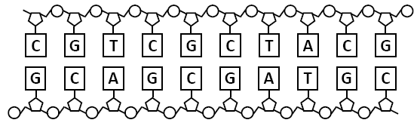
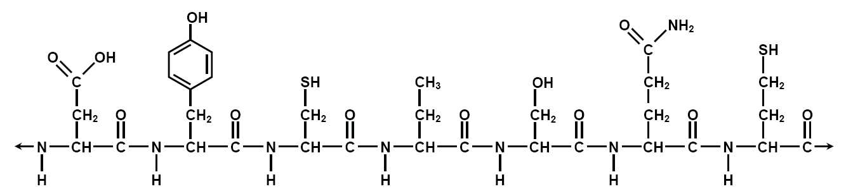
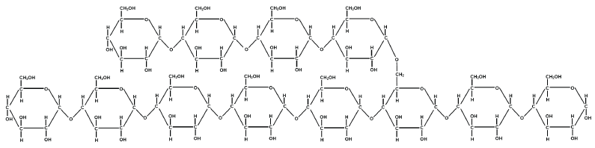
Biomolecule Structure
Biomolecules are polymers, long molecules made of very similar, repeating monomers.
Nucleic acids
Proteins
Carbohydrates

Slide 5
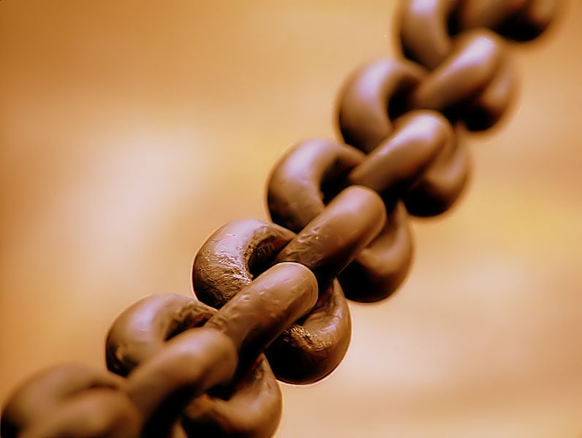
Understanding the Vocabulary
When we say “polymer” we are referring to the whole molecule. What would you call the entire object above?
It is a chain. I would say that chains are like polymers.

Slide 6
Understanding the Vocabulary
When we say “monomer” we are referring to the individual piece that keeps repeating. What would you call the individual pieces of a chain?
It is a link. I would say that links are like monomers.

Slide 7
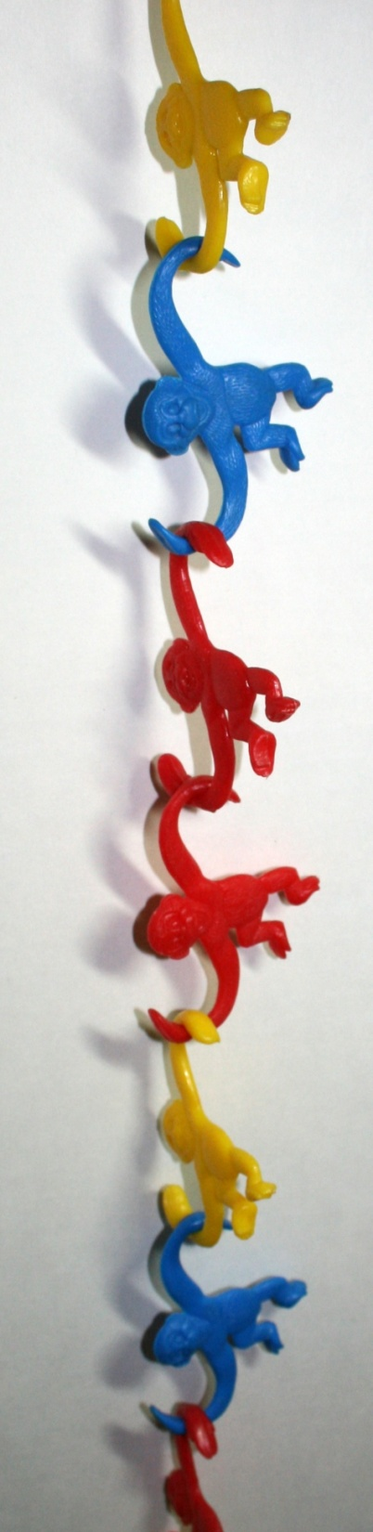
In this picture, what would you say is the polymer, and what would be the monomers?
The entire chain is the polymer, and each monkey is a monomer.

Slide 8
The four major groups of biomolecules:
Carbohydrates
Lipids
Proteins
Nucleic Acids

Slide 9
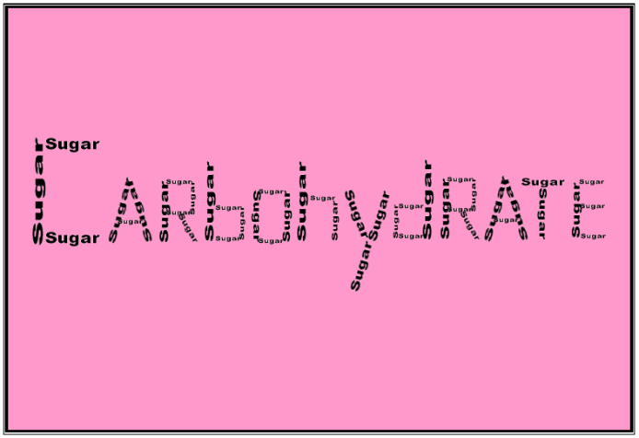
Carbohydrates are made of carbon, hydrogen, and oxygen. In a ratio of 1:2:1 (Monosaccharides)
They are the most common biomolecule.

Slide 10
Carbs Example: Sugars
Provide quick energy
Monosaccharides – 1 simple sugar
  like Glucose C6H12O6
Disaccharides – sugars build of 2 monosaccharides
  like Sucrose + Fructose
This is a
simple sugar

Slide 11
Carbs Example: Starches
Structural support and energy storage.
Polysaccharides – many monosaccharides together!
Glycogen – stores glucose in muscle tissues
Cellulose – provides structure
  Like in a plant cell wall
This large molecule is a polysaccharide.

Slide 12
Lipids
Lipids are made of glycerol and fatty acids.
(Fats)

Slide 13
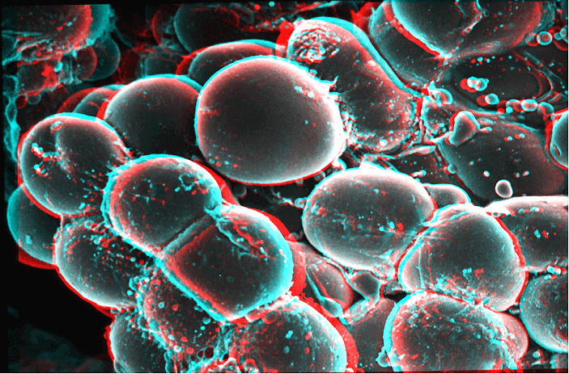
Lipids Continued
Fats are also called: Adipose
Long-term energy reserves are stored in adipose cells.
Saturated
  Solidifies – bad
  Examples: animal fat and butter
Unsaturated
  No solidification – good
  Examples: vegetable oils

Slide 14

Lipids Continued
Fat (adipose) provides insulation for warmth.
  Like in whales, seals, etc.
Provides cushioning for organs.

Slide 15
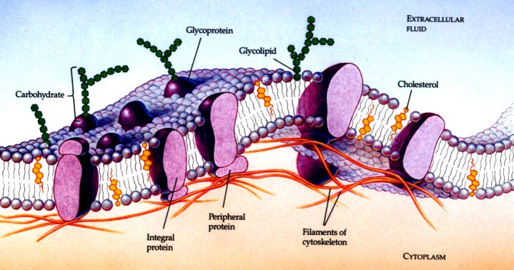
Lipids Continued:
Component of Cell Membranes
Phospholipids make up cell membranes.
The bilayer forms a boundary between the cell and the external environment.

Slide 16
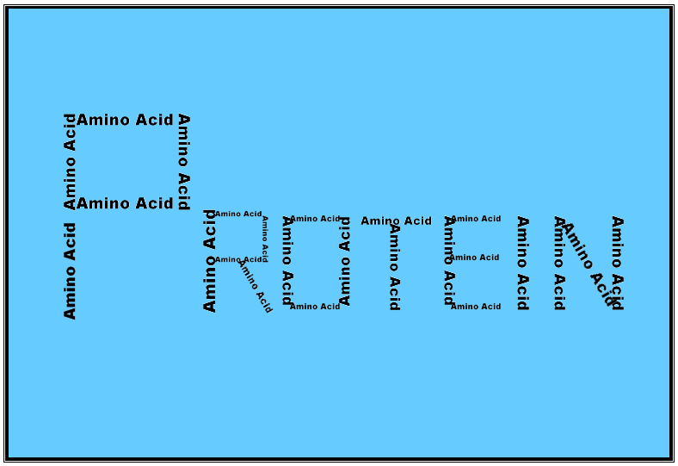
Proteins are made of
amino acids
This is an amino acid
This large molecule is a protein.

Slide 17
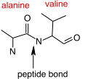
Protein Structure
Amino acids are made of an amino group (-NH₂) and a carboxyl group (-COOH)
There are 20 different amino acids.
2 or more amino acids are joined by a peptide bond.
That is why proteins are also called polypeptide chains.

Slide 18
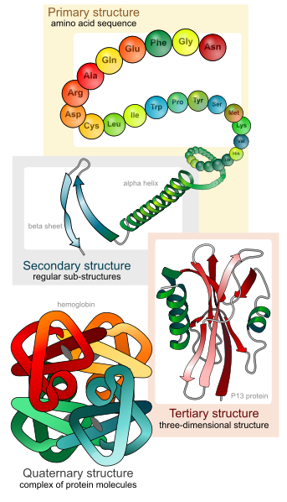
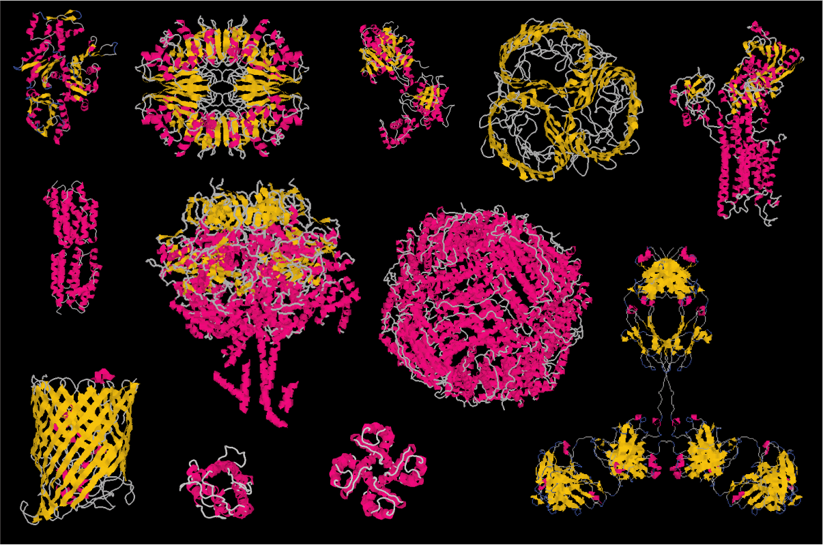
Structure=Function
The order of the amino acids determine the shape.
The shape determines the function, or job, of the protein.
There are four levels or protein organization.

Slide 19
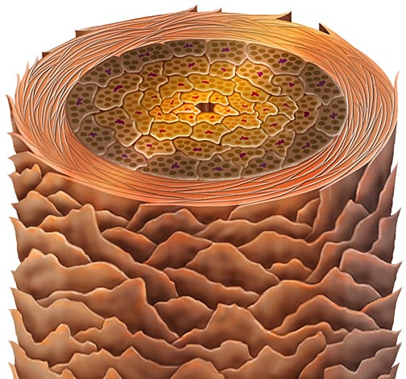
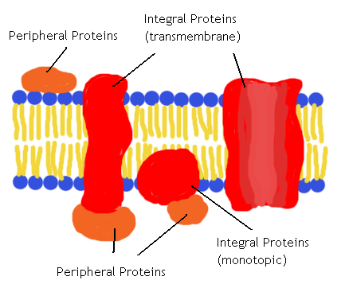
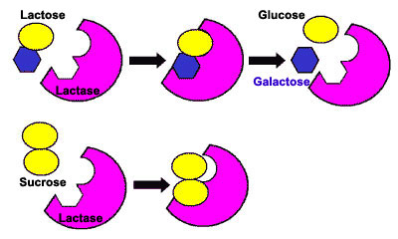
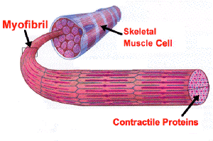
Functions of Protein
Support / Structure
  Like keratin in our nails and hair.
2. Transport
  Protein channels in cell membrane
3. Enzymes
  Catalysts that control the rate of reactions.
  Like Lactase (breaks down lactose in milk)
4. Contractile
  Muscle fibers

Slide 20
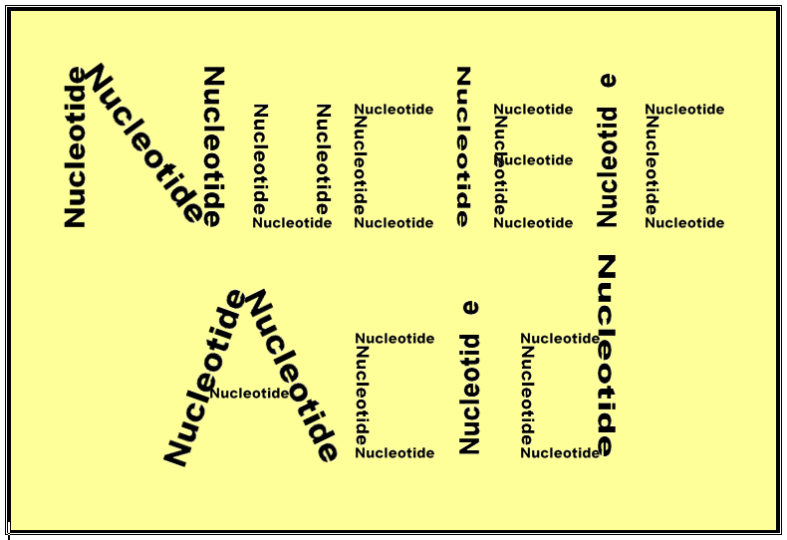
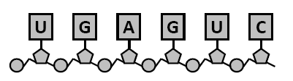
Nucleic acids are made of nucleotides.
This is a nucleotide
This large molecule is a nucleic acid.

Slide 21
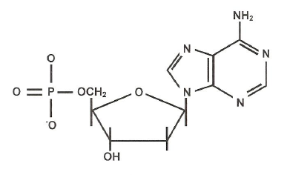
Every nucleotide has 3 basic parts:
1. The phosphate group
2. A sugar named deoxyribose
3. One of the 4 nitrogen bases

Slide 22
Function of Nucleic Acids
Stores genetic information used to make proteins.
DNA and RNA are the main types of nucleic acids.
DNA = deoxyribonucleic acid
  Genetic material
RNA = ribonucleic acid
  Controls protein synthesis

