Slide 1
Describing Motion: Speed and Velocity

Slide 2
Speed
Describes movement from one place to another over time

Slide 3
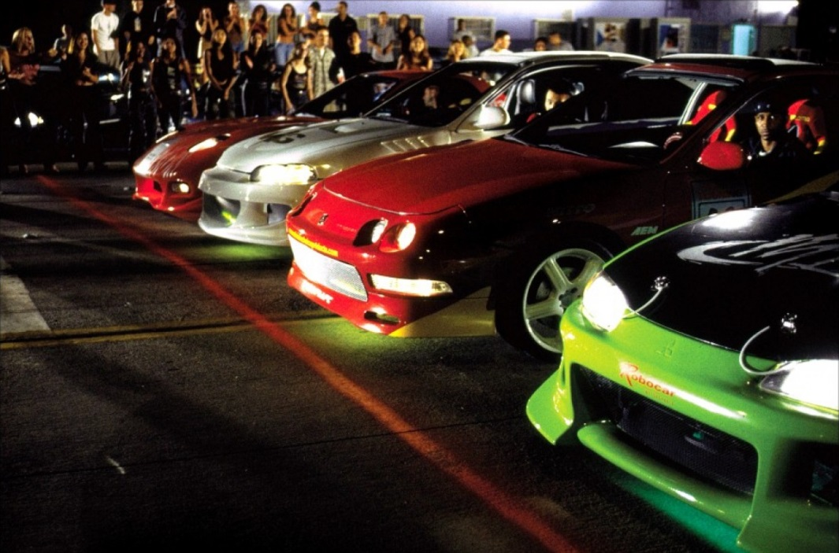
Calculating Speed
The equation for speed is $s=\frac{d}{t}$
s = speed
d = distance
t = time

Slide 4
The Triangle Method
Use the triangle method for 3 variable equations.
The horizontal line means to divide.
The vertical line means to multiple.

Slide 5
Speed and the Triangle Method
$$s=\frac{d}{t}$$
d
Divide
s
t
Multiply

Slide 6
I can derive 3 equations from this triangle:
$s=\frac{d}{t}$
$d=st$
$t=\frac{d}{s}$
d
s
t

Slide 7
Distance
d
s
t

Slide 8
Time
d
s
t

Slide 9
GUESS Method
G: given
What information do I already know?
U: unknown
What variable am I solving for?
E: equation
What equation do I need to use to solve for the missing variable?
S: solve
Plug the given info into the equation (or triangle)
S: solution
Write the answer with the correct units and circle or box it.

Slide 10
Now let’s put the equation, the triangle method and the GUESS method together…

Slide 11
A car travels 25 meters in 5 seconds. What is the speed of the car?

Slide 12
How long does it take a motorcycle to travel 17 meters if it is traveling at a rate of 2.3 m/s

Slide 13
If a van is traveling at a speed of 4.6 m/s, how far can it go in 10 seconds?

Slide 14
What is the difference between speed and velocity?
$s=\frac{d}{t}$
Describes movement from one place to another over time; distance divided by time
$v=\frac{d}{t}$
Describes movement from one place to another over time and in a certain direction

Slide 15
Distance/Time Graphs aka Position/Time graphs
Speed (s) is the slope (rise over run) of a position (d) vs. time (t) graph
Reasoning:
$$slope=\frac{rise}{run}$$
$$speed=\frac{distance}{time}$$
Rise is change in y (distance)
Run is change in x (time)
Thus:
$slope=\frac{rise}{run}$ = $speed=\frac{distance}{time}$

Slide 16
Interpreting the slope of a distance time graph
We can use distance/time graphs to find instantaneous speed:
The speed of an object at a specific point in its journey
What is the speed of the car at 4 seconds?
-Find 4 seconds on the x axis
-Then move your finger to the left to find the position (distance) of the car at 4 seconds.
Finally, use the equation for speed to find the answer.
$speed=\frac{disance}{time}$
$speed=\frac{2 meters}{4 seconds}=0.5$m/s

Slide 17
Interpreting the slope of a distance time graph
We can use distance/time graphs to find average speed:
How fast something moves over a certain distance.
What is the average speed of the car between 4 and 8 seconds?

Slide 18
What is the average speed of the car between 4 and 8 seconds?
Find the corresponding y values for 4 and 8 seconds
X1=4 seconds
Y1=2 meters
X2=8 seconds
Y2=4 meters
Use the equation for slope to find the average speed:
(REMEMBER: slope = speed!)
Speed = $slope=\frac{rise (change in y) }{run (change in x)}$
$slope= \frac{4m −2m}{8s−4s}$ =$\frac{2m}{4s}=0.5 m/s$
Average speed = 0.5 m/s

