Slide 1
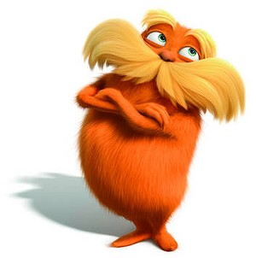
Introduction to Environmental Systems
What’s all the fuss about??

Slide 2
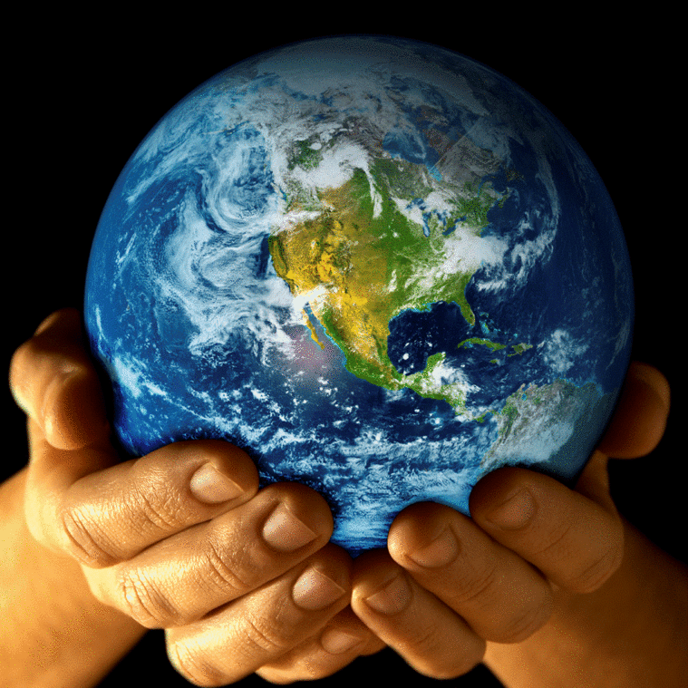
First of all, what is the environment?
Everything around us!
It includes the natural world and things made by humans.

Slide 3
What is Environmental Science?
The study of the environment that includes the physical, biological, and social sciences.
List some of the most significant environmental problems today. (table partners)

Slide 4
What are our main environmental problems?
Resource Depletion
Pollution
Biodiversity

Slide 5
Resource Depletion
Can you think of any examples?
Renewable vs. non renewable
Resources are depleted when a large fraction of the resource is used up.

Slide 6
Pollution
Pollution is an undesired change in air, water, or soil that adversely affects the health, survival, or activities of humans or other organisms.

Slide 7
Loss of Biodiversity
Biodiversity is the number and variety of species that live in an area.
Organisms of the world are considered natural resources.
When a species goes extinct it is gone forever.
Nonrenewable resource
Disruption of ecosystems.

Slide 8
The Goal of ES
To understand and solve environmental problems.
To address this goal, we must examine two main interactions between humans and the environment:
How we use natural resources
How our actions alter our environment

Slide 9
“When one tugs at a single thing in nature, he finds it attached to the rest of the world” John Muir

Slide 10
Discuss!
One of the basic concepts of ES is that everything is connected to everything else.
What is an example of this concept? (Elbow partners)
How does this concept make is difficult for people to reach an agreement about environmental issues? (Across partners)

Slide 11
A Sustainable World
Sustainability is the condition in which human needs are met in such a way that a human population can survive indefinitely at a standard of living similar to the current one.
Components of Sustainability
Society
Environment
Economy

Slide 12
Society
How are people affected?
How are cultures affected?
Do some people benefit at the expense of others?

Slide 13
Environment
How are plants and animals affected?
How are air, water, and soil affected?
What is the long-term impact on the environment?

Slide 14
Economy
How are local, national, and international economies affected?
Are meaningful job opportunities provided?
Is there a long-term economic gain for people and communites?

Slide 15
Ecophobia?
Our problems are big and serious.
But they are not insurmountable!
The idea of the acorn.
Everyone needs to participate.

