Slide 1
Part II:
Evidence of Evolution

Slide 2
Evidence for Evolution
1. Fossil Evidence:
  Paleontology - Study of Fossils
  Fossil - preserved evidence of past life
  Fossil record: shows organisms that are no longer living and how they changed over time.
  a. Relative dating
      Which rock layer is the fossil found…If you know the age of one, the rest of them are about the same age.
      Index fossils: wide range, short time period
  b. Radioactive dating
      Measuring radioactive isotope vs. stable atom content
        Carbon 14

Slide 3
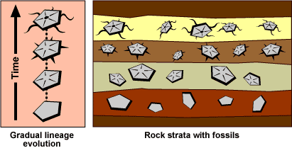
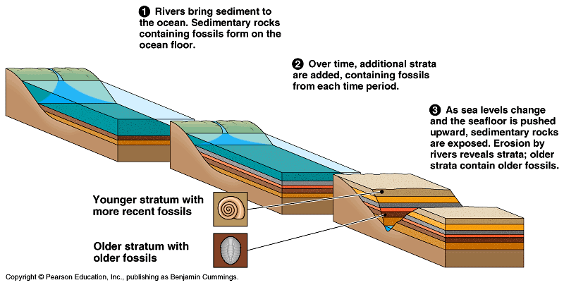
Fossil Formation

Slide 4
MORPHOLOGICAL HOMOLOGY (similarities)
2. HOMOLOGOUS STRUCTURES
  Structures that are similar because they are derived from a common ancestral structure

Slide 5
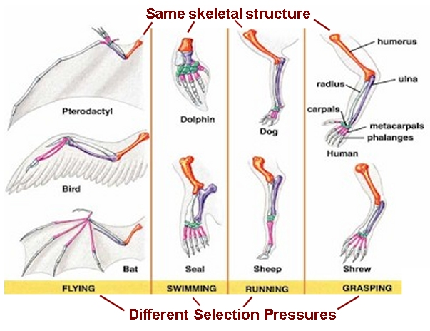

Slide 6
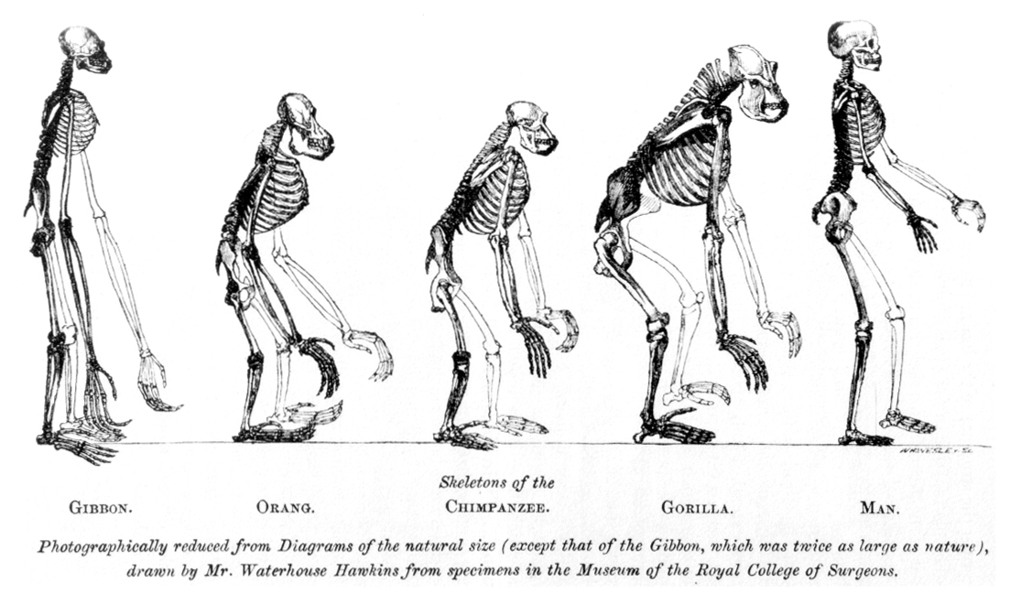

Slide 7
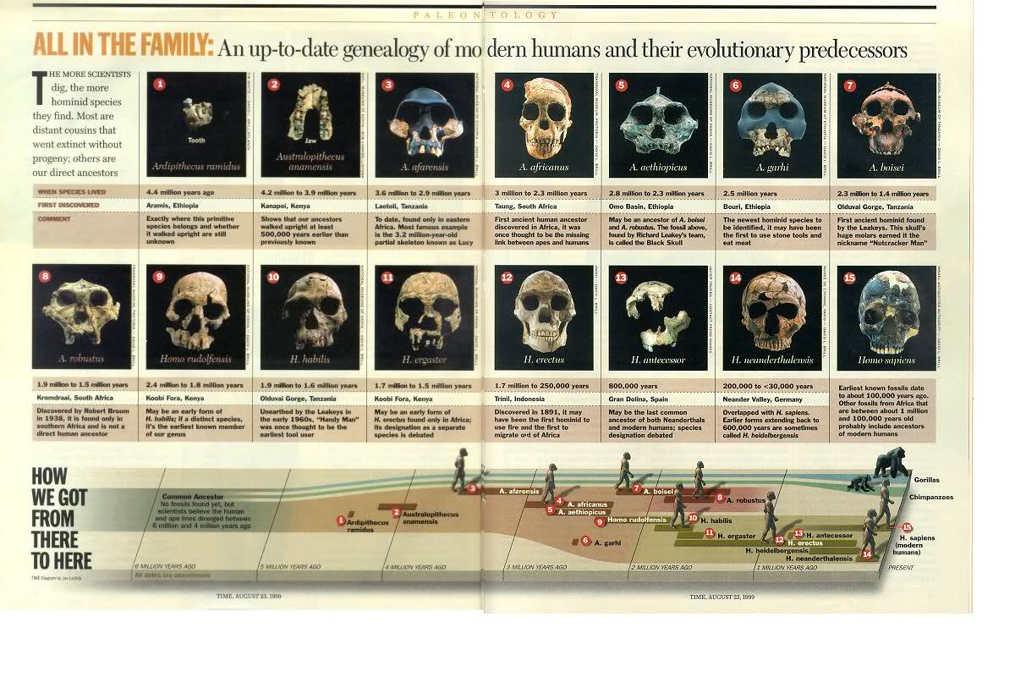

Slide 8
A structure that serves the same function in two taxa, but is NOT derived from a common ancestral structure is said to be an
ANALOGOUS STRUCTURE

Slide 9
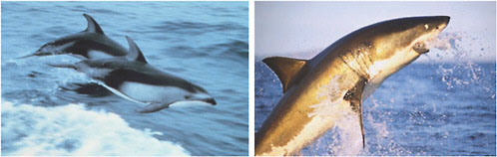
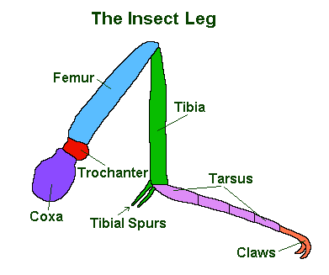
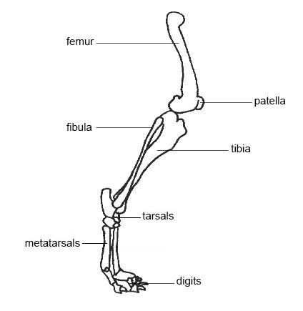
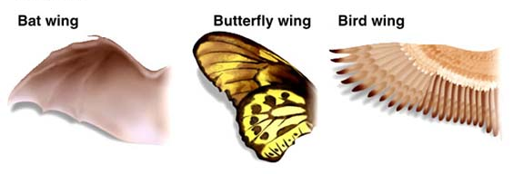

Slide 10
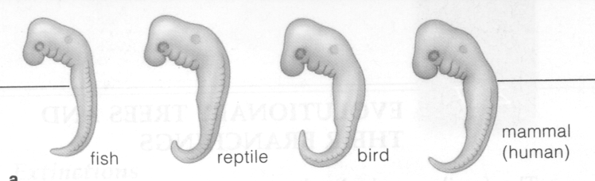
3. Embryology (ontogenic) Homology
Evidence for Evolution
As organisms develop, they go through many stages that are similar to other organisms.
  The longer two organisms share developmental stages, the more closely related they are to each other.

Slide 11
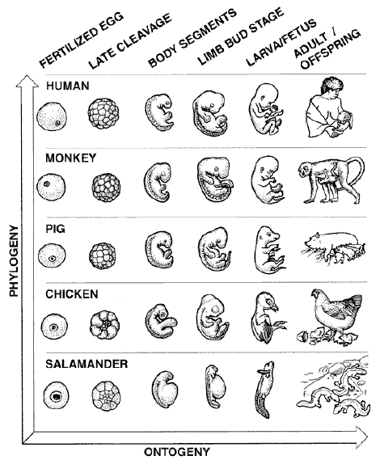

Slide 12
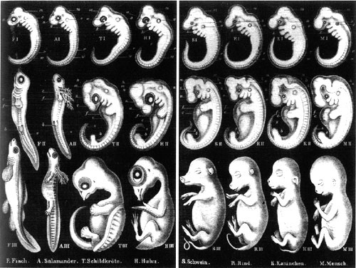

Slide 13
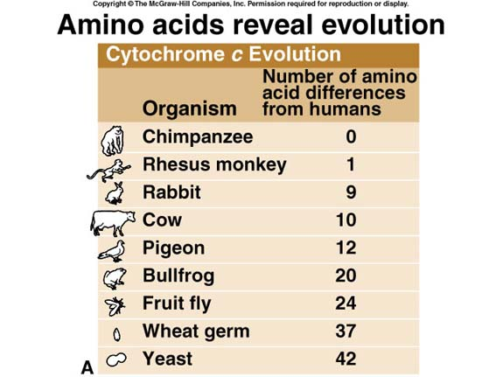
4. Molecular Homology
-The comparison of different proteins (amino acids) can show how closely related species are to each other.
-The fewer differences in the genetic make-up, the closer related they are.
Evidence for Evolution

Slide 14
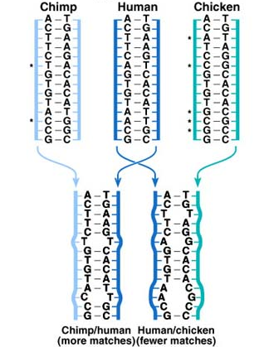
Evidence for Evolution
Hybridization of DNA can also show evolutionary relationships.

Slide 15
5. Vestigial Structures
Evidence for Evolution
Structures that have marginal, if any, use to the organisms in which they occur.
  Reduced in size.
  Derived from an earlier ancestor that did use/need this structure.

Slide 16
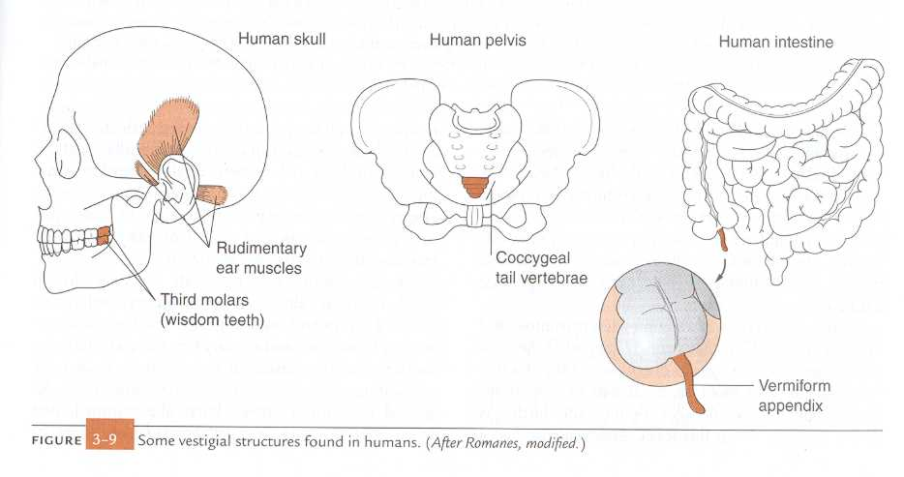
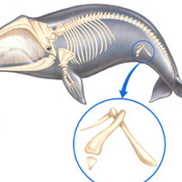
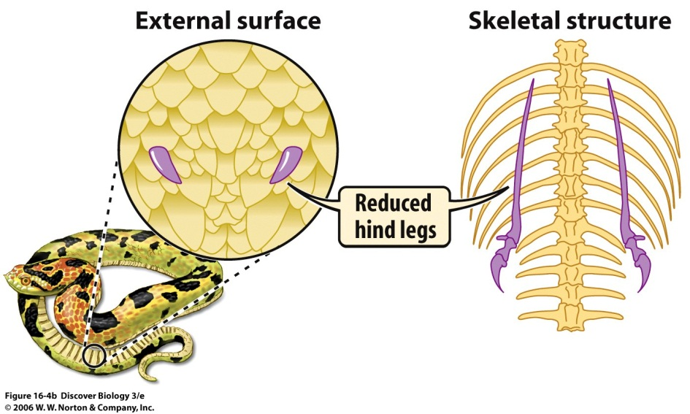

Slide 17
6. Biogeography
The study of the geographical distribution of organisms.
  Species that are related to each other tend to live near each other. (fossils of ancestors are present too)
  As geography changes, populations are separated or combined with new populations.
    Continent movement (collide and separate), rivers, mountains, lakes, etc. separate populations

Slide 18
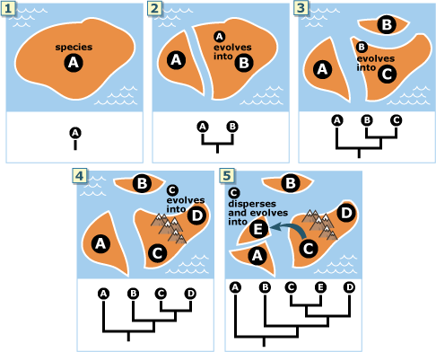

Slide 19
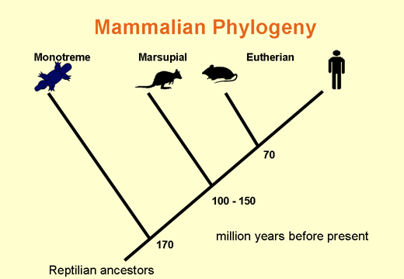
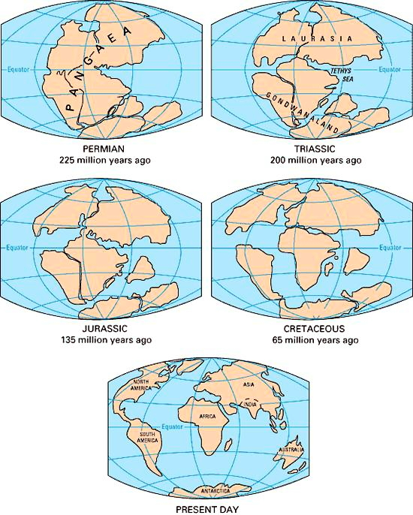
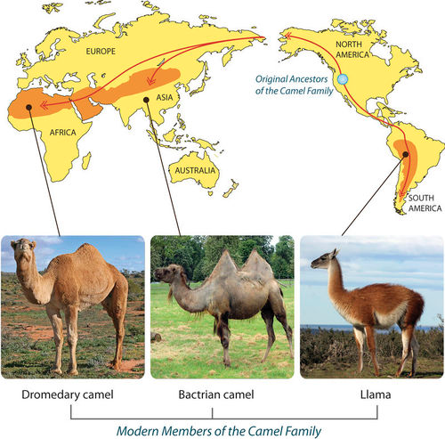

Slide 20
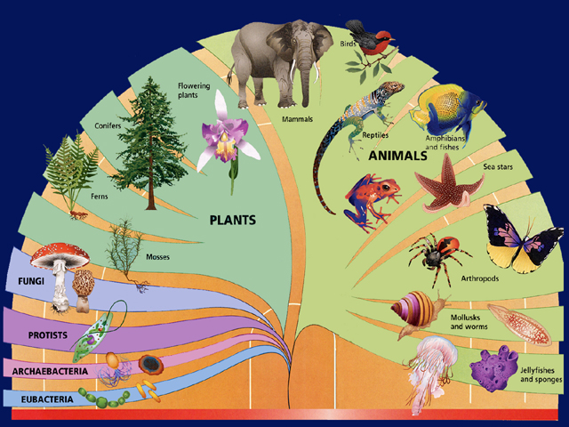
Phylogeny

Slide 21
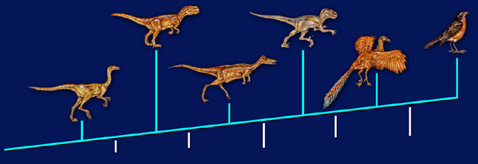
Phylogeny: Studying the evolutionary histories and relationships of organisms
Cladistics: a phylogenic study that assumes when probable groups of organisms diverged and evolved
Allosaurus
Velociraptor
Archaeopteryx
Sinornis
Theropods
Feathers with
shaft, veins,
and barbs
Flight feathers;
arms as long
as legs
3-toed foot;
wishbone
Down
feathers
Light bones

Slide 22
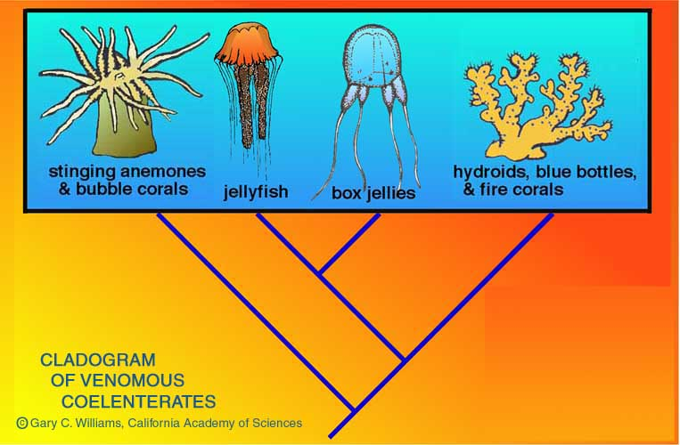
Cladograms
“Family tree” that represents evolutionary relationships (and not just physical appearances)

Slide 23
CLADOGRAM
Lizard
Mouse
Fish
Hagfish
Frog
Pigeon
Chimp
Feathers
Fur &
Mammary
Glands
Claws
or Nails
Lungs
Jaws

Slide 24
