Slide 1
Part III
Speciation
Causes of evolution
Rates of evolution

Slide 2
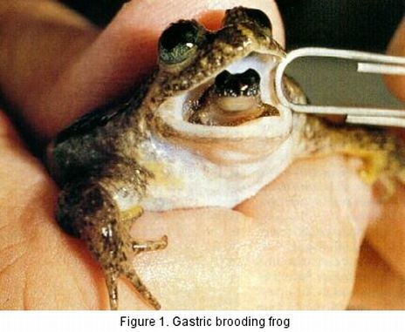
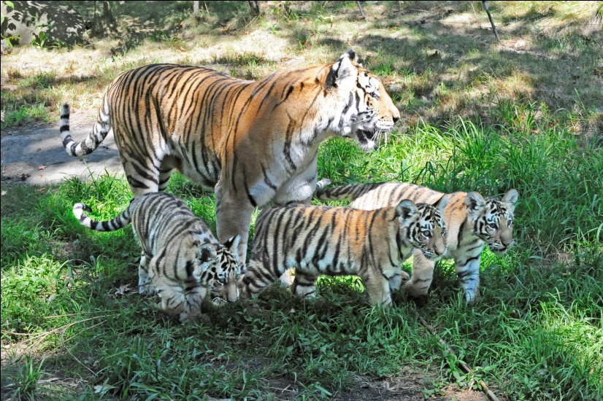
Species
An organism that has the potential to interbreed in nature and produce viable, fertile offspring that looks like their parents.
Speciation is the creation of a new species

Slide 3
What leads to the formation of a new species?
Reproductive Isolation
Two species are prevented from interbreeding

Slide 4
Reproductive Barriers
A reproductive barrier is any factor that prevents two species from producing fertile hybrids, thus contributing to reproductive isolation.
Habitat/Geographical Isolation
Temporal Isolation
Behavioral Isolation
Mechanical Isolation
Gametic Isolation

Slide 5
Types of Isolation
Behavioral Isolation:
Produced by behavioral differences
Mating/ courtship dances (and other behaviors) are not recognized by other species….don’t recognize other species as a potential mate.
Bird A dances the salsa, Bird B dances country.
Geographical Isolation:
Produced by physical barriers
Rivers, mountains, different continents/countries, etc.
Populations cannot get to each other to interbreed.
Frog on one side of a mountain range can’t get to frog on other side.
Temporal Isolation:
Produced by different breeding/mating times
Species breed at different times of the year/day.
One flower opens only in the morning and another in the afternoon.
One frog breeds in March, another in June.

Slide 6
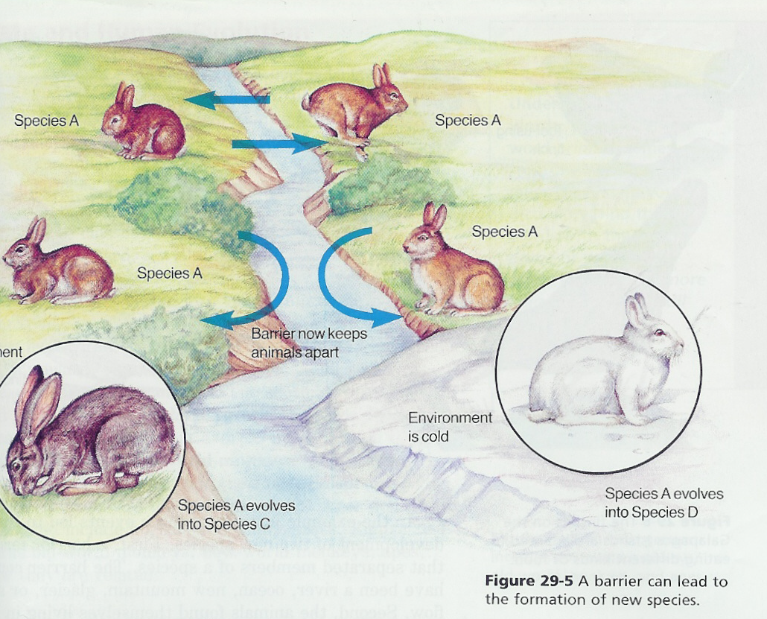

Slide 7
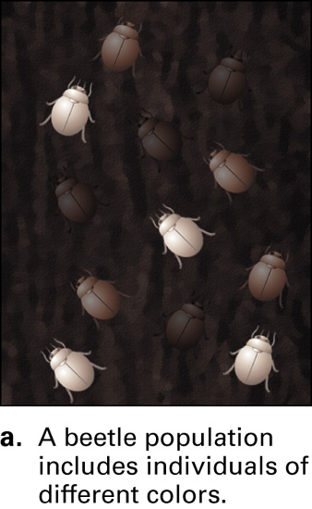
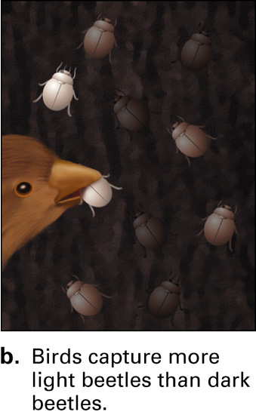
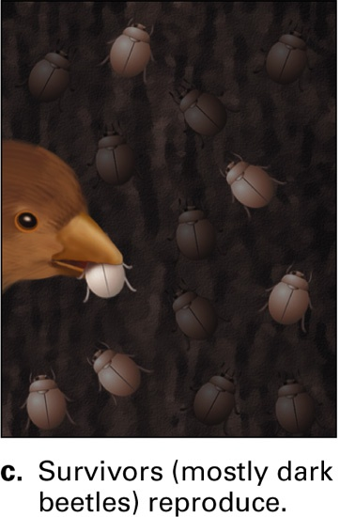
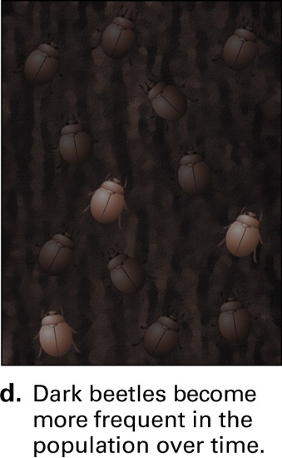
Causes of Evolution
Mutations - random changes in genetic material at the level of the DNA nucleotides or entire chromosomes
Natural Selection - most important cause of evolution; measured in terms of an organism's fitness
The contribution an individual makes to the gene pool of the next generation, relative to the contributions of other individuals…the more fit, the more they contribute.

Slide 8
Modes of Selection (types of natural selection)
a. Stabilizing Selection - average phenotypes have a higher fitness over the extreme phenotypes
b. Directional Selection - phenotype at one extreme has a higher fitness over the average and the other extreme
c. Disruptive Selection - both extreme phenotypes have a higher fitness than the intermediate phenotypes

Slide 9
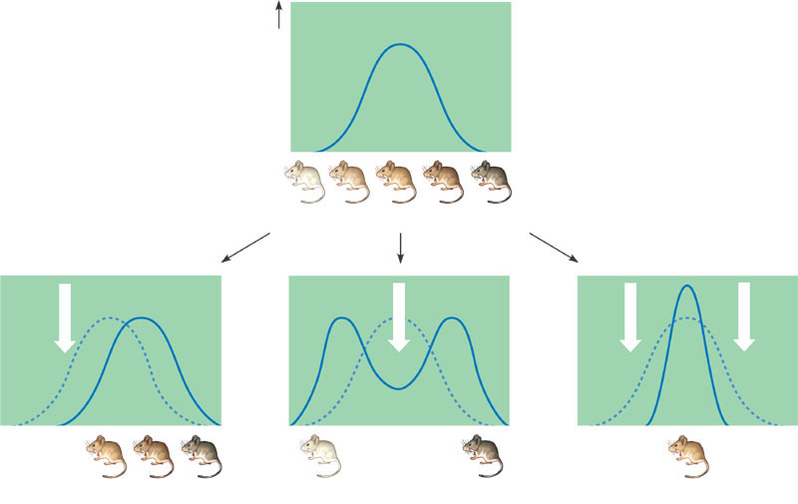
Modes of Selection
Original population
Frequency of individuals
Original
population
Evolved
population
Phenotypes (fur color)
Directional
Disruptive
Stabilizing
These mice have colonized a
patchy habitat made up of light
and dark rocks, with the result
that mice of an intermediate
color are at a disadvantage.
In this case, darker mice are favored
because they live among dark
rocks and a darker fur color conceals
Them from predators.
If the environment consists of
rocks of an intermediate color,
both light and dark mice will
be selected against.

Slide 10
Causes of Evolution
3. Mating Preferences - Organisms usually do not choose their mates at random, thus the selection process can cause evolution
4. Gene Flow - Transfer of genes between different populations of organisms. This situation leads to increased similarity between the two populations (Tends to reduce differences between populations over time)
5. Genetic Drift (Founder Effect & Bottleneck) - Situation that results in changes to a population's gene pool caused by random events, not natural selection. This situation can have drastic effects on small populations of individuals. Common on islands.

Slide 11
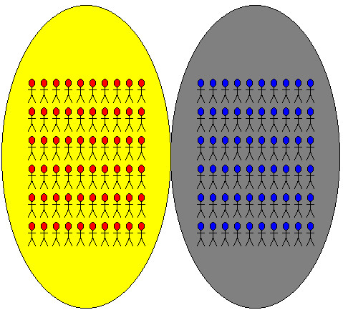
Gene Flow

Slide 12
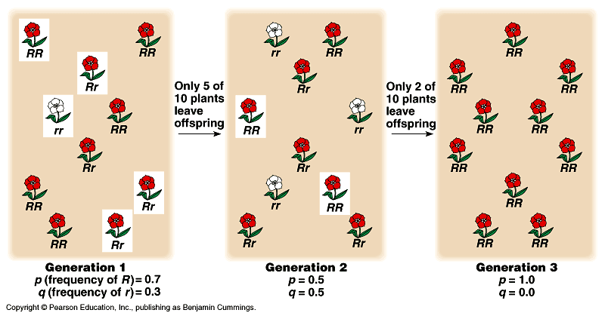
Genetic Drift

Slide 13
Founder effect:
the alleles that are present in the organisms that colonize an area are the only alleles that can be inherited

Slide 14
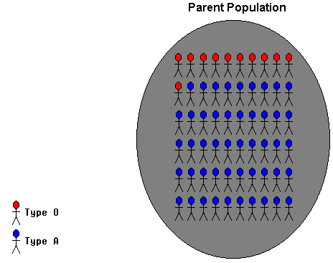
Founder Effect

Slide 15
Bottleneck
Happens when a small selection of a population is isolated from the whole population.

Slide 16
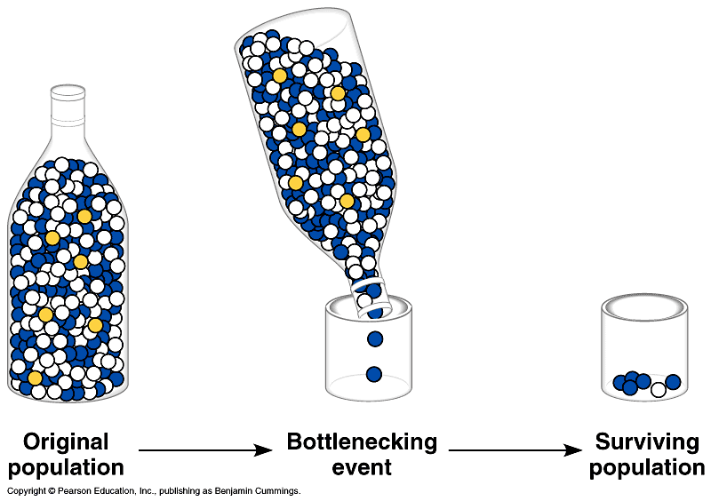
Bottleneck Effect

Slide 17
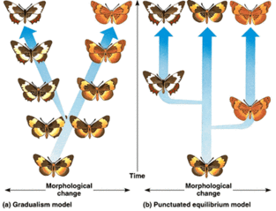
Rate of Evolution

Slide 18
Rates of Evolution
1. Punctuated equilibrium: Sudden changes in the environment after long periods of no change. Species remain the same for long periods of time and then suddenly change into new species.
Fossil record: find one species in one layer and then suddenly it is gone and a new, different one is found in the next layer.
2.Gradualism: Very gradual changes occurring in the environment that cause very gradual changes in species. Small changes add up to big changes over time.
Fossil record: each layer contains fossils that resemble fossils in next layer and the next, etc. small changes in each layer.

