Slide 1
Part IV:
Types of Evolution
Extinction

Slide 2
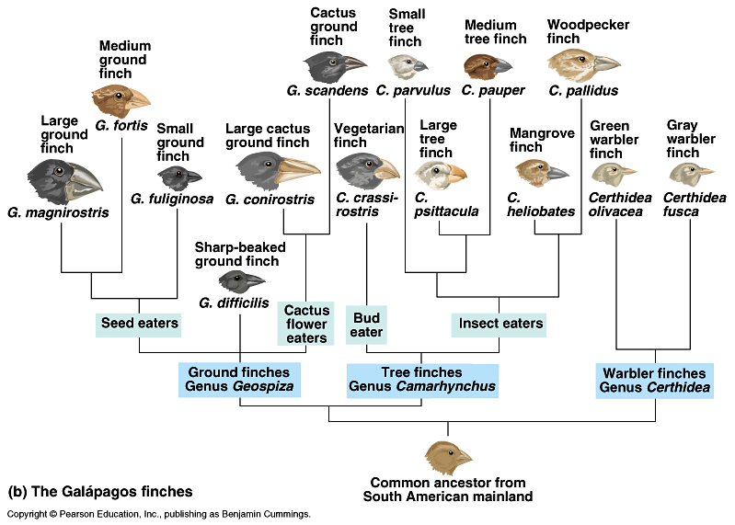
Types of Evolution
1. Divergent Evolution - Multiple species of organisms descended from the same common ancestor at some point in the past.
Method of evolution accounting for the presence of homologous structures.
Adaptive Radiation – organisms change into a variety of new forms, particularly when a change in the environment makes new resources available, creates new challenges, or opens new environmental niches.
Ex. Darwin’s finches

Slide 3
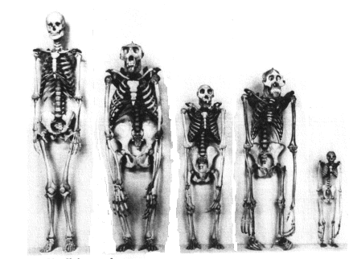

Slide 4
2. Convergent Evolution - Because certain adaptations are more advantageous in different environments, unrelated organisms that live in similar environments will have similar features that perform similar functions.
Method of evolution accounting for the presence of analogous structures.
Ex. Dolphins and shark

Slide 5
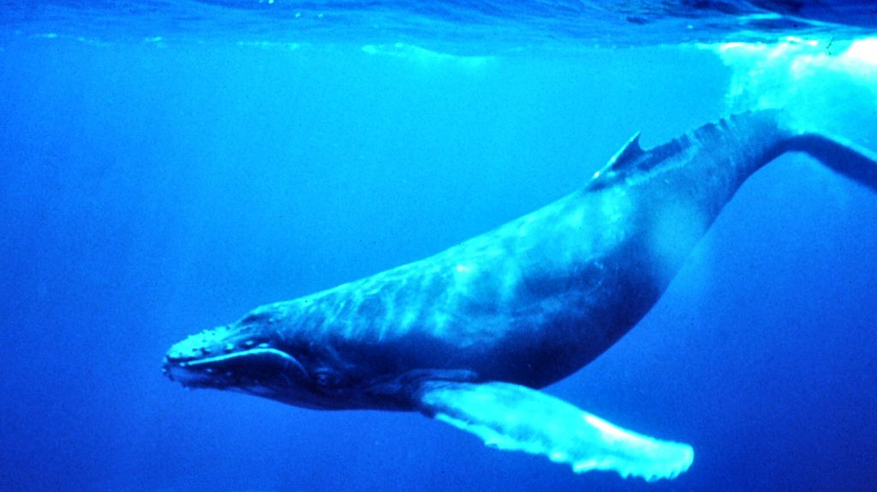
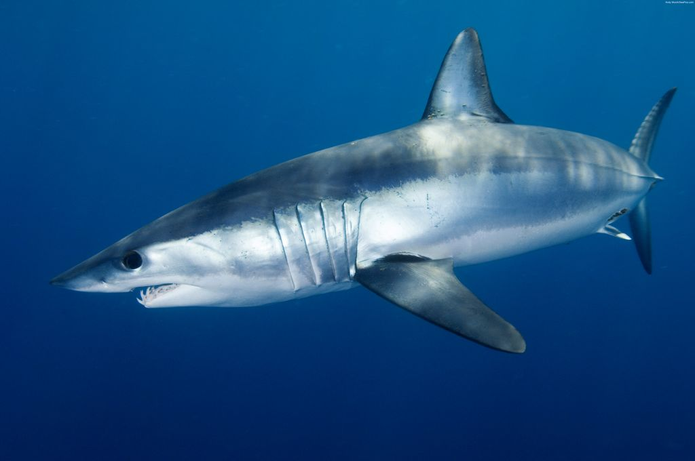
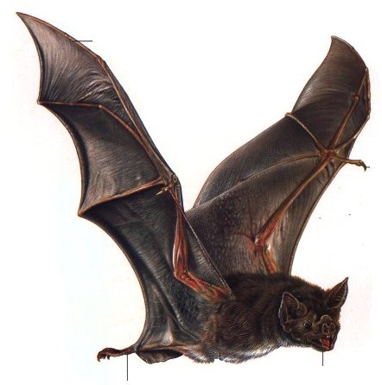

Slide 6
3. Coevolution –Organisms that are closely connected evolve together.
Method of evolution accounting for specialists.
Ex. Monarch butterfly and milkweed plants
Insects and flowers

Slide 7
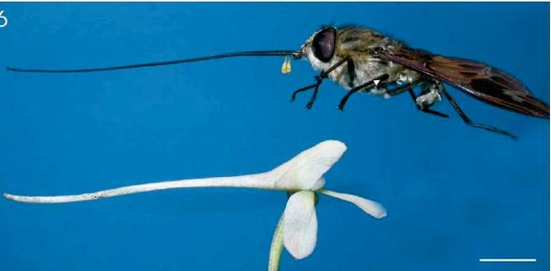
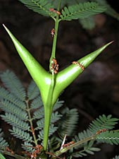
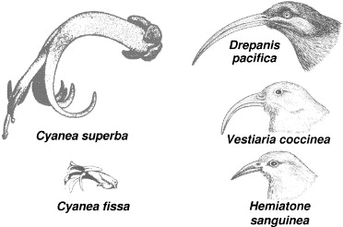

Slide 8
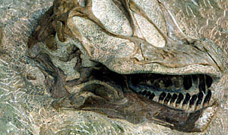
Extinction
As the environment changes, organisms must have variations (adaptations) that will determine whether they can survive with the changes or they can’t and they die.
If an entire species cannot adapt, that species will then become extinct.
No More, Finished, Bye-Bye!
Notes:
Photo – National Park Service – Dinosaur National Monument

Slide 9
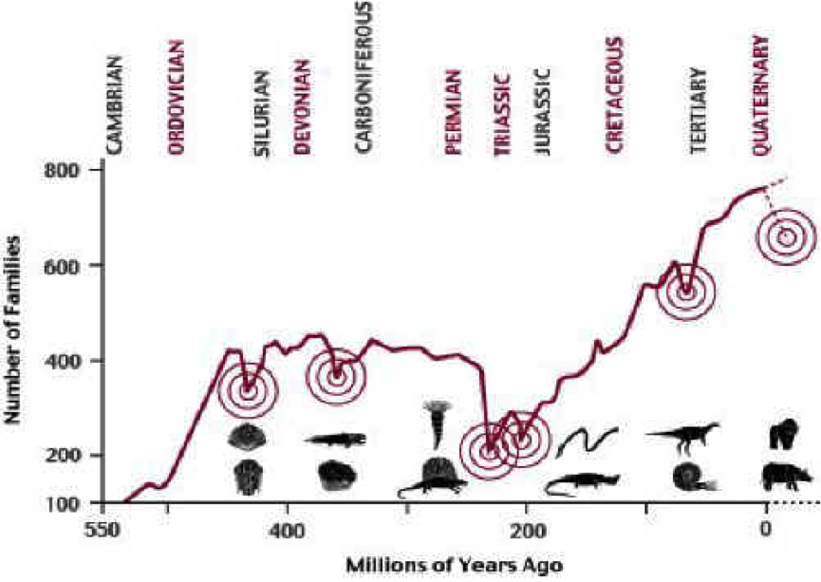
Mass Extinction
There have been at least 5 MASS extinctions during Earth’s history where a huge % of the living species were destroyed
Notes:
For an article on mass extinctions and the % of loss, see
http://www.space.com/scienceastronomy/planetearth/extinction_sidebar_000907.html
Photo courtesy of Donald E. Davis, also in public domain from NASA.

Slide 10
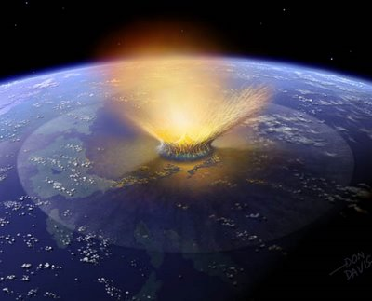
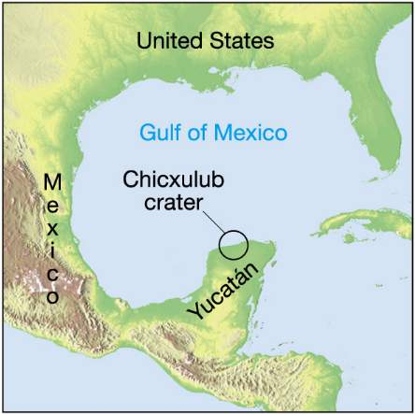
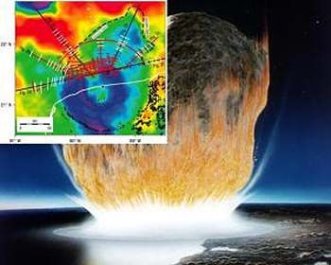
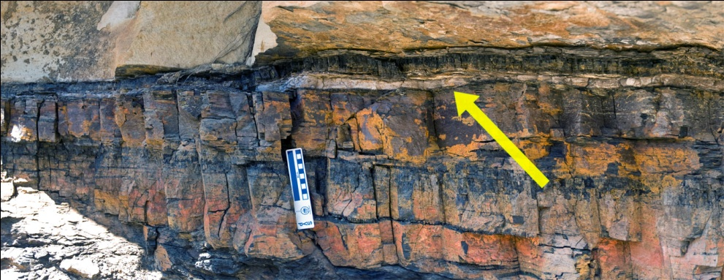
At least one of these mass extinctions has been attributed to meteor impact and it’s consequences.

Slide 11
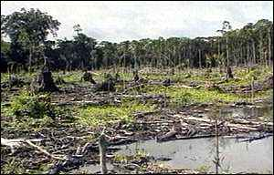
Many scientists say that the earth is currently experiencing a mass extinction crisis.
It is estimated that 1/5 or more of the world’s species will become extinct if the rainforests are destroyed.
Notes:
Photo – Clearcut in Cameroon rainforest. - Earth Crash Earth Spirit - http://www.eces.org/archive/gallery/forestsgfx/forests39.shtml

