Slide 2
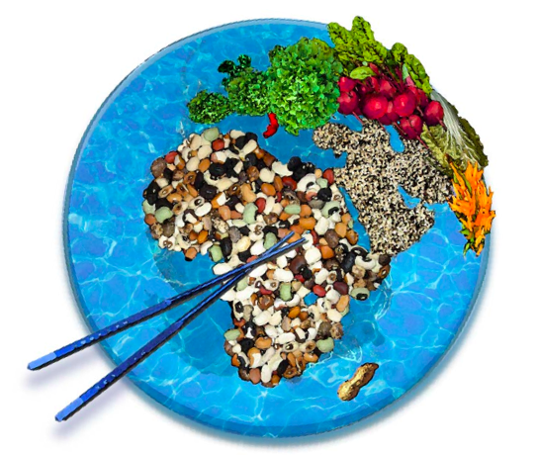
Feeding the World
Food and Agriculture

Slide 3
Think, Pair, Share
Is there enough food available in the world to feed everyone?
Hypothesize why everyone does not get enough food?

Slide 4
Think, Pair, Share
Is there enough food available in the world to feed everyone?
There may not be enough food to feed everyone fully nutritious diets, but there may be enough to prevent starvation.
About 925 million people are undernourished each day out of a human population of about 6.8 billion.
Hypothesize why everyone does not get enough food.
Unequal distribution of resources
Environmental factors

Slide 5
Humans and Nutrition
The Human body uses food for
A source of energy
A source for building and maintaining body tissues
1 Calorie = 1,000 calories or 1 kilocalorie
The major nutrients we get from foods are
Carbs
Proteins
Lipids

Slide 6
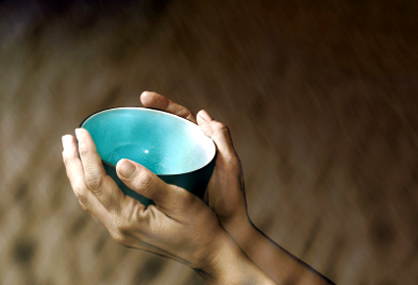
Malnutrition
A condition that occurs when people do not consume enough Calories or do not eat a sufficient variety of foods to fulfill all of the body’s needs.
Famine – widespread starvation caused by a shortage of food.

Slide 7
Sources of Nutrition
Diet: the type and amount of food that we eat.
A healthy diet maintains a balance of the right amounts of:
Nutrients
Minerals
Vitamins

Slide 8
Diets Around the World
Grains are the foods produced in the greatest amount worldwide.
Diets vary by geographic region.
People in more developed countries tend to eat more food and larger portions of proteins and fats than people in less developed countries.

Slide 9
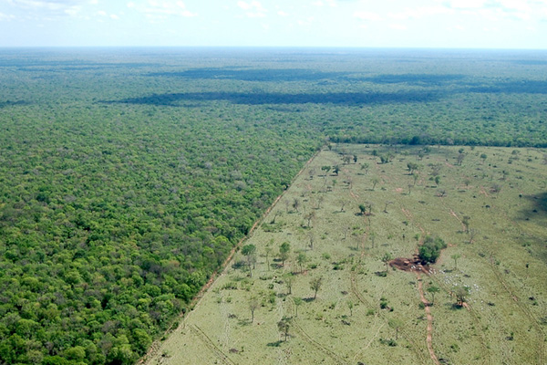
The Ecology of Food
“As the human population grows, farmland and suburbs replace forest and grasslands. Feeding everyone while maintaining natural ecosystems becomes more difficult.”

Slide 10
Production vs. Population
How can grain production increase while grain per person decreases?

Slide 11
Food Efficiency
Efficiency is a measure of the quantity of the food produced on a given area of land with limited inputs of energy and resources.
An ideal food crop:
Produces a large amount of food
Little environmental impact

Slide 12
Food Efficiency
More energy, water, and land is needed to produce a Calorie of food from animals than from plants.
Thus a given area of land generally produces more food for humans when it is used to grow plants than to raise animals.
However, meat generally provides more nutrients per gram than most plants.

Slide 13
Food Efficiency
Yield is the amount of food that can be produced in a given area.
Ideally, we are interested in crops that:
Produce a high yield
Can thrive in various climates
Do not require large amounts of
Fertilizer
Pesticides
Fresh water

Slide 14
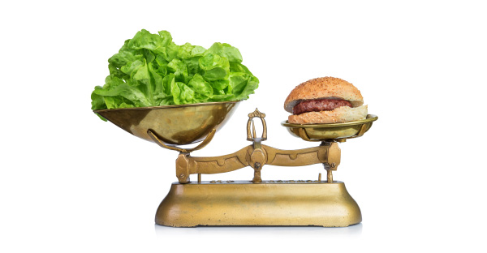
World Food Problems
“The world’s farmers produce enough grain to feed up to 10 billion people an adequate vegetarian diet. However, no one is satisfied with eating just the minimal amount of food needed for survival. And, many of us consume about a third of our Calories from animals, not grains.”

Slide 15
Poverty and Violence
Poverty and violence are some of the main causes of malnutrition
People who lack money and security do not have the necessary resources to purchase adequate amounts of food.
Diverting crops to use for biofuel can contribute to malnutrition. (?)

Slide 16
The Green Revolution
Between 1950 and 1970 Mexico and India increased their grain/rice production significantly using the same amount of land. -> Green Revolution
They were using new varieties of grain. (GMOs?)
Would produce a large yield if:
Enough water
Fertilizer
Pesticides
<-Lowered the price of food and improved quality of living.

Slide 17
Norman Borlaug and The Green Revolution
http://www.youtube.com/watch?v=Lg9-HTtgFOk

Slide 18
The Green Revolution - Limitations
Large farms benefitted/small, subsistence farmers suffered.
Must have money and space to acquire water, materials, machinery.

