Slide 1
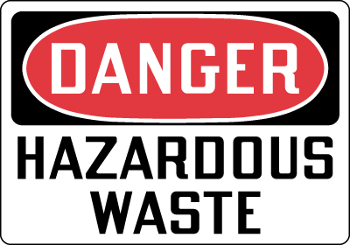
Hazardous Waste
Any waste that is a risk to the health of humans and other living things.
For note taking purposes:
abbreviated HW

Slide 2
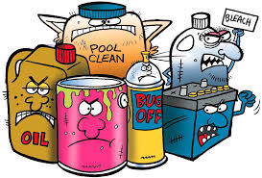
Types of Hazardous Waste
Solid, liquid, or gas
Contain toxic, corrosive, or explosive materials.

Slide 3
Love Canal
Located in Niagara Falls, New York
Dumping site in 1920s
Purchased by the Niagara School Board for $1.00
In the 1970s hw began to come to the surface that had been stored in the canal.

Slide 4
Love Canal
Caused many serious health problems.
Asthma, Dizziness, Blurred Vision, Seizures, Miscarriages, Birth defect, Cancer
Families were ordered to evacuate.
The state purchased the homes and paid for their relocation.
Declared a federal disaster area.

Slide 5
The Resource Conservation and Recovery Act
RCRA
Requires producers of HW to keep records of how their wastes are handled from creation to disposal.
Requires all HW treatment plants to be built and operated according to standards that protect the environment.

Slide 6
The Superfund Act
Comprehensive Environmental Response, Compensation, and Liability Act (CERCLA)
Allows EPA to sue the owners of HW sites who illegally dump waste.
Forces site owners to pay for the cleanup
$$$$

Slide 7
Superfund Sites in Texas: 49? In US: 41,400+
ADCO-Avinger Development Company
Air Force Plant #4
Aztec Ceramics
Bailey Waste Disposal
Bio-Ecology Systems, Inc.
Brio Refining
Col-Tex Refinery
Crystal Chemical
Dixie Oil Processors
Federated Metals
First Quality Cylinders
French Limited
Geneva Industries
Gulf Metals Industries
Hall Street
Harris Sand Pits
Harvey Industries
Higgins Wood Preserving
Highlands Acid Pit
Houston Lead
Houston Scrap
J C Pennco
JCS Company
Jensen Drive Scrap
Kingsland (main entrance of southeast plume)
La Pata Oil Company
Many Diversified Interests, Inc.
Materials Recovery Enterprises
McNabb Flying Service
MOTCO, Inc.
North Cavalcade
Pesses Chemical Company
Petrochemical Systems, Inc. (Turtle Bayou)
Phipps Plating
Rockwool Industries, Inc.
RSR Corp. (Murph Metals)
Sheridan Disposal
Sikes Disposal Pits
Sol Lynn/Industrial Transformer
Solvent Recovery Services
South Cavalcade
State Marine
Tex-Tin
Texas American Oil
Triangle Chemical
United Creosoting

Slide 8
Hazardous Waste Management
Preventing HW:
Produce less of it
Find alternatives
Find a way to recycle or reuse it
“One mans trash is another man’s treasure”

Slide 9
Hazardous Waste Management
Land Disposal
Deep-well injections: wastes are pumped deep into the ground, absorbed into a dry layer of rock below the level of ground water.
Surface impoundment: sealed bottom pond evaporation system
Some solid or concentrated wastes are stored in barrels and either buried or stored in HW landfills.

Slide 10
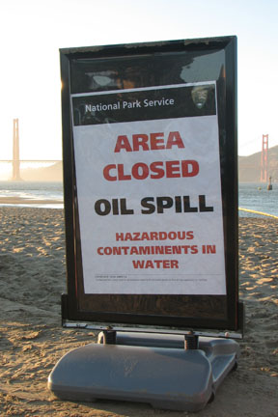
Remediation
Remediation: some HW can be cleaned up absorbed or broken down by treatment with biological and chemical agents.
Bacteria – oil spills
Plants – absorb heavy metals

Slide 11
Incinerating Hazardous Waste
Incineration is the most expensive form of waste disposal.
Requires a lot of energy
Must closely monitor hazardous gases

Slide 12
Exporting Hazardous Waste
Can be sent to foreign countries because there may be a facility for treating, disposing of, or recycling waste located there.

Slide 13
Hazardous Waste at Home
Hazardous materials are often poured down the drain or put in the trash.
Must go to special HW facilities.
http://austintexas.gov/what-do-i-do

