Slide 1
Planning a Community!
With your table group: design a community on your plot of land
Take into consideration your prior knowledge of Environmental Systems when making your decisions.
Trace the patterns, please do not glue them down. I will reuse them!
Be prepared to present your community and justify your choices!

Slide 3
NY Times: Love Canal
https://www.youtube.com/watch?v=yRVCFT2rUQY
https://www.youtube.com/watch?v=LkgE0_OOqso

Slide 4
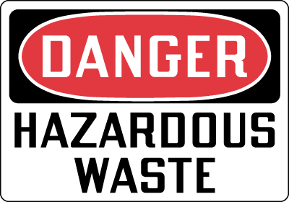
Hazardous Waste
Any waste that is a risk to the health of humans and other living things.

Slide 5
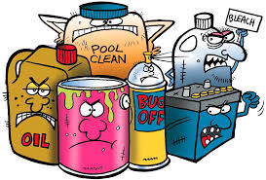
Types of Hazardous Waste
Contain toxic, corrosive, or explosive materials.

Slide 6
Love Canal
Located in Niagara Falls, New York
Dumping site in 1920s
Purchased by the Niagara School Board for $1.00
In the 1970s hazardous waste began to come to the surface that had been stored in the canal.

Slide 7
Love Canal
Caused many serious health problems.
Asthma, Dizziness, Blurred Vision, Seizures, Miscarriages, Birth defect, Cancer
Families were ordered to evacuate.
The state purchased the homes and paid for their relocation.
Declared a federal disaster area.

Slide 8
Were there any positive outcomes?

Slide 9
The Resource Conservation and Recovery Act
Aka: RCRA
1976
Gives EPA the authority to control hazardous waste from the "cradle-to-grave.“
generation, transportation, treatment, storage, and disposal

Slide 10
Comprehensive Environmental Response, Compensation, and Liability Act
Aka: CERLA or Superfund
1980
Provides a Federal "Superfund“ to clean up uncontrolled or abandoned hazardous-waste sites as well as accidents, spills,
Gives EPA power to find parties responsible and assure their cooperation in the cleanup.

Slide 11
Superfund Sites in Texas: 49? In US: 41,400+
ADCO-Avinger Development Company
Air Force Plant #4
Aztec Ceramics
Bailey Waste Disposal
Bio-Ecology Systems, Inc.
Brio Refining
Col-Tex Refinery
Crystal Chemical
Dixie Oil Processors
Federated Metals
First Quality Cylinders
French Limited
Geneva Industries
Gulf Metals Industries
Hall Street
Harris Sand Pits
Harvey Industries
Higgins Wood Preserving
Highlands Acid Pit
Houston Lead
Houston Scrap
J C Pennco
JCS Company
Jensen Drive Scrap
Kingsland (main entrance of southeast plume)
La Pata Oil Company
Many Diversified Interests, Inc.
Materials Recovery Enterprises
McNabb Flying Service
MOTCO, Inc.
North Cavalcade
Pesses Chemical Company
Petrochemical Systems, Inc. (Turtle Bayou)
Phipps Plating
Rockwool Industries, Inc.
RSR Corp. (Murph Metals)
Sheridan Disposal
Sikes Disposal Pits
Sol Lynn/Industrial Transformer
Solvent Recovery Services
South Cavalcade
State Marine
Tex-Tin
Texas American Oil
Triangle Chemical
United Creosoting

Slide 12
Hazardous Waste Management
Land Disposal
Deep-well injections: wastes are pumped deep into the ground, absorbed into a dry layer of rock below the level of ground water.
Surface impoundment: sealed bottom pond evaporation system
Some solid or concentrated wastes are stored in barrels and either buried or stored in HW landfills.

Slide 13
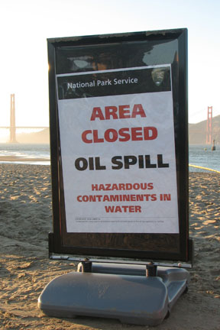
Remediation
Remediation: some Hazardous Waste can be cleaned up absorbed or broken down by treatment with biological and chemical agents.
Bacteria – oil spills
Plants – absorb heavy metals

Slide 14
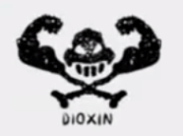
Incinerating Hazardous Waste
Incineration is the most expensive form of waste disposal.
Requires a lot of energy
Must closely monitor hazardous gases

Slide 15
Exporting Hazardous Waste
Can be sent to foreign countries because there may be a facility for treating, disposing of, or recycling waste located there.
NIMBY???

Slide 16
“Uh, Ms. Hall, What does this have to do with me? What am I suppose to do about it?”

Slide 17
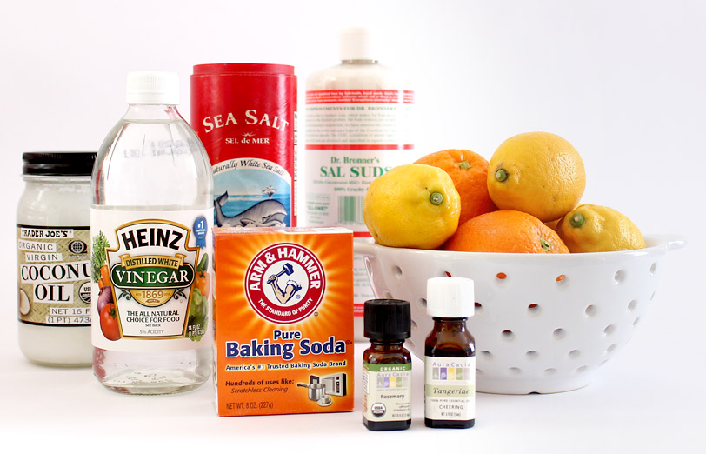
Hazardous Waste Management
Preventing Hazardous Waste:
Produce less of it
Find alternatives
Find a way to recycle or reuse it

Slide 18
Hazardous Waste at Home
Hazardous materials are often poured down the drain or put in the trash.
Must go to special Hazardous Waste facilities.
http://austintexas.gov/what-do-i-do

