Slide 1
Quick Write
Respond to the following statement:
True or False?
“An ecosystem has historical aspects; the present is related to the past, and the future is related to the present.”

Slide 2
Pahoa Lava Flows
http://www.nbcnews.com/watch/nightly-news/pahoa-lava-flow-in-hawaii-threatens-homes-349641283955

Slide 3
Imagine your house was overcome with lava and has just burnt down.

Slide 4
1.) Day of disturbance 2.) Five years later
3.) 20 years later 4.) 50 years later

Slide 5
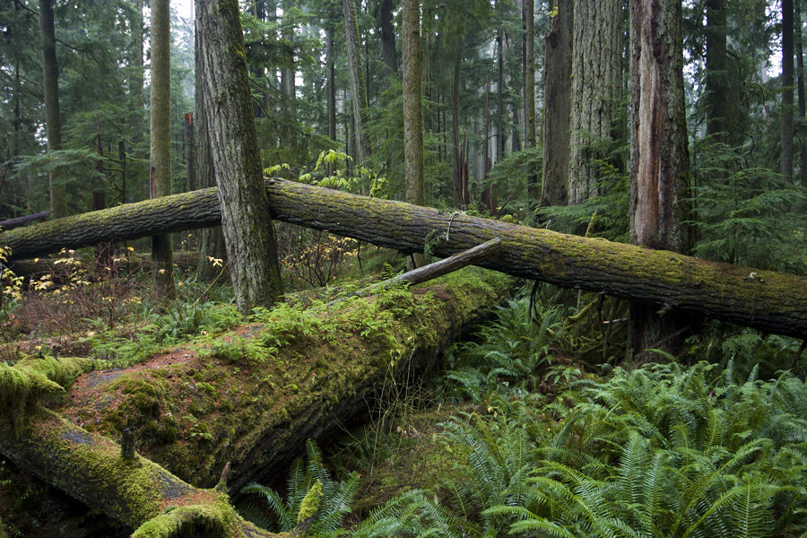
How Ecosystems Change

Slide 6
Ecological Succession
Ecological Succession is a gradual process of change and replacement of some or all of the species in a community.
Can take 100s or 1000s of years.

Slide 7
Summary of Succession
Step 1) A major disaster occurs such as a wildfire destroying plant life Step 2) Smaller plants "pioneer" the land and make the area suitable for larger life in the future Step 3) More "advanced" life take over land. Example= trees taking land from bushes Step 4) Eventually a peak of growing can be reached where life returned to the original state, or is complete Step 5) The same disaster stuff could happen again.

Slide 8
Ecological Succession

Slide 9
There are two different types of succession:
Primary
Secondary

Slide 10
Primary Succession
Primary Succession is succession that begins in an area that previously did not support life.
Like on rocks or sand dunes.
Islands created by volcanic eruptions.
Happens very slowly because it beings where there is no soil. (it takes a long time to produce fertile soil naturally.)

Slide 11
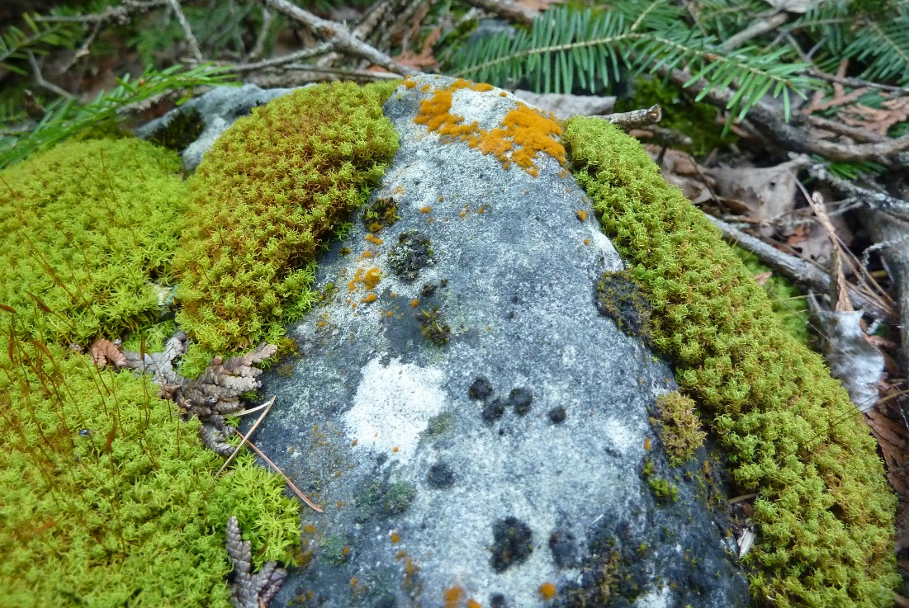
Pioneer Species
Pioneer Species is a species that colonizes an uninhabited area and begins the process of primary succession.
Example: Lichens: a fungus and an algae, can begin to breakdown rock.
Rocks are also broken down by water, air, plants, and decayed organisms.

Slide 12
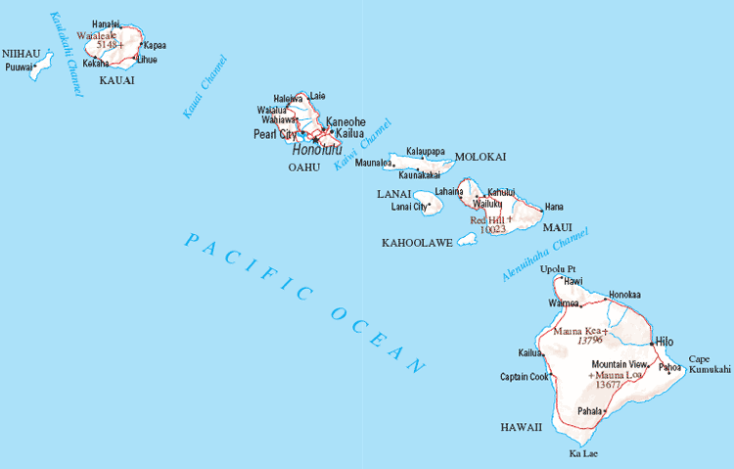
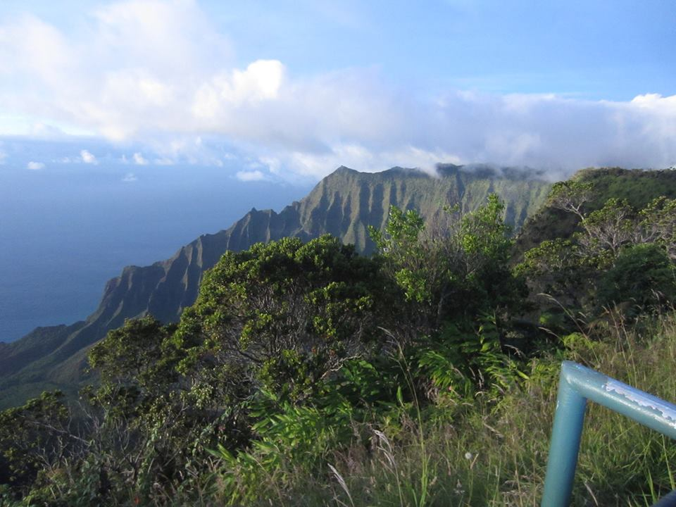
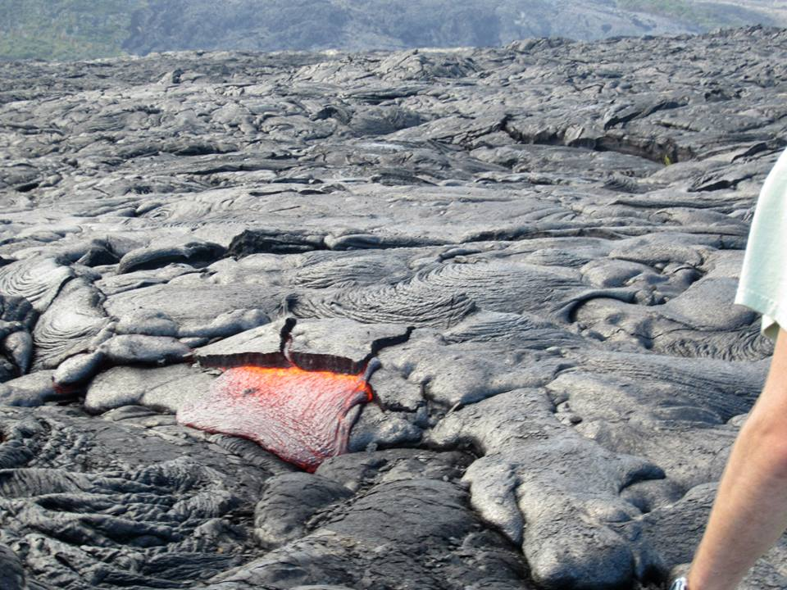

Slide 13
Secondary Succession
Secondary succession occurs in areas where an ecosystem has previously existed.
For example, ecosystems that have been disrupted or partially destroyed
by animals, humans, or natural processes like storms.
Pioneers species colonize first, then over time, more stable species become established.
A climax community is a final and stable community.

Slide 14
Case Study: Communities Maintained by Fire
Take the lecture quiz.
Turn it into the drawer.
Read the case study.
Answer the questions in your field journal.
Be ready to discuss.

