Slide 2
What is a public space?

Slide 3
What is a public space?
A public space is a social space that is generally open and accessible to people.

Slide 4
PUBLIC SPACES UNIT: essential questions
What is a public space, who uses it, and how is it used?
How do vibrant and interactive public spaces contribute to a community?

Slide 5
PUBLIC SPACES
What are some example of public spaces in our community?

Slide 6
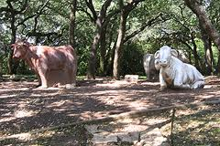
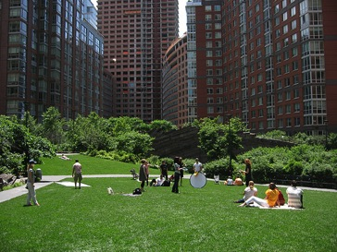
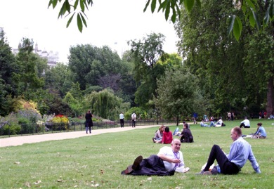
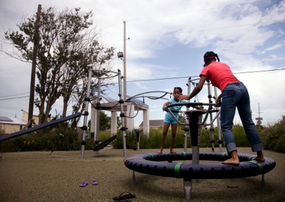
Parks
Notes:
Point out to the students some of the features and benefits of public parks: natural or planted areas, used for recreation and fitness, etc. Take a moment to have a short discussion about who uses public parks and why they use them.
IMAGE park 2 guys front http://www.pps.org/refocusing-attention-on-public-green-spaces-in-england/
IMAGE playscape: http://miamieverydayphoto.blogspot.com/2008_01_01_archive.html
IMAGE city park w/ bldg: http://switchboard.nrdc.org/blogs/kbenfield/tpl_publishes_comprehensive_da.html
IMAGE arboretum austin: http://blog.lamadeleine.com/2012/07/10/best-salades-in-austin/

Slide 7
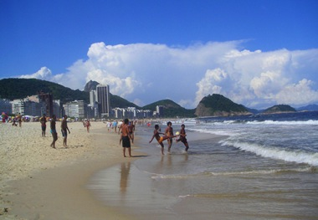
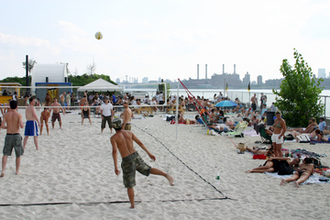
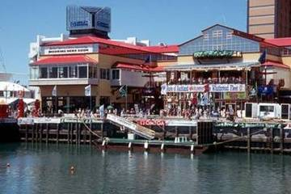
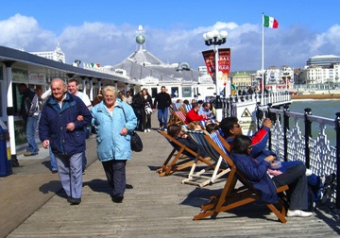
Beaches & Waterfronts
Notes:
Point out to the students some of the features and benefits of waterfronts and beaches: cultural centers of trade, travel, leisure, exercise, etc. Take a moment to have a short discussion about who uses beaches and waterfronts and why they use them.
Image 1: beach Photo by Claudia Fogg, http://www.hotels.com/articles/ar000551/top-10-waterfront-cities-in-the-world/
Image 2: waterfront http://www.pps.org/reference/10_qualities_of_a_great_waterfront/
Image 1: Photo by Claudia Fogg, http://www.hotels.com/articles/ar000551/top-10-waterfront-cities-in-the-world/
Image 2: http://www.pps.org/reference/10_qualities_of_a_great_waterfront/

Slide 8
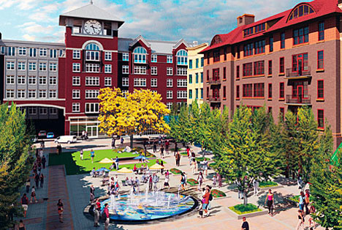
Public Spaces
Town Square
Notes:
Town Square: Talk with students about town squares are used for community gatherings and often feature a fountain or central statue.
Image: http://www.cooltownstudios.com/2006/11/27/the-piazzas-are-coming

Slide 9
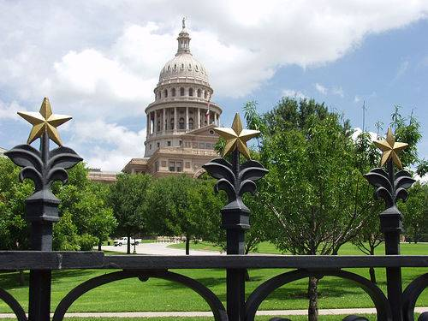
Public Spaces
Civic Centers
Notes:
Talk with students about how civic centers are constructed areas used as community focal points that contain dominant public buildings and multipurpose venues. This is the Austin Capitol. Talk with kids about their experience visiting the Capitol.
Image: http://www.topix.com/album/detail/austin/FP77GTTCHEVAQV6K

Slide 10
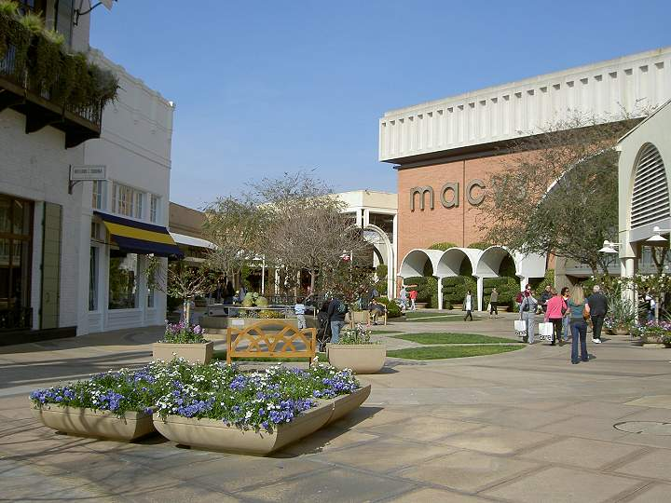
Public Spaces
Malls & Markets
Notes:
Talk with students about how malls as markets are groups of shops or stalls that could be indoor or outdoor; people can easily walk between them. Ask kids if they can identify one green feature in a mall (motion sensed lighting, solar panels, plantings, etc.)
Image: http://rhorii.com/Stanford/Stanford-Neighborhood.html

Slide 11
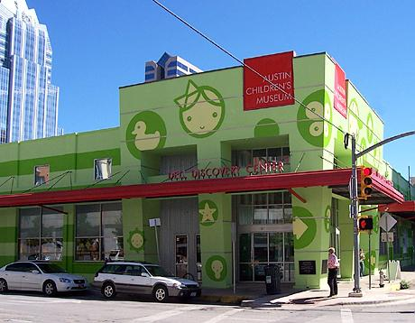
Public Spaces
Museums
Notes:
Talk with students about how museums care for various collections (art, history, culture, science) and make the available to the public.
Image: http://centraltexasmurals.com/business/austin-childrens-museum/

Slide 12
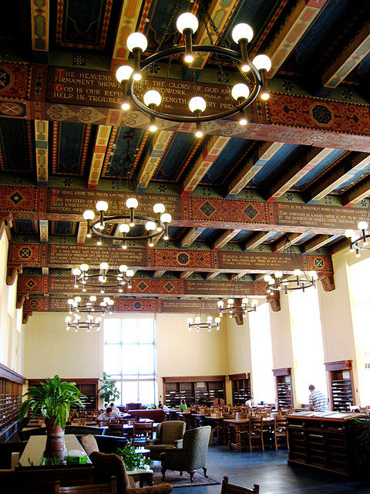
Public Spaces
Public Libraries
Notes:
Talk with students about how public libraries house books and media collections. Ask them if the know the location of the nearest library in their neighborhood.
Image: http://www.campusgrotto.com/more-beautiful-college-libraries.html

Slide 13
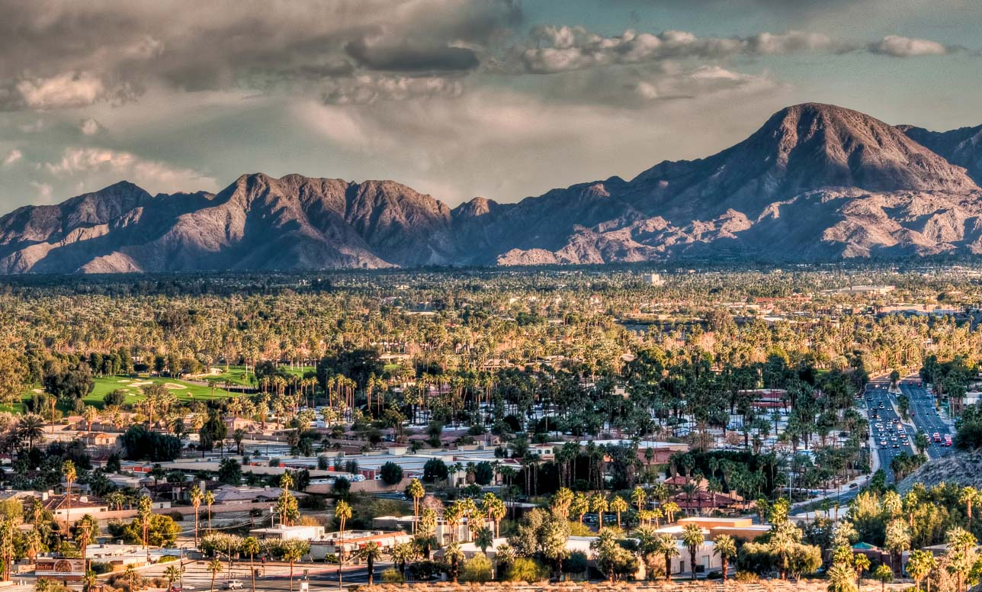
How We Use Land

Slide 14
Land Use and Land Cover
We use land for many purposes
Farming, mining, recreation, buildings, highways, etc.
Land cover is what you find on a piece of land.
Types of land cover depend on how the land is used.

Slide 15
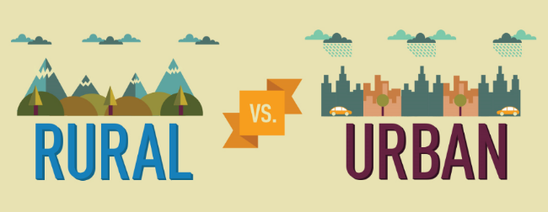
Rural vs. Urban
Land that contains relatively few people and large areas of open space is Rural
Land that is covered mainly with buildings and roads is urban.
An area that contains 2,500+ people and usually have a governing body.

Slide 16
Rangeland:
Land used to graze livestock and wildlife.
27% of U.S. Land Cover
Source: United States Department of Agriculture.

Slide 17
Forest Land:
Land used for growing and harvesting wood, and harvesting wildlife, fish, nuts, and other resources.
30% of U.S. Land Cover
Source: United States Department of Agriculture.

Slide 18
Farm or cropland:
Land used to grow plants for food or fiber
18% of U.S. Land Cover
Source: United States Department of Agriculture.

Slide 19
Parks and Preserves:
Land used for recreation, scenic enjoyment, and for preserving native animal and plant communities and ecosystems.
14% of U.S. Land Cover
Source: United States Department of Agriculture.

Slide 20
Wetlands, mountains, deserts, and other
Land that is difficult to adapt for human use.
8% of U.S. Land Cover
Source: United States Department of Agriculture.

Slide 21
Urban Land:
Land used for houses, businesses, industry, and roads.
3% of U.S. Land Cover
Source: United States Department of Agriculture.

Slide 22
Where We Live
Until about 1850, most people lived in rural areas.
The Industrial Revolution replaced many rural occupations with machinery.
People moved to cities to find jobs.

Slide 23
The Urban-Rural Connection
Even if people live in an urban area, they still depend on resources produced in rural areas.
Ecosystem services are resources produced by natural and artificial ecosystems.

Slide 24
Supporting Urban Areas
The area of rural land needed to support one person depends on many factors, such as:
Climate
Standard of living
How efficiently resources are used

Slide 25
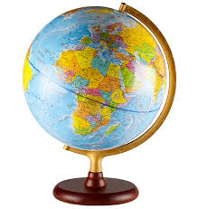
Supporting Urban Areas: Comparisons
Average person in a developed nation uses ecosystem services provided by 8 hectares of land and water.
The average American: 12 hectares
The average German: 6 hectares
Some developing countries: <1 hectare.
Note: 1 hectare = 2.47 acres

