Slide 1
Isotopes

Slide 2
If you change the number of… | It will affect the… | And the result will be…
Protons | Atomic number | A different element

Slide 3
If you change the number of… | It will affect the… | And the result will be…
Protons | Atomic number | A different element
Electrons | Charge | An Ion

Slide 4
If you change the number of… | It will affect the… | And the result will be…
Protons | Atomic number | A different element
Electrons | Charge | An Ion
Neutrons | Atomic Mass | An Isotope

Slide 5
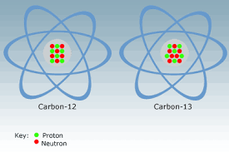
Isotopes
Are atoms that have the same number or protons but a different number of neutrons

Slide 6
Isotopes
Are atoms that have the same number or protons but a different number of neutrons
Do the number of protons ever change in an isotope?

Slide 7
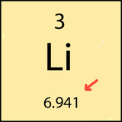
When you change the number of neutrons…
You are changing the atomic mass of the atom!

Slide 8
Why does the atomic mass on the PT have so many decimal places?
Because it is an average of all of the different isotopes of that element!

Slide 9
Think of it like averaging your grades
Homework 1: 90
Homework 2: 100
Quiz 1: 85
Quiz 2: 95
Test 1: 85
HW is worth 20%
Quizzes are worth 30%
Test are worth 50%

Slide 10
Percent Abundance
Is how often something occurs in nature
It is important to consider how much of each isotope of an element exists in nature.
It will affect the average in the same way weighing a test more than a quiz will.

Slide 11
So how do you find the atomic mass of an element?
The formula:
(Mass of isotope 1)(Percent abundance/100)
+
(Mass of isotope 2)(Percent abundance/100)
+
(Mass of isotope 3)(Percent abundance/100)
=
Atomic mass

Slide 12
Let’s work an example together…
(Work example from notes on the board together)

Slide 13
How do you find how many neutrons an isotope has?
Sometimes you will see this notation: Element - #
The number stands for the mass number.
Mass number = protons + neutrons (remember?!)

Slide 14
Examples (first one on your practice handout)
 | Chromium-58 | Chromium-63
Protons
Nuetrons
Electrons

Slide 15
Examples (first one on your practice handout)
 | Chromium-58 | Chromium-63
Protons | 24 | 24
Nuetrons | 34 | 39
Electrons | 24 | 24

