Slide 1
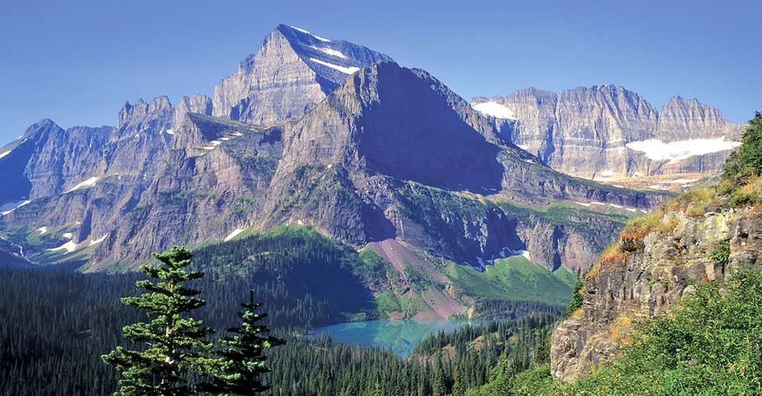
Land Management and Conservation

Slide 2
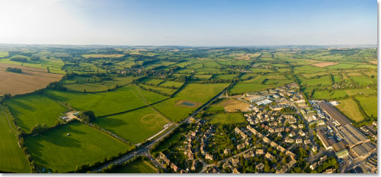
Land Management and Conservation
As populations grow we need more resources to support them.
The condition of rural lands is important because of the ecosystem services they provide.

Slide 3
Farmlands
Threatened by urban development
In 1996, the national Farmland Protection Program was established to protect farmland in danger of being paved over/otherwise developed. (renewed in 2008)

Slide 4
Rangelands
The most common use of rangelands is for grazing of livestock.
Like farmlands, rangeland is essential for maintaining the World’s food supply.

Slide 5
Problems on the Range
Some rangelands in the U.S. Have become degraded by poor land management strategies.
The most damaging is overgrazing: allowing amore animals to graze in an area than the range can support.
More desirable plants are eaten, leaving less desirable plants to invade the area.
In severe cases, all the vegetation is eaten, leaving nothing to keep the soil from eroding.

Slide 6
Maintaining the Range
Limit herds to sizes that do not degrade the land.
Leave land unused so vegetation can recover.
Killing invasive plants
Planting native vegetation
Fencing in areas so they can recover.
Multiple water sources so livestock do not overgraze the vegetation around a single source.

Slide 7
Forest Lands
Trees are harvested for products like paper, furniture, lumber and plywood for homes, etc.
Forests also produce products like maple syrup and turpentine.
Removal of CO₂: carbon sequestration

Slide 8
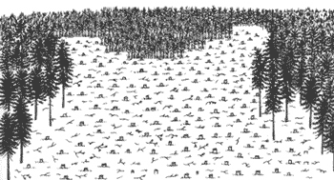
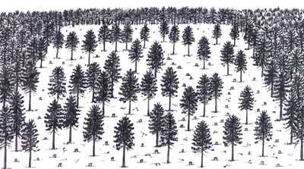
Harvesting Trees
Clear cutting is the process of removing all or most of the trees in an area of land.
Can dramatically change an ecosystem, destroy habitats, and cause soil erosion.
Selective cutting is the process of cutting and removing on certain trees.
More expensive but is usually less destructive and can improve the health of the forest.

Slide 9
Deforestation
The clearing of trees from an area without replacing them.
Places become deforested as populations expand and the demand for forest products increase.
Forests are cleared for farmland, roads, homes, factories, and office buildings.
Causes loss of wildlife habitats, soil erosion, and reduction of soil nutrients.

Slide 10
Reforestation
The process by which trees are planted to re-establish trees that have been cut down in a forest land.

Slide 11
Parks and Preserves
A group of explorers explained to Congress that they found a magnificent expanse of land in Wyoming and Montana.
They were concerned it would be damaged by development.
Congress agreed to protect the land leading to the first national park: Yellowstone.

Slide 12
Wilderness
The U.S. Wilderness Act (1964) designated certain lands as wilderness areas.
Wilderness is an area in which the land and the ecosystems it supports are protected from exploitation.
Wilderness areas are open to hiking, fishing, boating (without motors), and camping.
Building roads or structures and using motorized equipment are not allowed.
Cook Lake in the Bridger Wilderness, Bridger-Teton National Forest, Wyoming, U.S.

Slide 13
How Wolves Change Rivers
https://www.youtube.com/watch?v=ysa5OBhXz-Q

Slide 14
Benefits of a Protected Area
Protect species (and their habitats) that would otherwise be extinct.
Conserve precious resources.
Provide recreation for people.
Places for learning and researching.

Slide 15
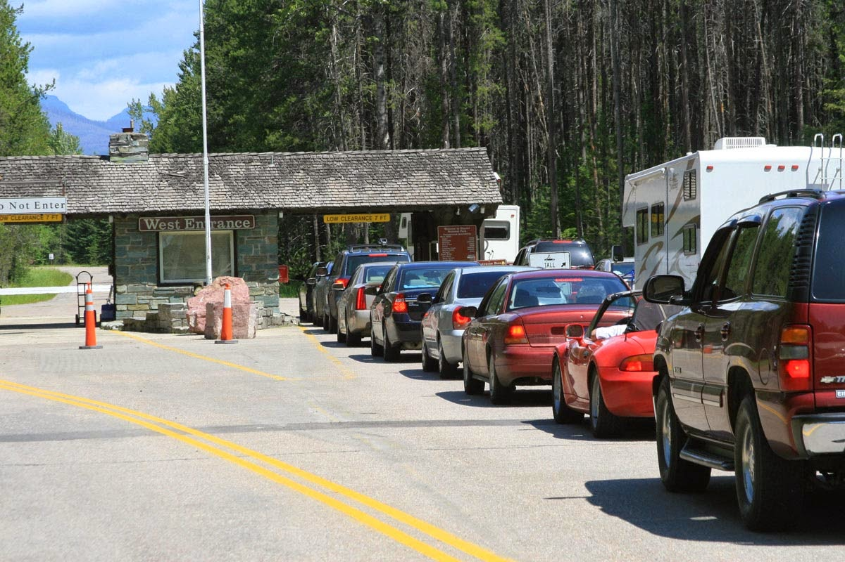
Threats to Protected Areas
More and more people visit parks are wilderness areas each year and leave their mark.
“Loving our parks to death.”
Some of the issues we face in the city, like litter and traffic, have affected our parks.
Leave No Trace Outdoor Ethics

Slide 16
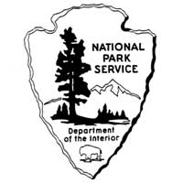
Let’s go on an adventure!

Slide 17
Arches National Park in Utah

Slide 18
Crater Lake National Park in Oregon

Slide 19
Big Bend National Park in Texas

Slide 20
Big Sur National Park in California

Slide 21
Hawaii Volcanoes National Park in Hawaii

Slide 22
Denali National Park in Alaska

Slide 23
Grand Canyon National Park in Arizona

Slide 24
Olympic National Park in Washington

Slide 25
Zion National Park in Utah

Slide 26
Everglades National Park in Florida

Slide 27
Shenandoah National Park in Virginia

Slide 28
Acadia National Park in Maine

Slide 29
Carlsbad Caverns National Park in New Mexico

Slide 30
Red Woods National Park in California

Slide 31
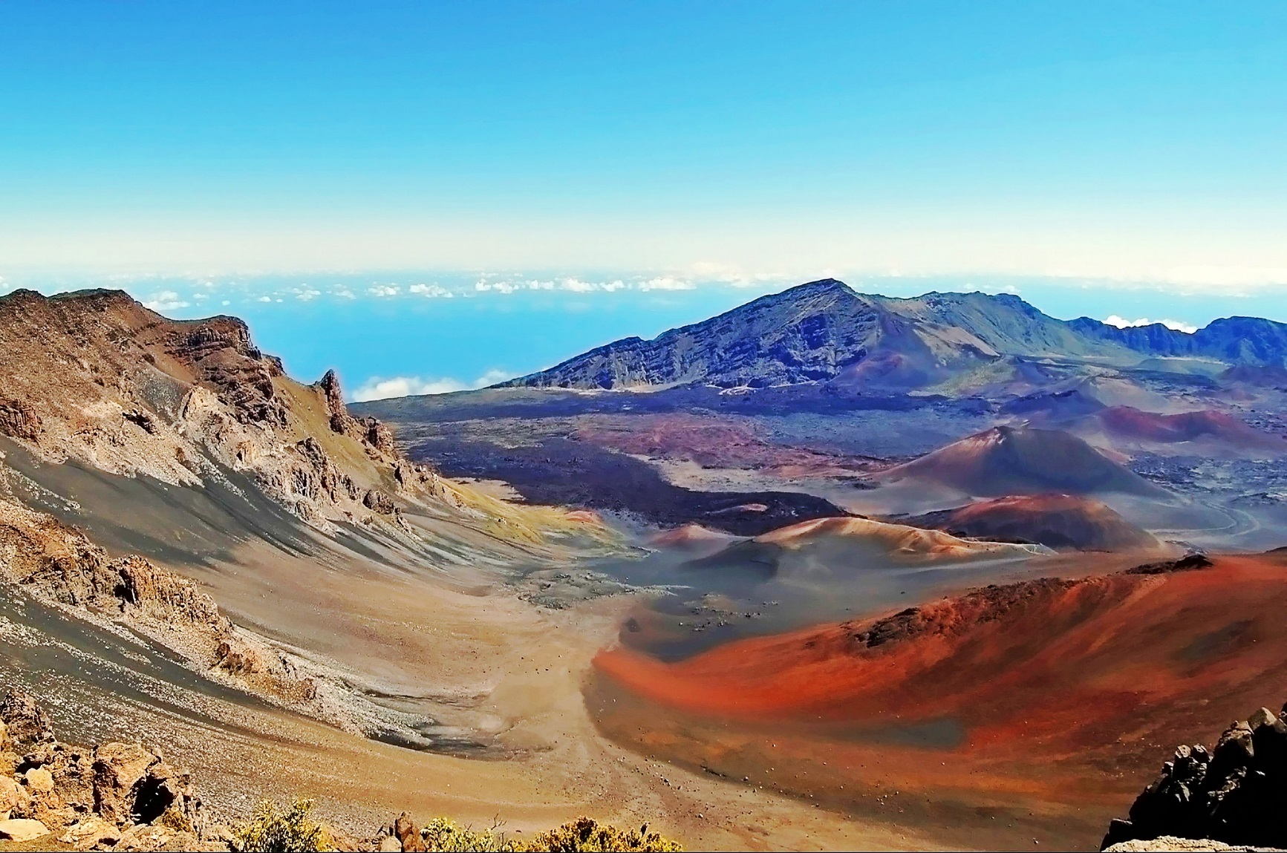
Haleakala National Park in Hawaii

Slide 32
Haleakala National Park in Hawaii

