Slide 1
Mineral and Energy Resources

Slide 2
Salt Mines in Maras, Peru There is a small town near Cusco that owns this salt mine. Each family owns a portion of it and pass it down from generation to generation.

Slide 3
Our guide told us that on average they are able to collect about 50 kilos of salt every 2-3 weeks from each pool. Each Kilo is worth about 2 Soles which is about 65 cents US.

Slide 4
This little spring fed stream provides the water necessary for the entire salt mine.

Slide 5
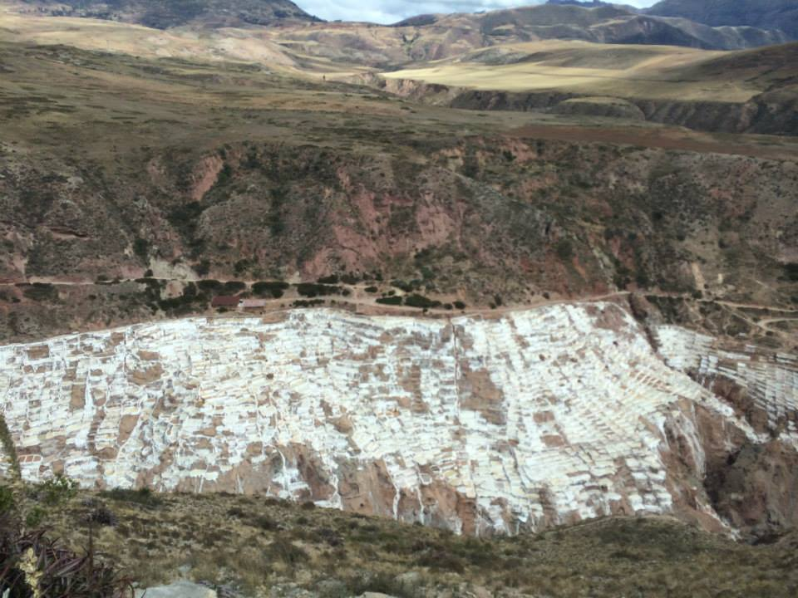

Slide 6
Pictures of Salminas were taken by Ashton Hall and Tiffany Steinkamp.

Slide 7
What is a mineral?
A mineral is a naturally occurring, usually inorganic solid that has a characteristic chemical composition, an orderly internal structure, and a characteristic set of physical properties.

Slide 8
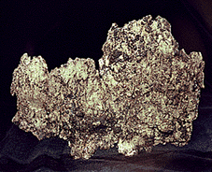
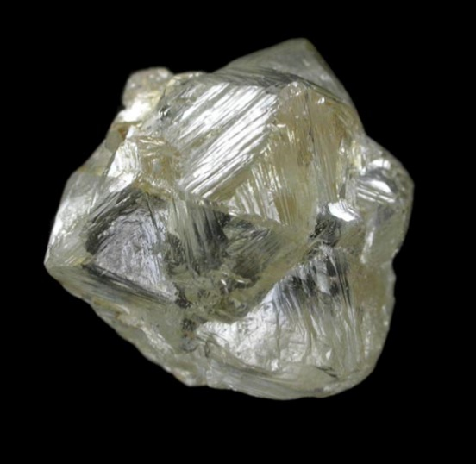
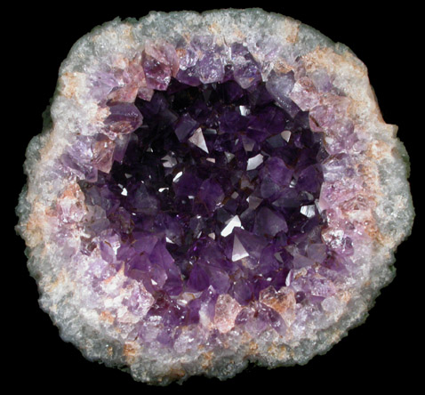
Ore Minerals
Ore minerals are minerals that are valuable and economical to extract.
Metallic Minerals – conduct electricity, have shiny surfaces, and are opaque. Examples: gold and silver
Nonmetallic Minerals – tend to be good insulators, may have shiny or dull surfaces, and may allow light to pass through them. Examples: diamond and amethyst

Slide 9
How do ore minerals form?
Evaporites – when the water in seas or lakes evaporate, deposits of dissolved salts are left behind.
Hydrothermal Solutions – hot, subsurface waters that contain dissolved minerals crystallize out of the solutions to fill fractures called veins.

Slide 10
Mineral Resources and Their Uses

Slide 11
Mineral Exploration
1. Explore rocks for mineralization
2. Rock samples are taken from the area to be analyzed to determine ore quality.
3. Companies will drill test holes.
4. If the ore grade is high enough and the deposit extensive enough, the cost to open a mine may be justified.
Through mineral exploration, mining companies can identify areas where there is a high likelihood of find valuable mineral resources.

Slide 12
Subsurface Mining
Ore deposits that are found 50m+ beneath the surface are mined using subsurface mining methods. (What does the prefix sub mean?)
Examples: Room and pillar mining, longwall mining, solution mining.

Slide 13
Surface Mining
Surface mining methods are used when ore deposits are located close to the surface.
Examples: Open pit mining, surface coal mining, quarrying, solar evaporation.

Slide 14
Undersea Mining
The ocean floor contains mineral resources.
It is cheaper to mine on land than underwater.
It is difficult to mine at great depths.
Not very successful to date.

Slide 15
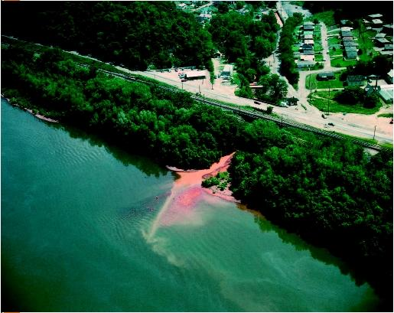
The Environmental Impact of Mining
Air and noise pollution
Water contamination
Displacement of wildlife
Erosion and sedimentation
Subsidence
Underground mine fires
Aerial view of shoreline, showing a stream polluted with waste water runoff from strip mining flowing into the Ohio river

Slide 16
State and Federal Regulation of Mining
To ensure contaminants from mines do not threaten water quality -> The Clean Water Act and The Safe Drinking Water Act
The regulation of the release of hazardous substances into the air, soil, and water by mining -> Comprehensive Response Compensation and Liability Act
To ensure that mining activities do not affect threatened or endangered species -> Endangered Species Act

Slide 17
Reclamation
Reclamation is the process of returning land to its original or better condition after mining is completed.
SMCRA – The Surface Mining Control and Reclamation Act of 1977 -> A set of standards that regulates surface coal mining on private and public land in order to minimize the surface effects of mining.

Slide 18
State Regulation of Mining
Mining companies must obtain permits from state environmental agencies before mining a site.
These permits specify standards for design and reclamation.
Mining companies must also post a bond with funds that will be utilized by the state to reclaim the site if the company fails to do so.
State agencies are also in charge of environmental inspections.

Slide 19
Nonrenewable Energy

Slide 20
Fossil Fuels
Most of the energy we use comes from a group of natural resources called fossil fuels.
Fossil fuels are the remains of ancient organisms that changed into coal, oil, or natural gas.
Fossil fuels are used for 5 main purposes: cooking, transportation, manufacturing, heating and cooling, and generating electricity.

Slide 21
The value of fuel is determined by:
Cost
Availability
Safety
Energy content
Byproducts of the fuel’s use

Slide 22
Problems with Fossil Fuels
The supply of fossil fuels is limited.
Obtaining and using fossil fuels causes environmental problems.

Slide 23
ENERGY 101
https://www.youtube.com/watch?v=20Vb6hlLQSg

Slide 24
Summary of the video:
Fossil Fuels are burned to produce warmth, which is used to boil water.
The water turns into steam, and the steam turns a turbine.
The turbine turns an electrically conductive material within the magnetic field inside the electrical generator, which produces energy.

Slide 25
World Patterns
People in developed countries use more energy than people in developing countries use.
There is also a difference between energy use in developed countries:
People in the US and Canada use twice as much energy as people in Japan or Switzerland.

Slide 26
US Patterns
The US uses more energy per person than most other countries in the world.
Why do you think that is?
The availability and cost of fuel influences fuel use.
There is very little incentive to conserve gasoline when the prices are low.

Slide 27
Fracking https://www.youtube.com/watch?v=6qKadxyMOYY

Slide 28
Fossil Fuel and the Future
As the demand of energy resources increases, the cost of fossil fuels will likely increase enough to make other energy sources more attractive.
Taxes or caps on emissions could also enhances the attractiveness of alternative energy sources.
We must plan for alternative resources now because it could take time for new options to make significant contributions to our energy supply.

Slide 29
Captain Planet: The Energy Vampire
http://captainplanetfoundation.org/episode/the-energy-vampire/

