Slide 1
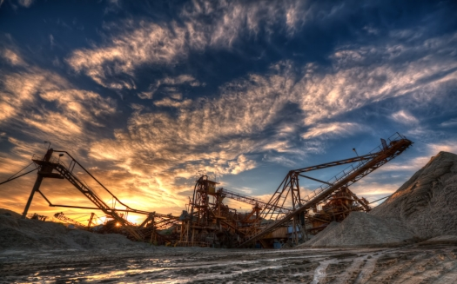
Mining and Mineral Resources

Slide 2
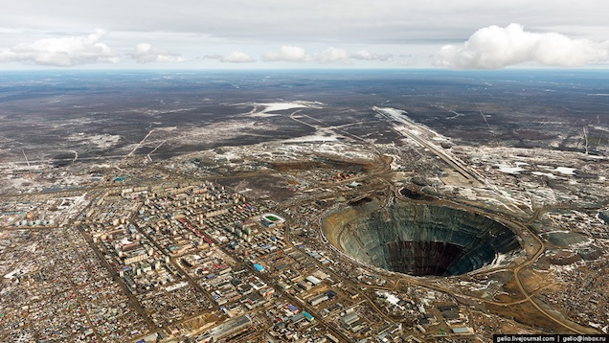
Former Soviet Mine

Slide 3
Salt Mines in Maras, Peru There is a small town near Cusco that owns this salt mine. Each family owns a portion of it and pass it down from generation to generation.

Slide 4
Our guide told us that on average they are able to collect about 50 kilos of salt every 2-3 weeks from each pool. Each Kilo is worth about 2 Soles which is about 65 cents US.

Slide 5
This little spring fed stream provides the water necessary for the entire salt mine.

Slide 6
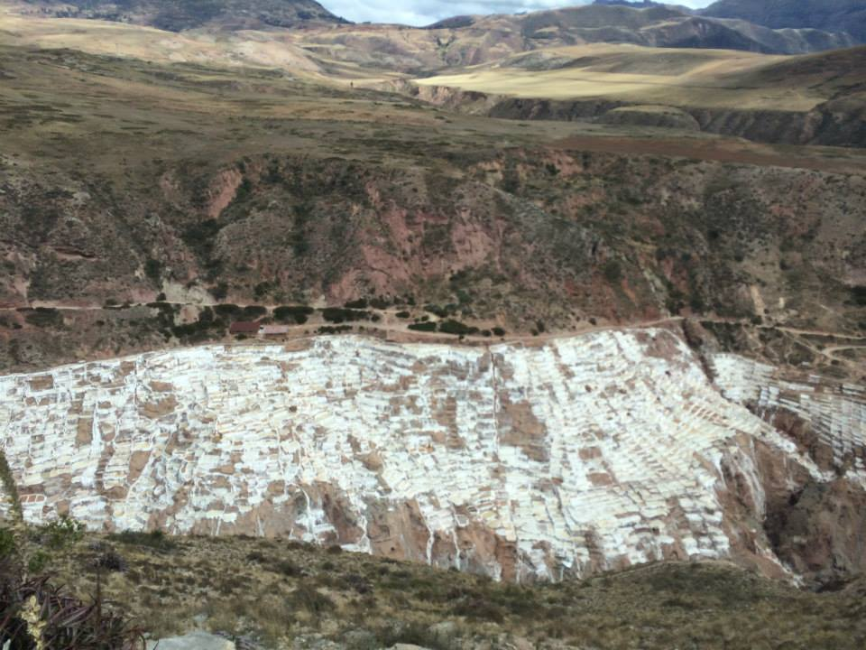

Slide 7
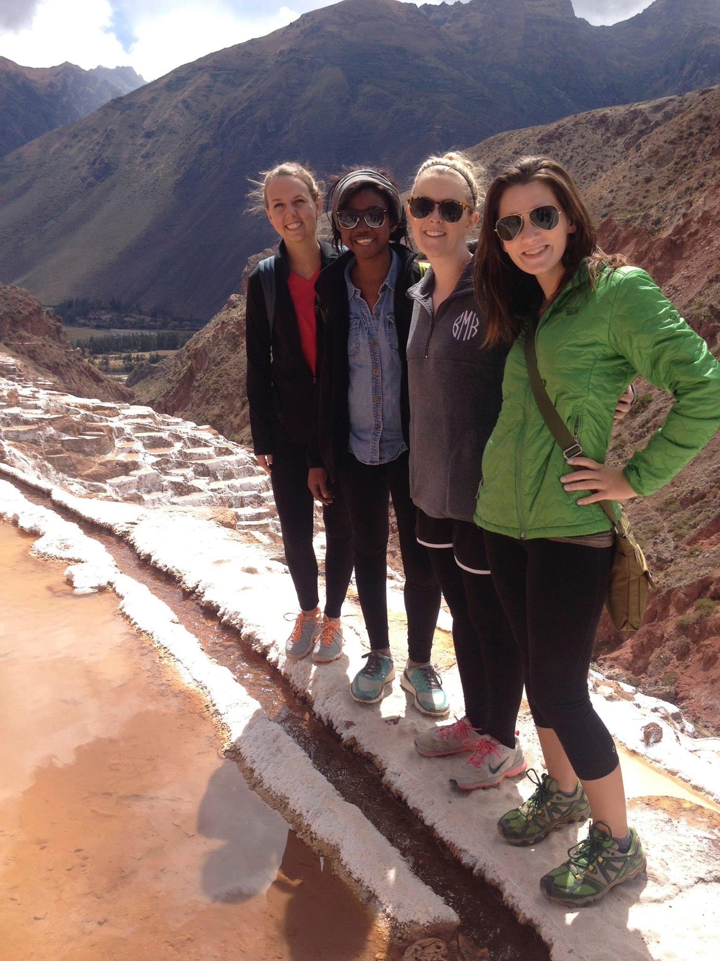
Pictures of Salminas were taken by Ashton Hall and Tiffany Steinkamp.

Slide 8
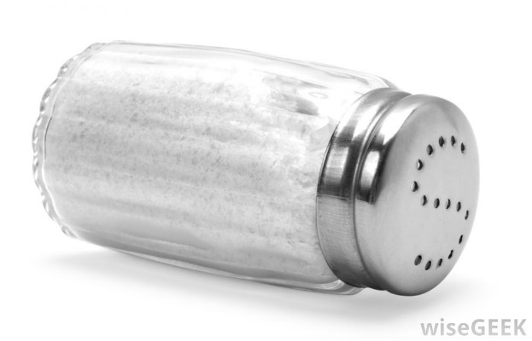
Salt, Historically Speaking
Salt has played an important role in human history. As early as 2,700 BCE the Pen-Tzao-Kan-Mu, the earliest known pharmacology treatise, listed uses for more than 40 kinds of salt and described two mining methods used today. In ancient Greece, the exchange of salt for slaves gave rise to the saying “not worth his salt,” and early Roman soldiers received special salt rations known as salarium argentum from which the world “salary” is derived. At the end of the 16th century, Spain became bankrupt when the Dutch blockaded the Iberian saltworks. Around the same time, the French monarchy imposed a salt tax known as the gabelle which increased the salt tax tenfold (to 140 times the production cost!). This tax became a major factor in the French Revolution.

Slide 9
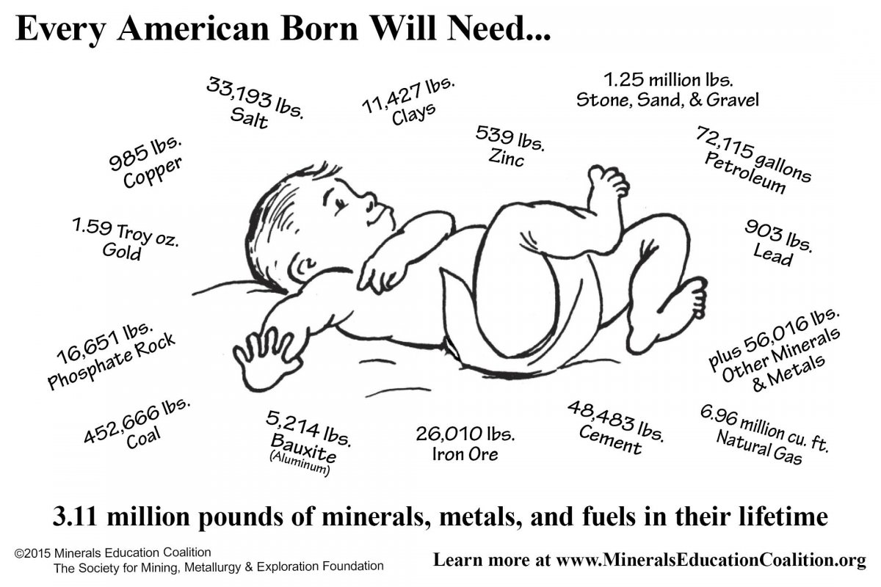

Slide 10
From Ore to More
https://www.youtube.com/watch?v=RmaGh4g1JtY

Slide 11
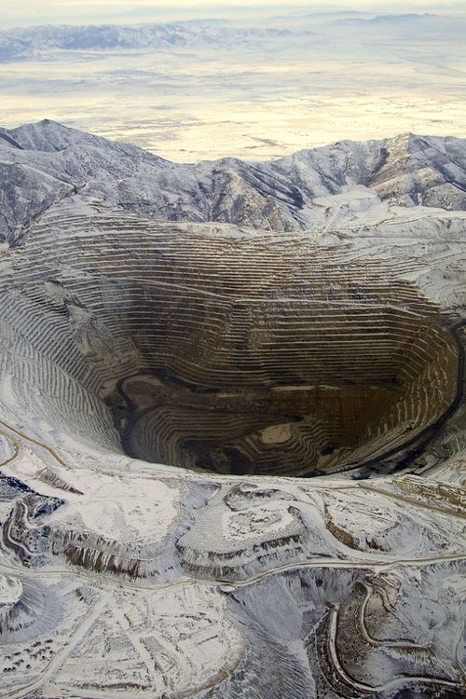
Bingham Canyon Mine from a commercial aircraft with snow cover. The mine is the world's largest man-made excavation. Located 28 miles southwest of Salt Lake City, the mine is 2 3/4-miles across and 3/4-mile deep. It is so big that it can be seen from outer space.

Slide 12
What is a mineral?
A mineral is a
naturally occurring
inorganic solid
that has a characteristic chemical composition
an orderly internal structure,
and a characteristic set of physical properties.
Example: Malachite
Banded green
Cu₂CO₃(OH)₂
Hardness 3.5-4
Light green streak test

Slide 13
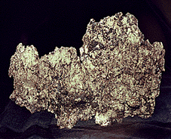
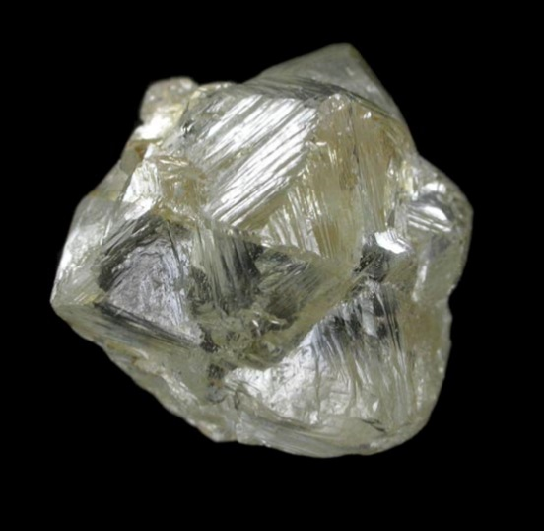
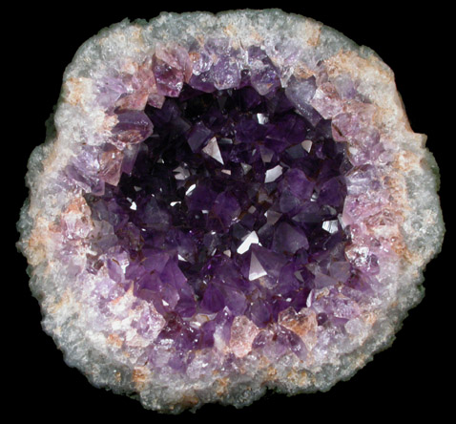
Ore Minerals
Ore minerals are minerals that are valuable and economical to extract.
Gangue minerals are the minerals that have no commercial value .
Metallic Minerals – conduct electricity, have shiny surfaces, and are opaque. Examples: gold and silver
Nonmetallic Minerals – tend to be good insulators, may have shiny or dull surfaces, and may allow light to pass through them. Examples: diamond and amethyst

Slide 14
Mineral Resources and Their Uses

Slide 15
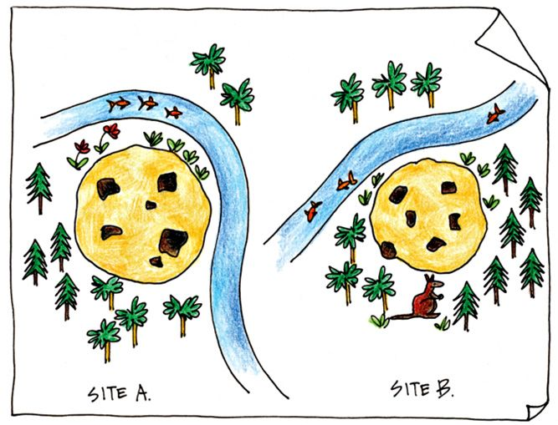
Mineral Exploration
1. Explore rocks for mineralization
2. Rock samples are taken from the area to be analyzed to determine ore quality.
3. Companies will drill test holes.
4. If the ore grade is high enough and the deposit extensive enough, the cost to open a mine may be justified.
Through mineral exploration, mining companies can identify areas where there is a high likelihood of find valuable mineral resources.

Slide 16
Subsurface Mining
Ore deposits that are found 50m+ beneath the surface are mined using subsurface mining methods. (What does the prefix sub mean?)
Examples:
Room and pillar mining
Longwall mining
Solution mining.

Slide 17
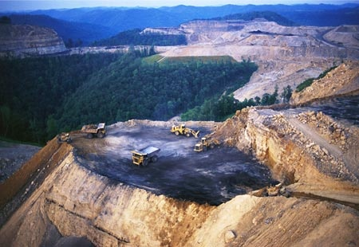
Surface Mining
Surface mining methods are used when ore deposits are located close to the surface.
Examples:
Open pit mining/Strip mining, surface coal mining
Quarrying
Solar evaporation

Slide 18
Undersea Mining
The ocean floor contains mineral resources.
It is cheaper to mine on land than underwater.
It is difficult to mine at great depths.
Not very successful to date.

Slide 19
Surface vs. Subsurface Mining
Surface Mining
+ Workers are in greater safety above ground.
+ Easier access to ore.
Alters the landscape.
Greater potential for contaminating the environment.
Subsurface Mining
+ Easier to contain harmful wastes.
+ Doesn’t necessarily affect the landscape.
Potential for miners to be trapped underground.
Possibility of underground fires and explosions.

Slide 20
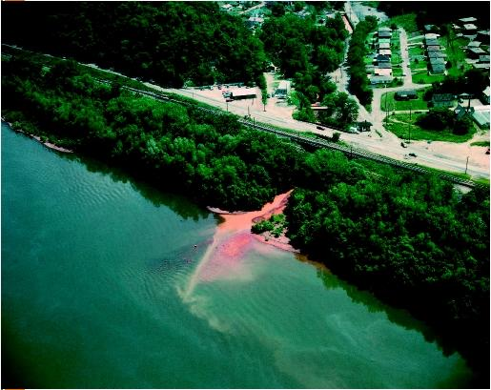
The Environmental Impact of Mining
Air and noise pollution
Water contamination
Displacement of wildlife
Erosion and sedimentation
Subsidence
Underground mine fires
Aerial view of shoreline, showing a stream polluted with waste water runoff from strip mining flowing into the Ohio river

Slide 21
State and Federal Regulation of Mining
To ensure contaminants from mines do not threaten water quality -> The Clean Water Act and The Safe Drinking Water Act
The regulation of the release of hazardous substances into the air, soil, and water by mining -> Comprehensive Response Compensation and Liability Act
To ensure that mining activities do not affect threatened or endangered species -> Endangered Species Act

Slide 22
Reclamation
Reclamation is the process of returning land to its original or better condition after mining is completed.
SMCRA – The Surface Mining Control and Reclamation Act of 1977 -> A set of standards that regulates surface coal mining on private and public land in order to minimize the surface effects of mining.

Slide 23
State Regulation of Mining
Mining companies must obtain permits from state environmental agencies before mining a site.
These permits specify standards for design and reclamation.
Mining companies must also post a bond with funds that will be utilized by the state to reclaim the site if the company fails to do so.
State agencies are also in charge of environmental inspections.

