Slide 1
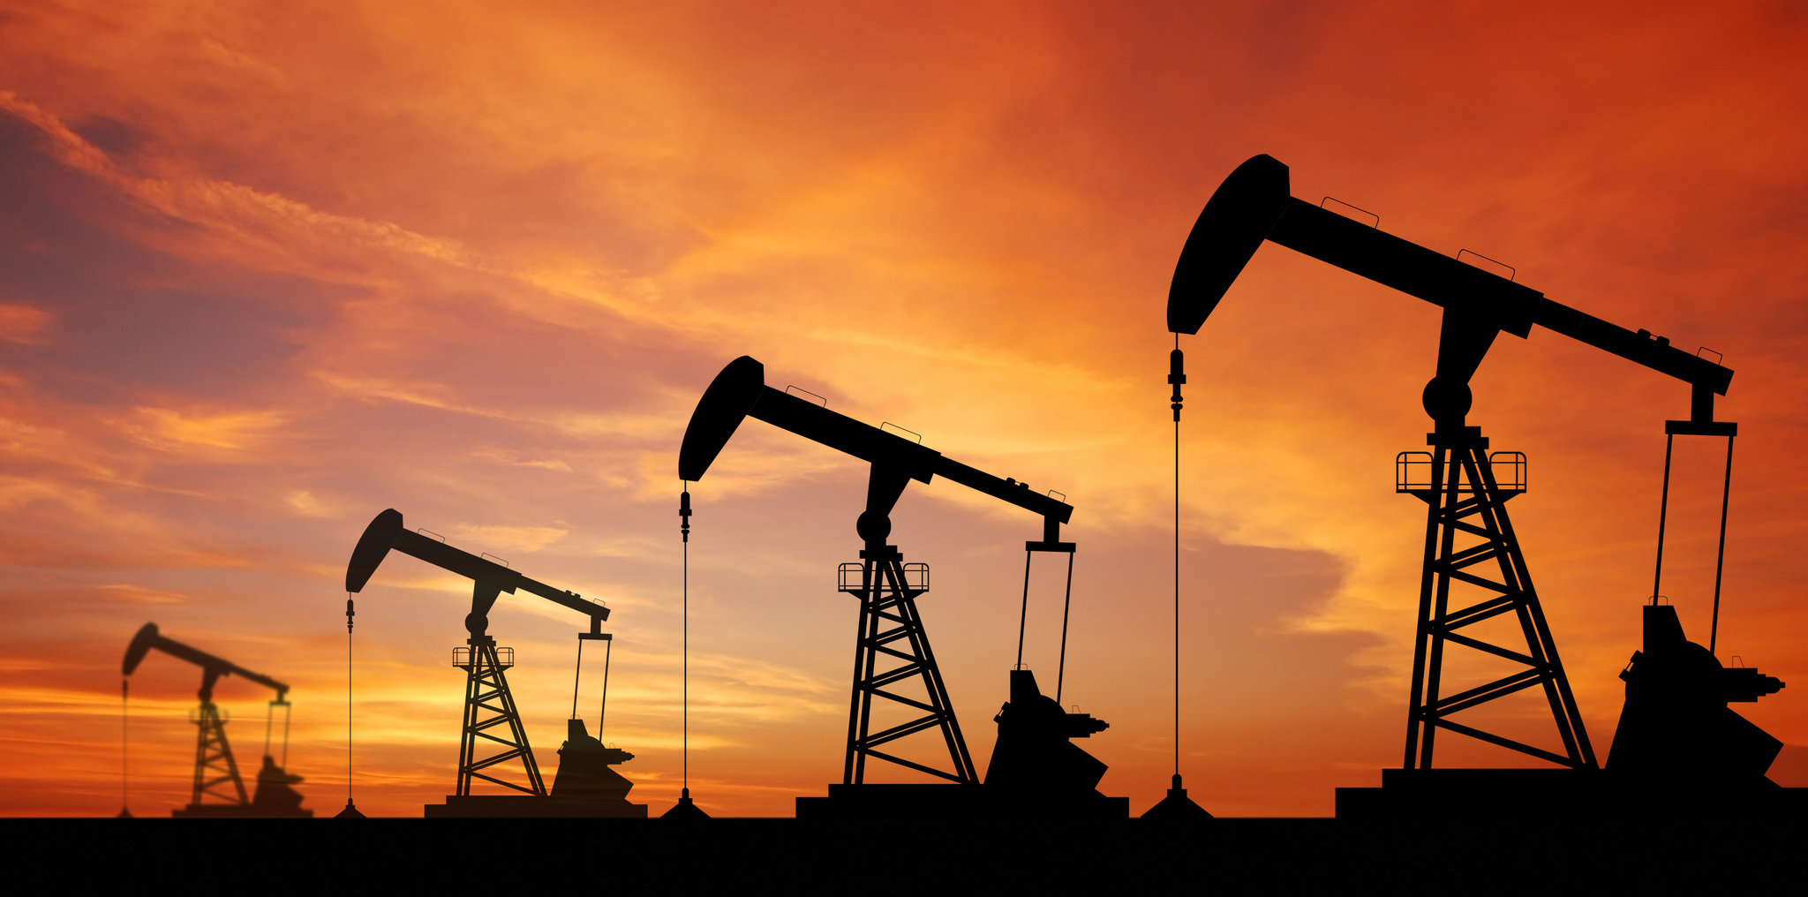
Nonrenewable Energy

Slide 2
Fossil Fuels
Most of the energy we use comes from a group of natural resources called fossil fuels.
Fossil fuels are the remains of ancient organisms that changed into coal, oil, or natural gas.
Fossil fuels are used for 5 main purposes: cooking, transportation, manufacturing, heating and cooling, and generating electricity.

Slide 3
The value of fuel is determined by:
Cost
Availability
Safety
Energy content
Byproducts of the fuel’s use

Slide 4
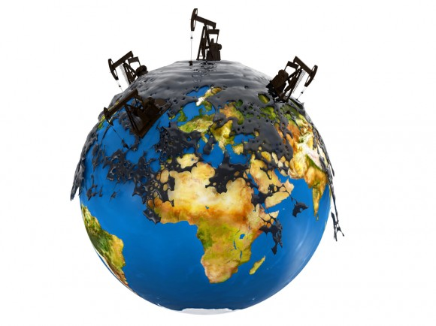
Problems with Fossil Fuels
The supply of fossil fuels is limited.
Obtaining and using fossil fuels causes environmental problems.

Slide 5
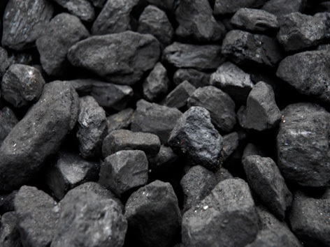
You may be wondering…
How does this…
Turn into this?

Slide 6
Energy 101
https://www.youtube.com/watch?v=20Vb6hlLQSg

Slide 7
Summary of the video:
Fossil Fuels are burned to produce warmth, which is used to boil water.
The water turns into steam, and the steam turns a turbine.
The turbine turns an electrically conductive material within the magnetic field inside the electrical generator, which produces energy.

Slide 8
World Patterns
People in developed countries use more energy than people in developing countries use.
There is also a difference between energy use in developed countries:
People in the US and Canada use twice as much energy as people in Japan or Switzerland.

Slide 9
US Patterns
The US uses more energy per person than most other countries in the world.
Why do you think that is?
The availability and cost of fuel influences fuel use.
There is very little incentive to conserve gasoline when the prices are low.

Slide 10
Fossil Fuel and the Future
As the demand of energy resources increases, the cost of fossil fuels will likely increase enough to make other energy sources more attractive.
Taxes or caps on emissions could also enhances the attractiveness of alternative energy sources.
We must plan for alternative resources now because it could take time for new options to make significant contributions to our energy supply.

