Slide 1
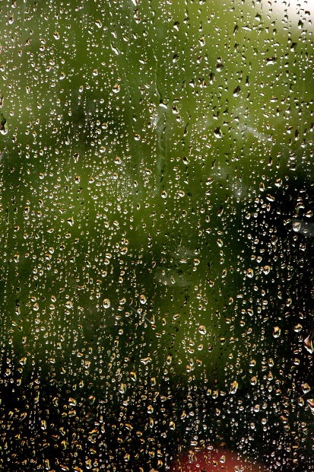
Rainwater Harvesting

Slide 2
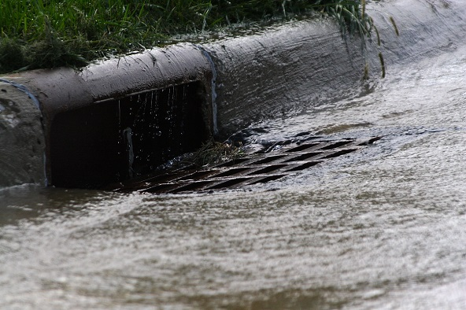
Rain water and $$$ down the drain…?

Slide 3
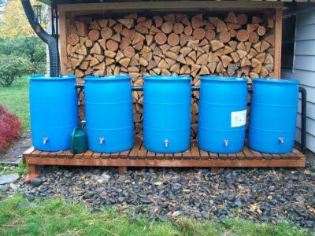
Or… in your rain barrel!

Slide 4
Benefits of Rainwater Harvesting
Is environmentally friendly
Is better for plants
Prevents soil erosion by reducing rainfall runoff (soil contaminates)
Increases self-sufficiency
Conserves energy from potable water processes
Saves money on water bills
Conserves water
Flood control
Fosters a greater appreciation of nature

Slide 5
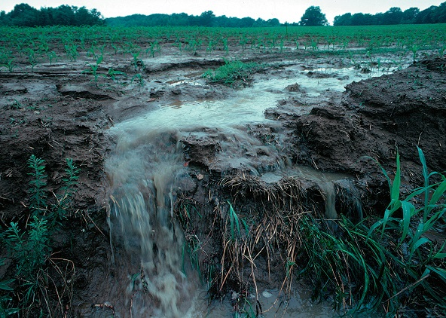
Heavy rain picks up lawn herbicides, chemicals and oil from the street, and agricultural run-off, before flushing into our creeks, streams, rivers.

Slide 6
Uses for Rainwater
Vegetable Gardens
Potted Plants
Planters
Fruit Trees
Emergency potable water
Flushing toilets
Drip irrigation systems
Decorative landscape fountains
Washing cars
Washing pets

Slide 7
BEST OF ALL!
Rain water is free!
Or is it??
Some states say that unless you own the water rights on the property, it is not permissible to salvage rainwater in barrels for future use.

Slide 8
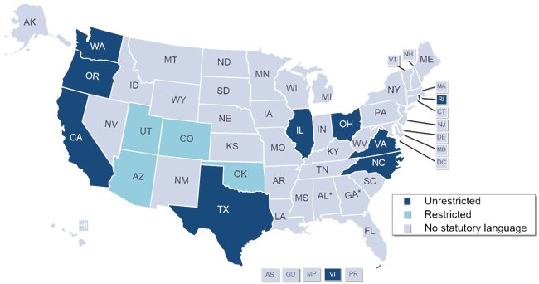
Hooray Texas!

Slide 9
Texas and Rainwater Harvesting
Texas is one of only a few states in the nation that has devoted a considerable amount of attention to rainwater harvesting and has enacted many laws regulating the practice of collecting rainwater.
Texas Tax Code 151.355 allows for a state sales tax exemption on rainwater harvesting equipment.
Texas Property Code 202.007 prevents homeowners associations from banning rainwater harvesting installations.
Texas House Bill 3391 requires rainwater harvesting system technology to be incorporated into the design of new state buildings and allows financial institutions to consider making loans for developments using rainwater as the sole source of water supply.

Slide 10
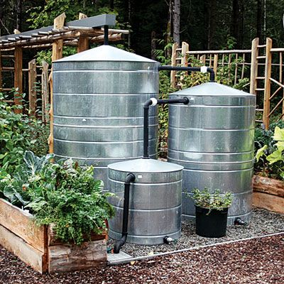
Lots of Options: Fancy (and expensive)
Pictured cisterns are from Texas Metal Cisterns ($380 for 200-gallon size to $1,070 for 1,200-gallon size; texas metalcisterns.net).

Slide 11
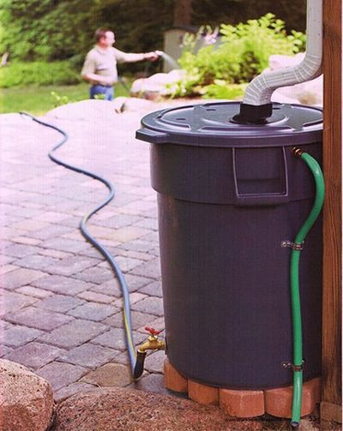
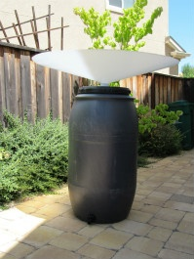
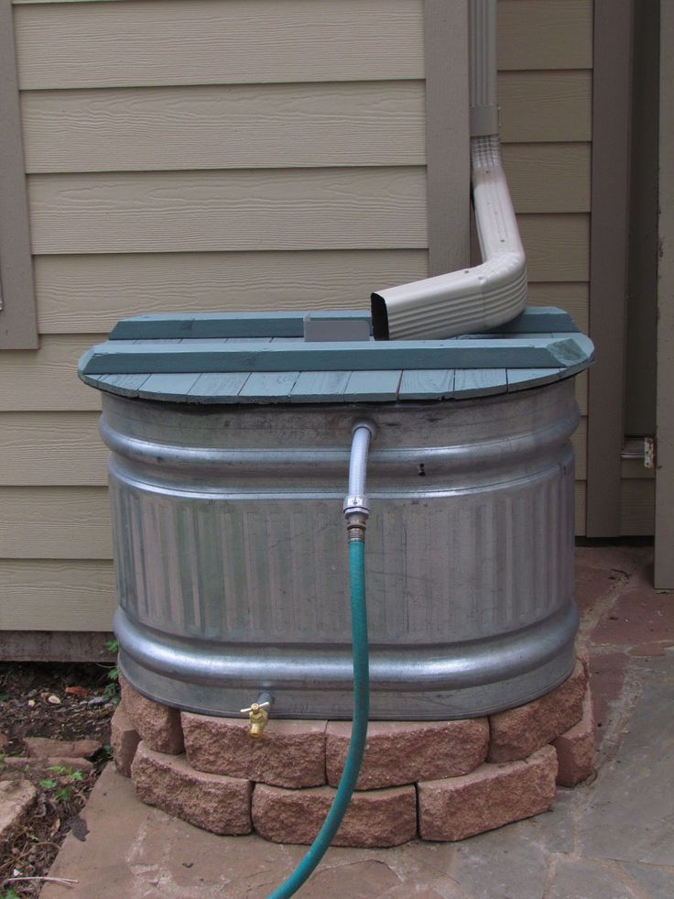
Lots of Options: Practical (and affordable)

Slide 12
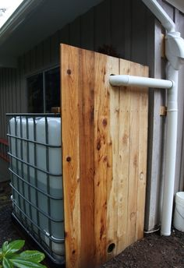
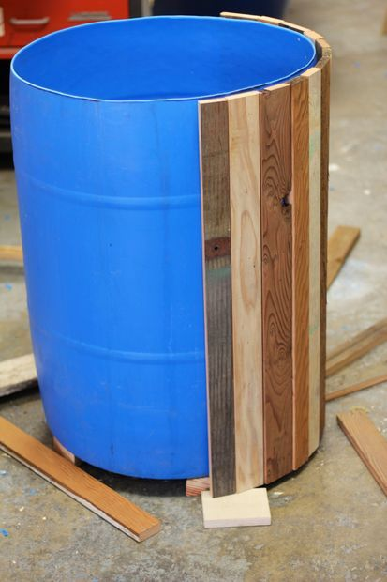
Or disguise it…

Slide 13
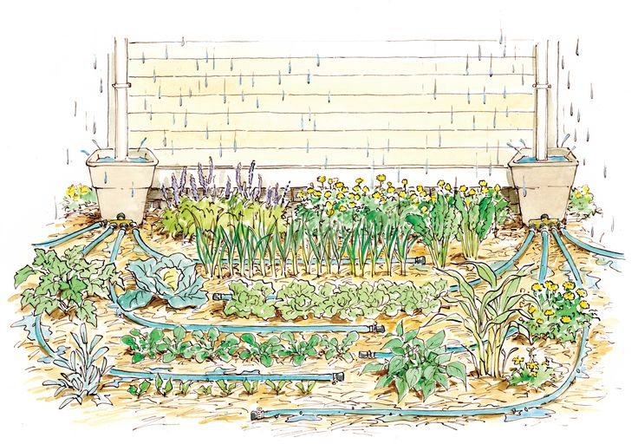
Just for your garden…

Slide 14
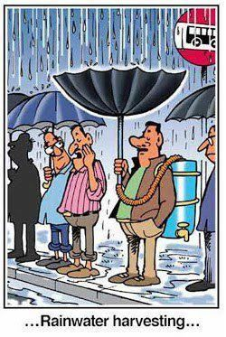
For the enthusiast…

Slide 15
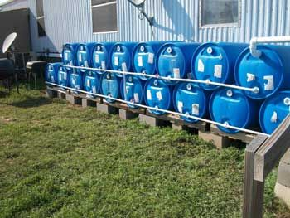
For the large family…or farm?

Slide 16
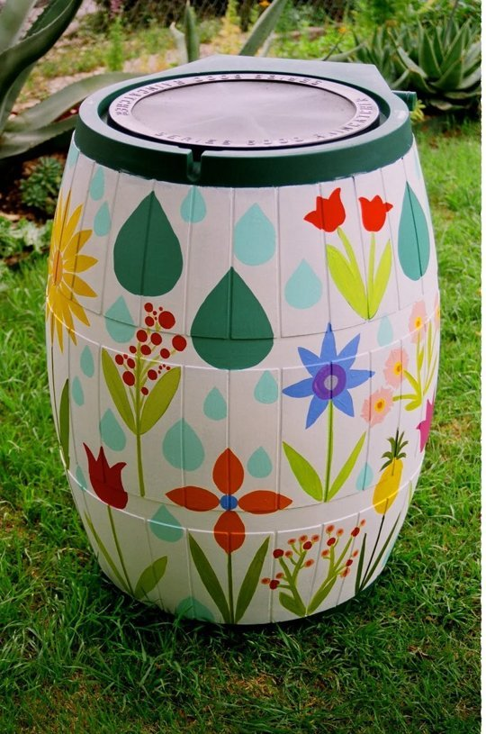
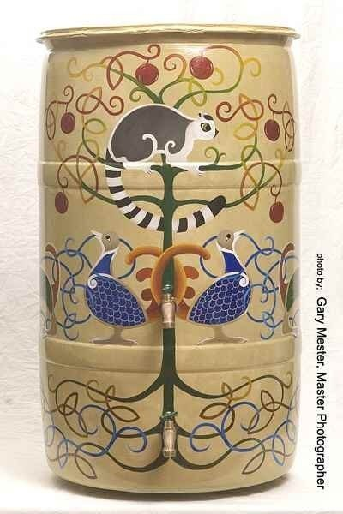

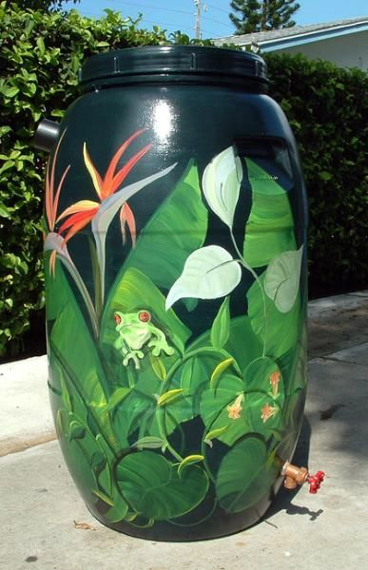
For the artsy folks…

Slide 17
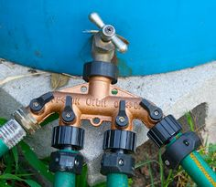
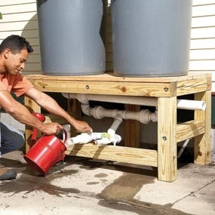
How do I get to use my rain water?

Slide 18
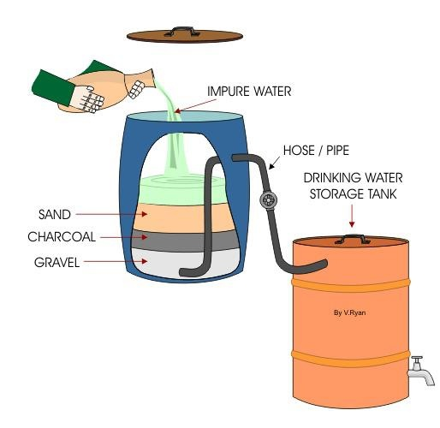
Can I drink it?

Slide 19
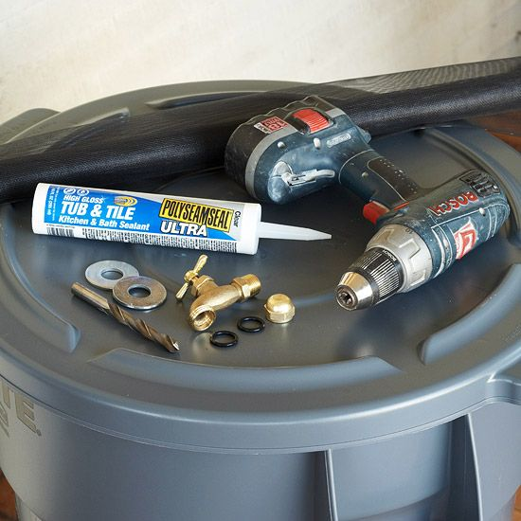
Make your own!
Materials:
1 large plastic garbage can
1 tube of watertight sealant
2 rubber washers
2 metal washers
1 hose clamp
1 spigot
A drill
Landscaping fabric

Slide 20

Drill a hole for the spigot
Tips:
Not too low! You need to be able to fit a watering can underneath the spigot.

Slide 21
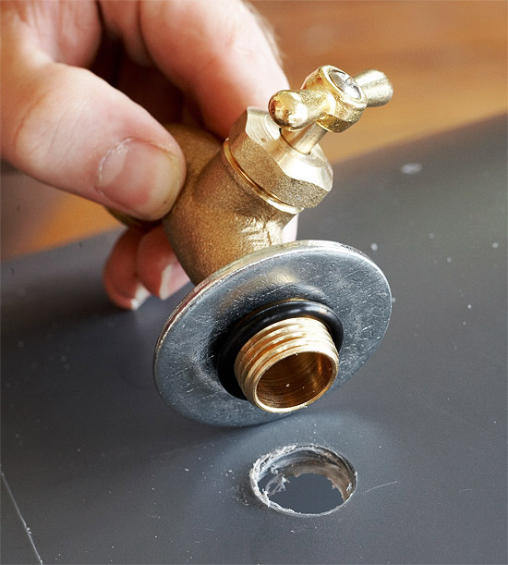
Insert the spigot
Tips:
Layer a metal and a rubber washer to prevent leakage

Slide 22
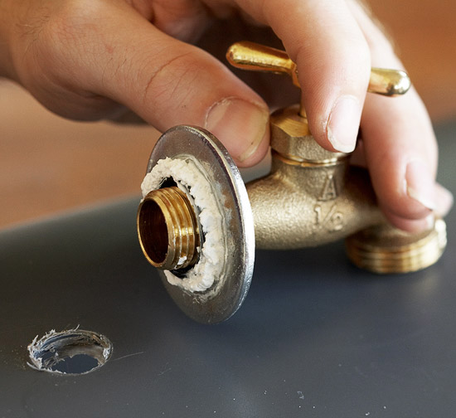
Seal it up
Tips:
Add the other two washers inside the barrel after the spigot is placed in the hole.

Slide 23
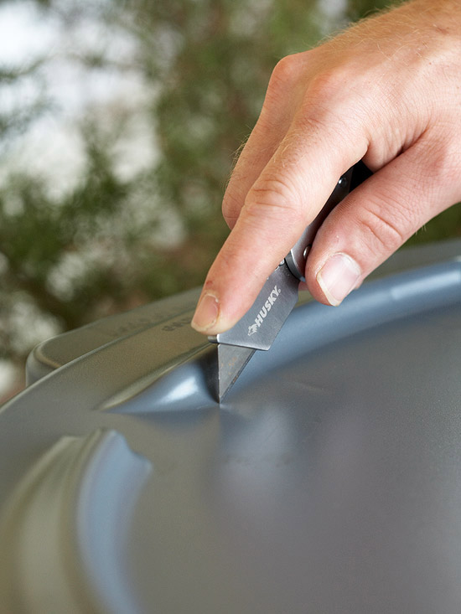
Make Entry
Tips:
You can cut additional holes for overflow and connect additional barrels with PVC pipe.

Slide 24
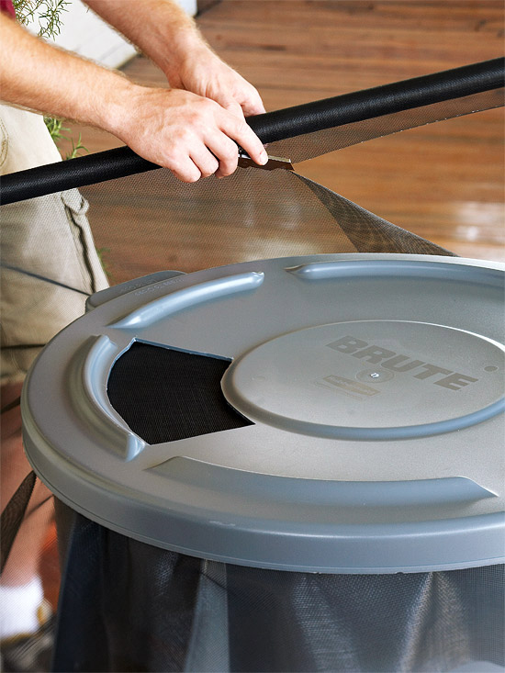
Seal the Top:
Tips:
Cut and secure landscaping fabric over the hole to prevent mosquitoes from getting in.
I recommend using the sealant to also glue the fabric in, instead of just securing it under the lid.

Slide 25
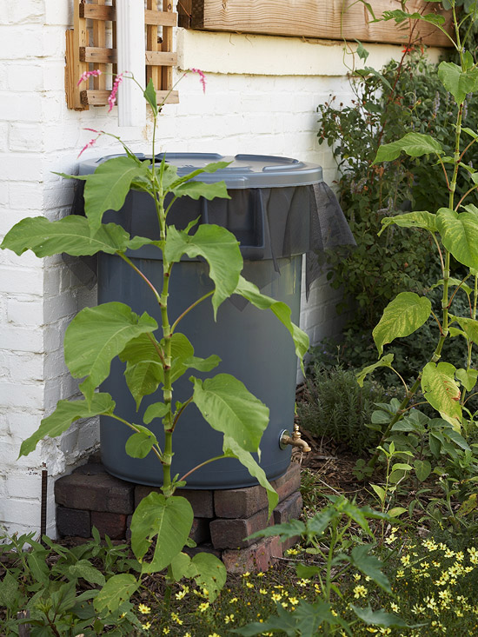
Ta Da!
Ready to use!

Slide 26
Rain water catchment contest
30 minutes to construct a rain water catchment design.
The team the collects the most water wins!

