Slide 1
Reducing Solid Waste

Slide 2
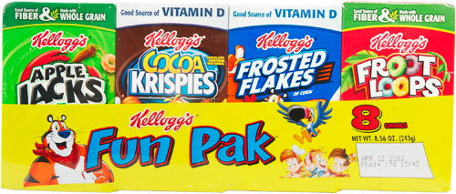
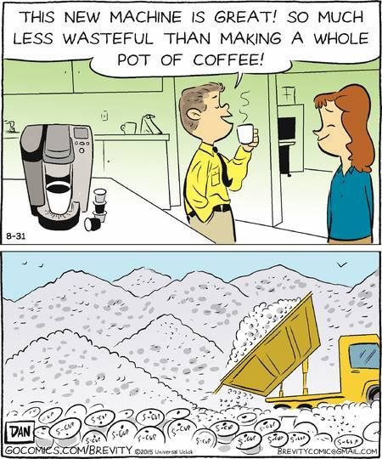
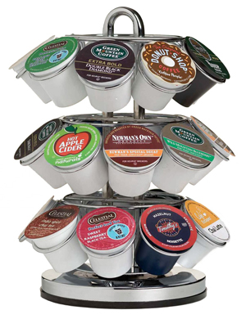
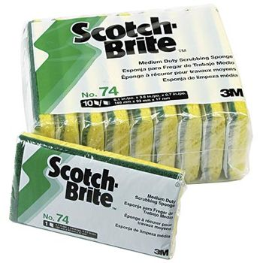
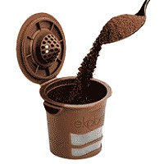
Coach Hall’s Consumer Complaints

Slide 3
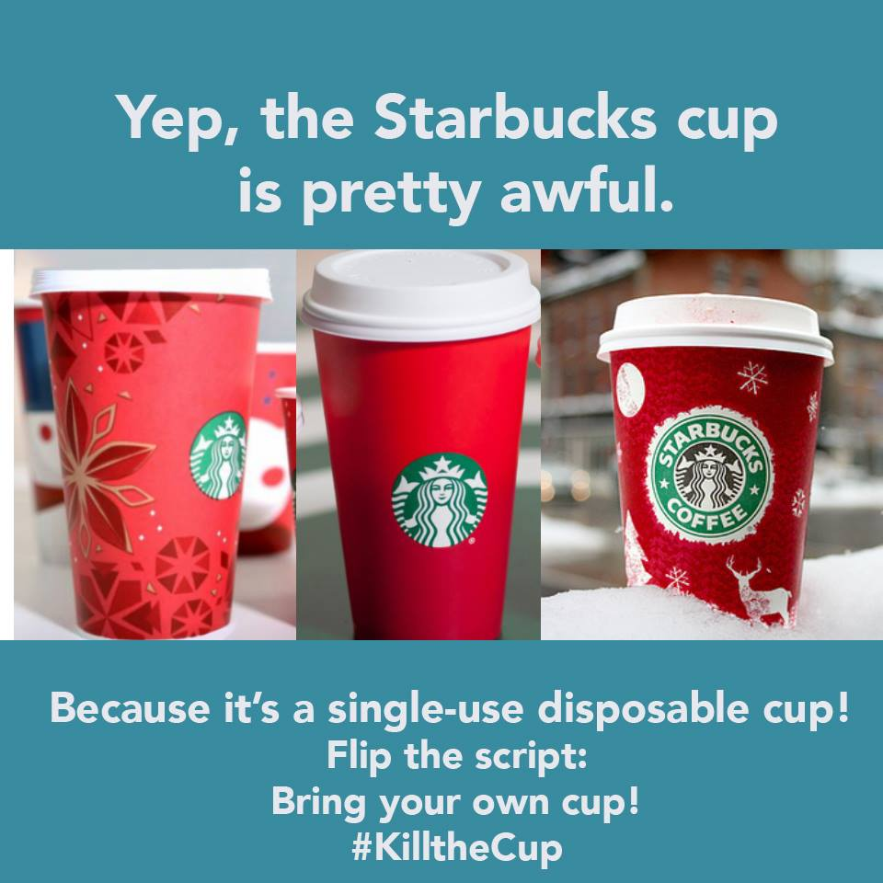
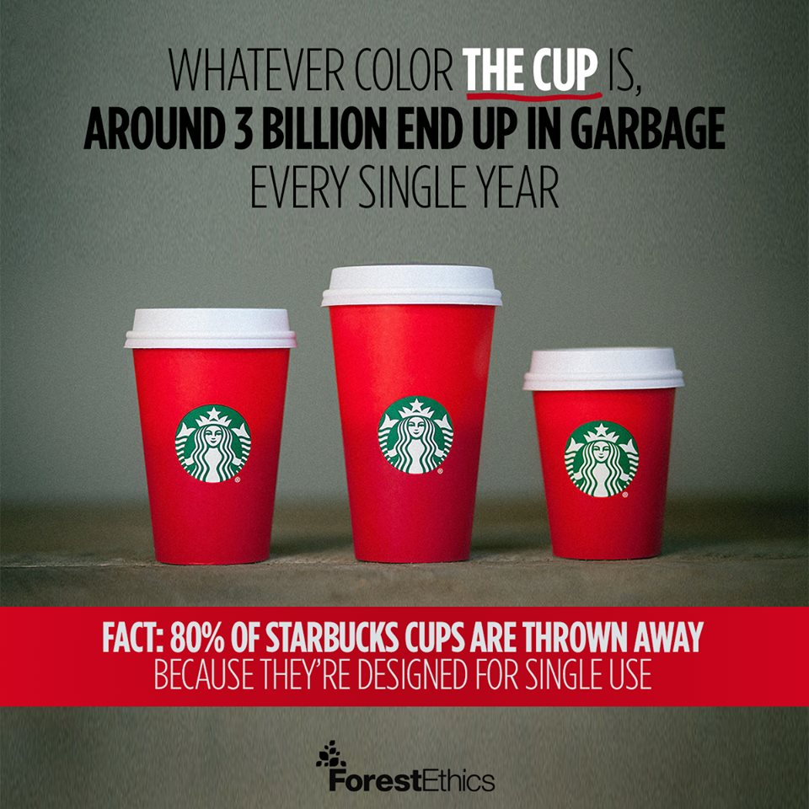

Slide 4
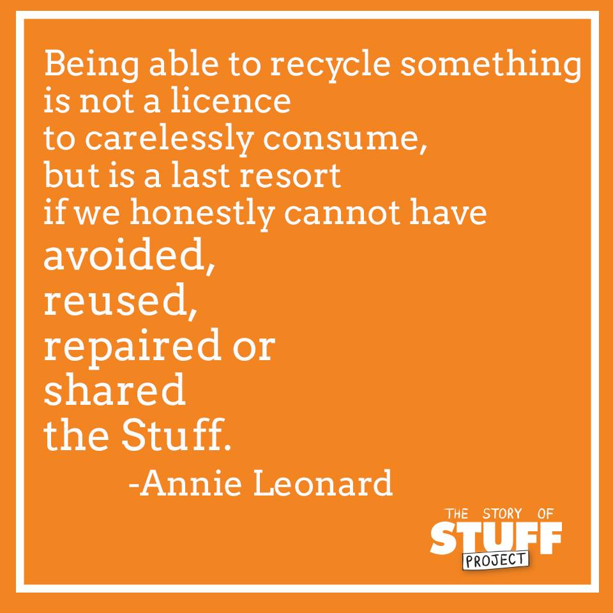
MISCONCEPTION ALERT!
You may think the best way to reduce waste is to recycle, but recycling should be the last resort!
Remember, the FIVE Rs:
Reduce
Reuse
Recycle
Rot
Reflect

Slide 6
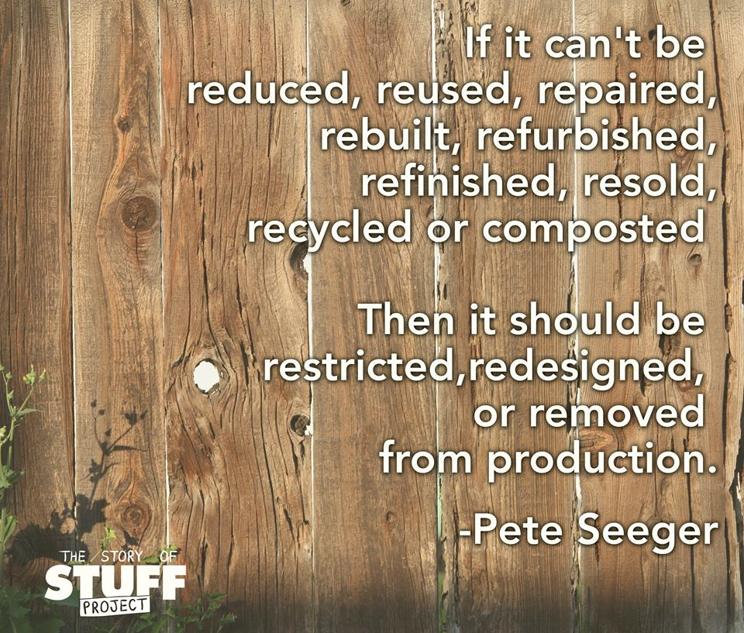
Source Reduction:
Is any change in design, manufacture, purchase, or use of materials or products to reduce their amount or toxicity before they become municipal solid waste.

Slide 7
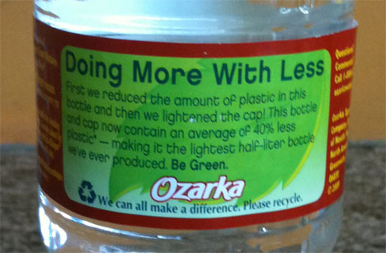
Reducing Waste
Manufacturers could:
Redesign products to use less materials
Design products that are easily repaired. (Interchangeable parts)

Slide 8
Reduce
Reduce the amount of packaging we dispose of by purchasing items in bulk rather than individually wrapped.
• Reduce the number of things we use only one time. For example, replace paper
towels with washable dish towels. Use durable utensils and plates instead of plastic
ones.
• Figure out how much of something you really need, and then purchase only that
amount so that nothing is wasted.
• Buy locally made and grown products from farmers markets or small retail stores to
reduce excess packaging.
• Reduce the amount of paper we use so trees don’t have to be cut down and the
paper doesn’t end up in the landfill. We can use both sides of each piece of paper
or cut paper in half for notes and things.
• Reduce the number of batteries we purchase by using rechargeable batteries.

Slide 10
CONSUMER POWER!

Slide 11
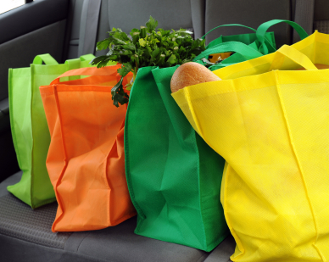
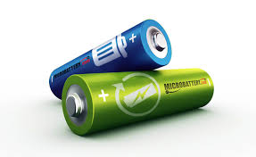
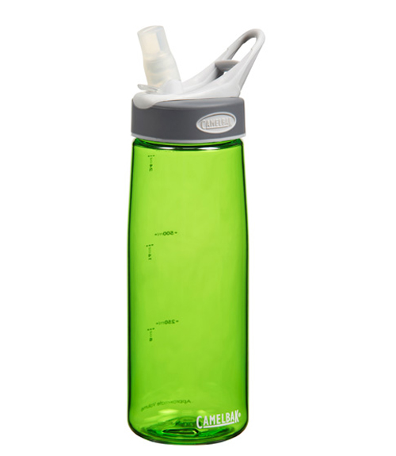
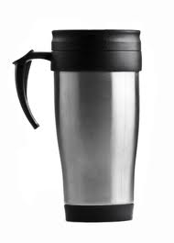
Reusing Materials
As a consumer, you can influence manufacturers to reduce solid waste.
Buy products that:
Have less packaging
Last longer
Are reusable

Slide 13
Recovering Resources
Recycling is the process of reusing materials or recovering valuable materials from waste or scrap.
Making products from recycled materials usually save energy, water, and other resources.
Example: 95% less energy is needed to produce aluminum from recycle aluminum than from ore.
Example: ~70% less energy is needed to make paper from recycled paper than from trees.

Slide 15
Steps to Recycling
Step 1: Material is collected and are taken to a facility to be sorted.
Step 2: Material must be cleaned and made ready to use again.
- glass is sorted by color and crushed
- paper is sorted by type and made into pulp with water.
Step 3: The materials are used to make new products
Step 4: New products are sold.

Slide 16
CONSUMER POWER!
If more people buy products made from recycled materials, the increase demand encourages manufacturers to supply recycled products.
When manufacturers build facilities to make recycled products, it becomes easier for communities to sell the material they collect from residents for recycling.

Slide 19
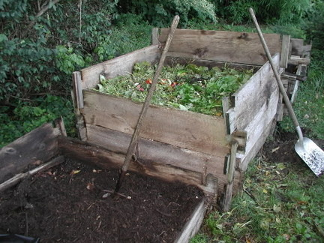
Composting
Can include:
Yard Waste
Fruits and vegetables trimmings and table trash
NO MEAT or ANIMAL WASTE!
Compost is a dark brown, crumbly material that is spread on gardens and fields to enrich the soil.
Rich in nutrients that help plants grow.
Turn compost pile often to encourage aerobic decomposition!

Slide 20
Benefits of Composting
Keeps organic waste out of landfills
Provides nutrients to the soil
Increases beneficial soil organisms such as worms and centipedes
Suppresses some plant diseases
Reduces the need for fertilizers and pesticides

Slide 21
Many of us just buy what we want without really thinking about what we need or how our habits may be harming the Earth.

Slide 22
What are some ways to reflect about our waste production?
Acknowledge the life cycle of every product and the environmental
impact of that product. In other words, we can think about what happens
to the product when it is thrown away. Does it take a long time for it to degrade? Can it be recycled?
Consider whether the products you use are really necessary. Can you buy
and consume less? Are there ways you can reduce packaging, reuse a
discarded object for something useful, or compost your trash?
Consider how the 5Rs can help us reduce our impact on the environment.
(They help us slow down and consider different ways to manage our waste
so that less trash ends up in landfills.)

Slide 24
