Slide 1
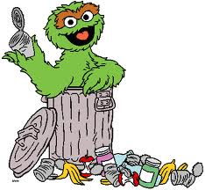
Solid Waste

Slide 2
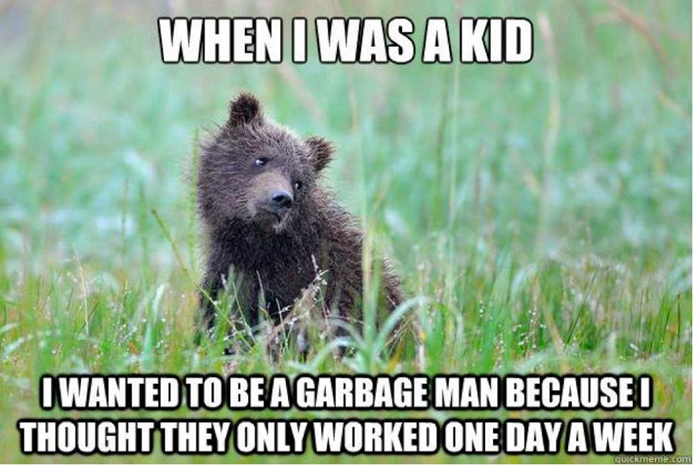

Slide 3
Out of Sight-Out of Mind: Where does your trash go when you throw it away?
Every year, the U.S. Generates more than 10 billion metric tons of solid waste.
Solid waste is any discarded solid material.

Slide 5
Space and Waste
Towns are running out of space to dispose the amount of trash people produce.
In 1987, Islip, NY ran out of space. Loaded up a barge with 3,200 tons of garbage trying to find a place to unload.
Traveled all the way to the Gulf of Mexico and back!
Ended up just burning it. (430 tons of ash)

Slide 6
Population and Waste
Population ↑
Waste ↑
Need for land (houses, agriculture, etc)↑
Land for waste↓

Slide 8
Not All Wastes are Equal
There are two types of solid waste:
Biodegradable
Nonbiodegradable
A material is biodegradable if it can be broken down by biological processes.
Products made from synthetic materials are not biodegradable.
Synthetic materials are made by combining chemicals to form compounds that do not form naturally.
Examples: polyester, plastic, some parts of electronics

Slide 9
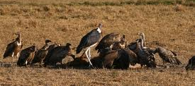
How is waste managed in nature?
Decomposers contribute to the break down of biodegradable materials.
Examples: bacteria and fungus
Scavengers also help.
Examples: vultures and insects

Slide 10
Plastic Problems
Plastics are made from petroleum or natural gas.
Petroleum and natural gases are made of carbon and hydrogen
They are put together in molecular chains that are not found in nature.
Some plastics will last for hundreds of years because microorganisms have not yet evolved ways to break down the molecular structure.

Slide 11
Plastic To Oil Machine
https://www.youtube.com/watch?v=7P3aUANOYOI

Slide 12
Types of Solid Waste - Municipal Solid Waste
Municipal Solid Waste - The waste produced by households and businesses.

Slide 13
Types of Solid Waste- Manufacturing Waste
Includes: scrap metal, plastics, paper, sludge, and ash.
Consumers do not directly produce waste from manufacturing, but they indirectly create it by purchasing products that have been manufactured.

Slide 14
Types of Solid Waste – Mining Waste
Includes: rocks and minerals left over from excavation.
Reclamation?
Run off?

Slide 15
Types of Solid Waste – Agriculture
Includes: crop waste and manure.
Both are biodegradable.
Using too much manure for fertilizer could harm plants and animals and contaminate groundwater.

Slide 16
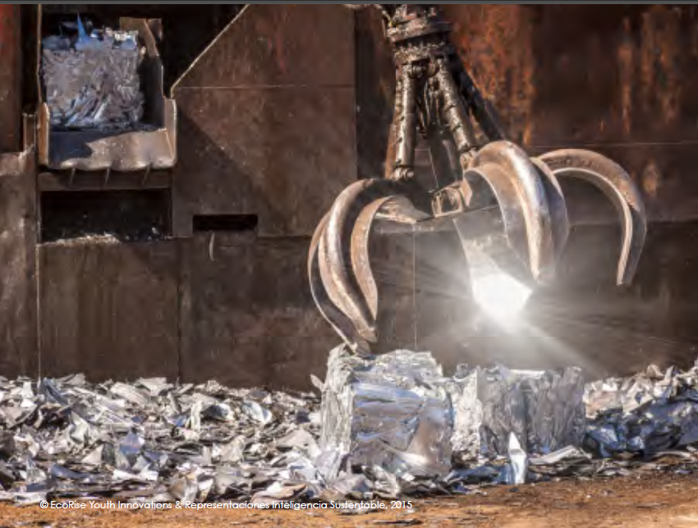
Solid Waste Management
Where Municipal Solid Waste in The United States Goes
Waste-disposal method | Percentage of waste by weight
Stored in landfills | 55%
Recycled | 30%
Incinerated | 15%

Slide 17
Landfills
A landfill is a permanent waste-disposal facility where wastes are put in the ground and covered each day with a layer of plastic, soil, or both.
Landfills contain waste so it does not contaminate surrounding soil or ground water.

Slide 20
Problems with Landfills
Leachate: a liquid that forms when water seeps down through a landfill and collects dissolved chemicals from decomposing garbage.
Landfills usually monitor, measure, and store leachate and treat it as waste water.
Otherwise, it could contaminate the groundwater.
Sounds like: LEECHATE

Slide 21
Problems with Landfills
Decomposing organic waste may produce highly flammable methane gas.
The gas can be pumped out to be used as a fuel.
If not handled properly, the methane can cause dangerous explosions.

Slide 22
Safeguarding Landfills
Landfills must be built with certain safeguards in place.
Landfills must be
Lined with clay and a plastic liner
Have systems for collecting and treating leachate
Install vent pipes to carry methane out of the landfill
$$$$

Slide 24
NIMBY
“Not in my backyard!”
It is hard to find acceptable places to build landfills.
NIMBY refers to community reluctance to having a landfill near their homes.
$$$ to transport trash further away.

Slide 25
Incinerators
One option for sending less waste to landfills is to burn it in incinerators.
Can be used to create electricity.
Trash is not separated before it goes into the incinerator so harmful toxins are sometimes released from burning cleansers, batteries, paints, etc.
Ash from incinerators goes to a landfill.

Slide 27
“It’s a Dirty Job!”
Read “Scenario Cards”

