Slide 1
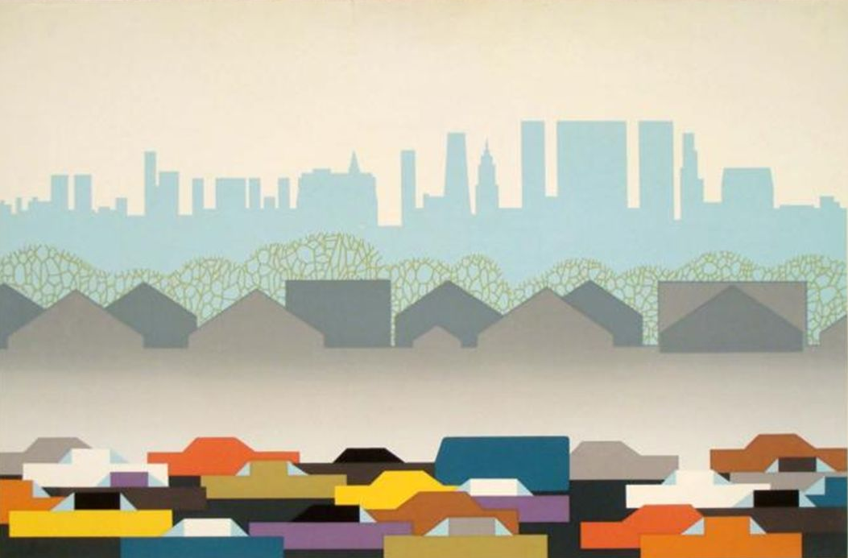
Urban Land Use

Slide 2
Urbanization
Urbanization: the movement of people from rural areas to cities.
People usually move for more or better paying jobs.

Slide 3
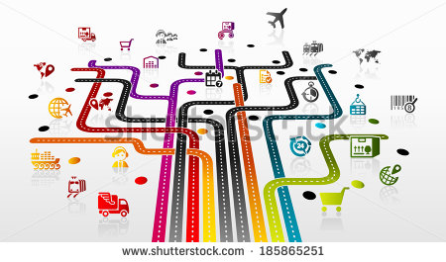
The Urban Crisis
Infrastructure: all of the things that a society builds for public use.
Roads, sewers, bridges, canals, fire and police stations, schools, libraries, hospitals, water mains, and power lines, etc.

Slide 4
The Urban Crisis Continued
When more people live in a city than its infrastructure can support, the living conditions deteriorate.
This is called Urban Crisis.

Slide 5
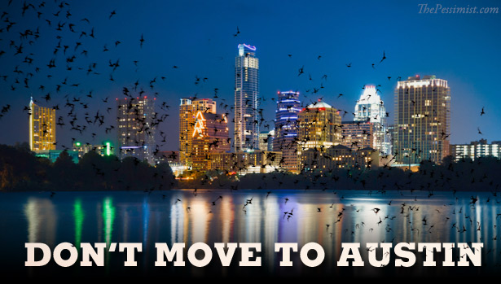

Slide 6
Urban Sprawl
Urban sprawl: rapid expansion of a city into the countryside around the city.
Much of this expansions results from the building of suburbs or housing and associated commercial buildings on the boundary of a larger city.

Slide 7
Disadvantage of Urban Sprawl
High Car Dependence
Inadequate facilities (cultural, emergency, health, etc.)
High per-person infrastructure costs
Inefficient street layouts
Low diversity of housing and business types
Higher per-capita use of energy, land, and water
Perceived low aesthetic value

Slide 8
Other Impacts of Urbanization
Environmental conditions in a city differ from those in the countryside.
Cities generate and trap heat.
The increased temperature in a city is called heat island.
Can affect local weather patterns, specifically rain.
Effect can be moderated by planting trees for shade or installing rooftops that reflect heat.

Slide 9
Urban Planning
Land-use planning: determining in advance how land will be used.
Where is the best location for housing, businesses, roads, etc?
Where will land be protected for recreation and conservation?
Where will sewers, electrical lines, etc. go?
Complex and controversial
Businesses, governments, and citizens often disagree about land-use plans.

Slide 10
Technological Tools for Urban Planning
GIS – Geographic Information System
A computerized system for storing, manipulating, and viewing geographical data.
GIS allows the user to look for specific data about an area, such as sewer lines, roads, parks, etc.
GIS users can layer information to help inform decisions.

Slide 11
Urban Planning and Transportation
Many U.S. cities are difficult to travel in without a car.
Most U.S. cities were built after the invention of the automobile.
At the time, availability of land was not an issue, so many cities are spread out over large areas.
Most cities in Europe were built before cars, so they are more compact.

Slide 12
Mass Transit Systems
Uses buses or trains to move many people at one time.
Save energy
Reduce highway congestion
Reduce air pollution
Limit loss of land to roadways and parking lots
In places where mass transit systems are not well developed, carpooling is an important alternative!

Slide 13
Open Space
Open space is land that is set aside for agriculture or scenic and recreational enjoyment.
Parks, public gardens, bicycle and hiking trails, etc.
Greenbelts are open spaces left in their natural condition.
Greenbelts provide important ecosystem services.

Slide 14
Environmental Benefits of Open Spaces
Plants absorb CO₂ and produce O₂, and filter out pollutants from the air and water.
Plants help keep the city cooler in the summer.
Provide food resources.
Reduce drainage problems.
Places for exercise and relaxation

