Slide 1
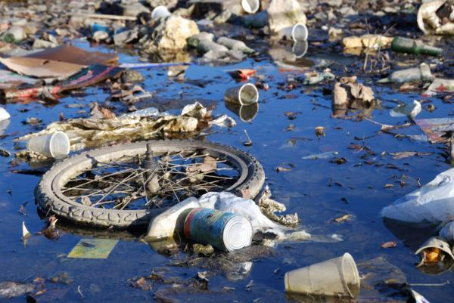
Water Pollution
Water Pollution is the introduction of chemical, physical, or biological agents into water that degrade water quality and harm the organisms that depend on the water.
Two major causes of water pollution: industrialization and rapid human population growth.

Slide 2
http://www.upworthy.com/at-first-you-think-theyre-just-playing-around-then-the-end-happens

Slide 3
Point-Source Pollution
Point-Source Pollution is pollution discharged from a single source.
PS pollution can often be ID-ed and traced to a source.

Slide 4
Sources of Point Pollution
Leaking septic tank systems
Leaking storage lagoons for polluted waste
Unlined landfills
Leaking underground storage tanks that contain chemicals or fuels such as gasoline
Polluted water from abandoned and active mines
Water discharged by industries
Public and industrial waste-water treatment plants

Slide 5
Nonpoint-Source Pollution
Non-Source Pollution (aka runoff pollution) comes from many different sources.
Extremely difficult to regulate and control.
Control of NPS pollution depends on public awareness.

Slide 6
Nonpoint sources of pollution
Chemicals added to roads (salt and other deicing agents)
Water runoff from city and suburban streets that may contain oil, gas, animal feces, and litter.
Pesticides, herbicides, and fertilizer from lawns, golf courses, and farmland.
Feces and agricultural chemicals from livestock feedlots.
Precipitation containing air pollutants
Soil runoff from farms and construction sites.
Oil and gasoline from personal watercrafts

Slide 7
Eutrophication
When lakes and streams contain too many nutrients they are eutrophic.
When organic matter builds up in the water, they begin to decay and decompose.
This processes uses a lot of oxygen which can change the oxygen content of the water.
Thus, the types of animals and plants that live there change over time.

Slide 8
Artificial Eutrophication
AE is a process that increases the amount of nutrients in a body of water through human activities, such as waste disposal and land drainage.
Nitrogen in fertilizers are the largest source of nutrients that cause AE.
Some laundry and dishwashing detergents contain phosphorus that can cause excessive algae growth.

Slide 9
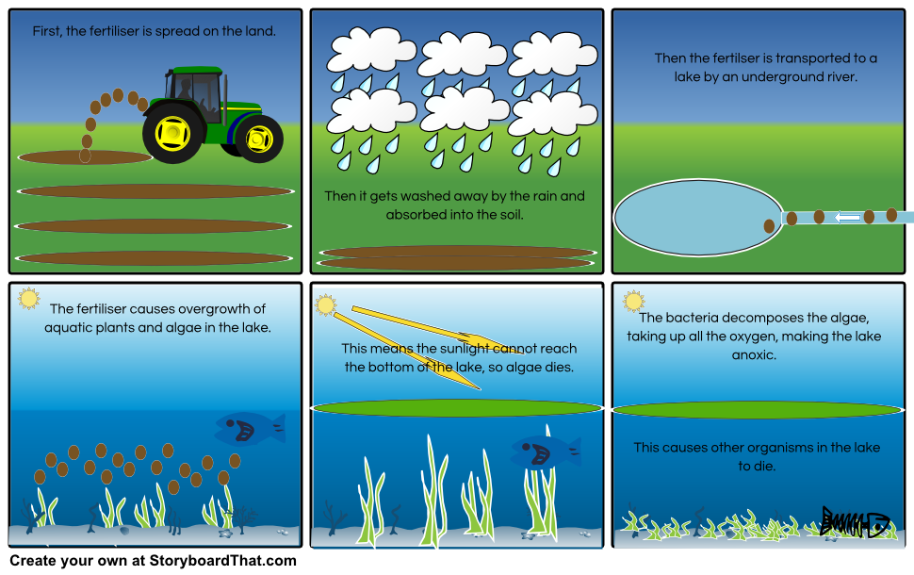

Slide 10
Thermal Pollution
A temperature increase in a body of water that is caused by human activity and that has a harmful effect on water quality and on the ability of that body of water to support life.
Can be caused when power plants or other industries use water in their cooling systems and then discharge the warm water into a lake or river.

Slide 11
Thermal Pollution
If water is too warm, it cause large fish kills.
If the temp. rises, it can effect the DO (dissolved oxygen), causing some aquatic organisms to suffocate and die.

Slide 12
Groundwater Pollution
Pollutants usually enter groundwater when polluted surface water percolates down from the Earth’s surface.

Slide 13
Cleaning Up Groundwater Pollution
One of the most challenging environmental problems
Ground water recharges very slowly.
It can take 100s or 1,000s of years for an aquifer to recycle and decontaminate polluted water.
Ground water is dispersed over large areas of rock and sand.
Even if you pumped out the entire aquifer, there could still be contaminated water left inside rocks and sand.

Slide 14
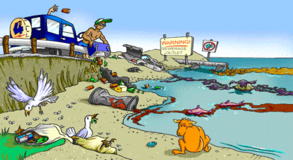
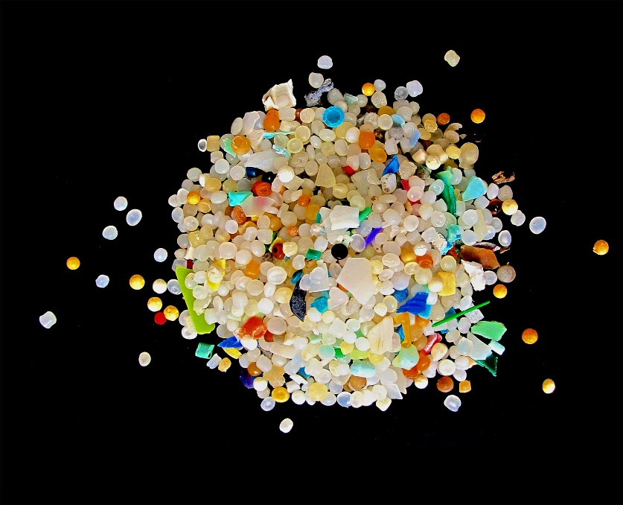
Ocean Pollution
Ships can legally dump garbage in some parts of the ocean.
OP comes from activities on land as well.
Plastics make up the majority of OP. (90%)
Large pieces of plastic are broken down into microplastics, that can be ingested by large and small organisms.

Slide 15
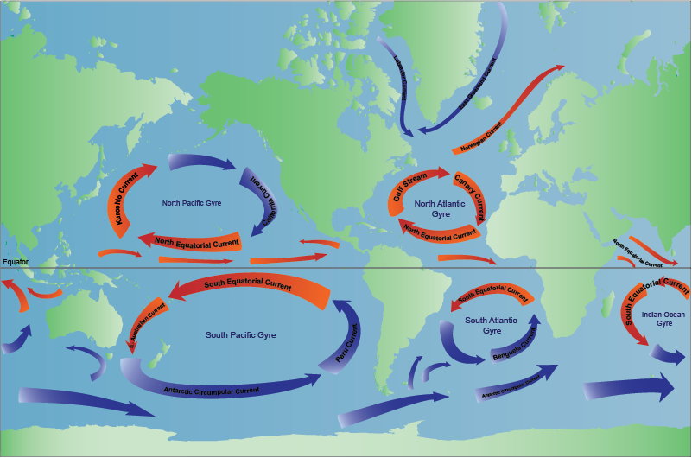

Slide 16
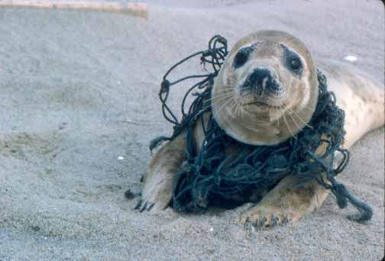
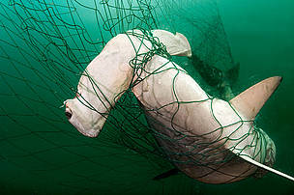
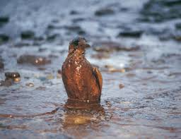
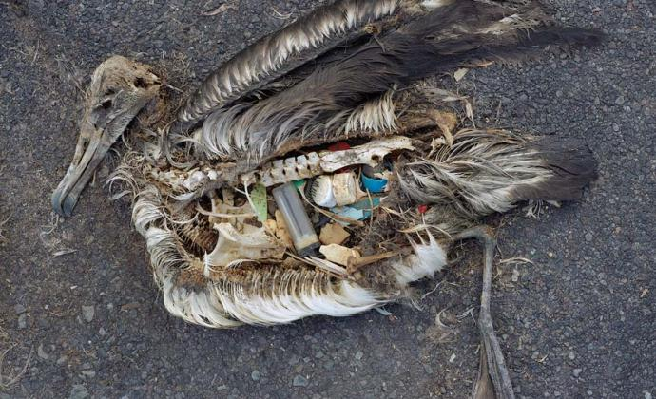
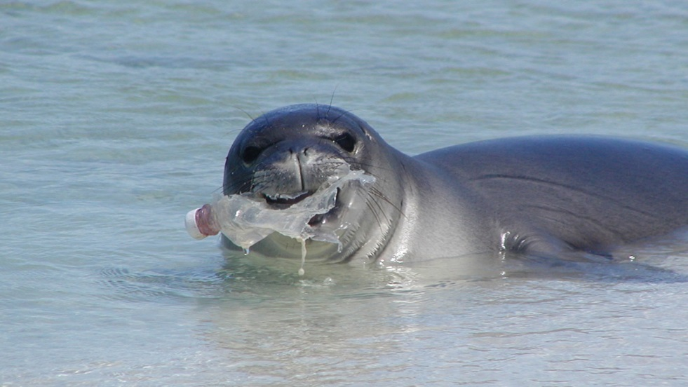

Slide 17
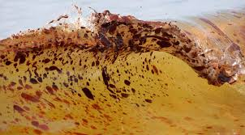
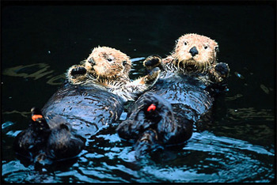
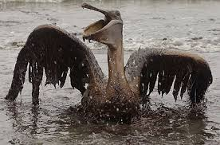
Oil Spills
An oil spill is the release of a liquid petroleum hydrocarbon into the environment, especially marine areas.
The oil coats the feathers and fur of mammals reducing its insulating ability, and making them more vulnerable to temperature fluctuations and much less buoyant.

Slide 18
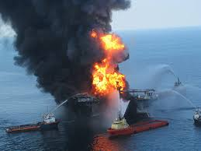
Major North American Oil Spills (Barrels of oil in thousands)
Nantucket, Massachusets, 1976: <500 barrels
Puerto Rico, 1978: <500 barrels
Atlantic Ocean, 1988: <500 barrels
Tuxpan, Mexico, 1996: <500 barrels
Galveston Bay, Texas, 1979: <500 barrels
Prince William Sound, Alaska, 1989: <500 barrels
Caribbean Sea, 1975: <500 barrels
Bay of Campeche, 1979: about 3,000 barrels
Gulf of Mexico, 2010: 5 million barrels

Slide 19
Water Pollution and Ecosystems
WP can cause immediate damage, like chemical spills can kill all of the organisms downstream.
WP can also cause more far-reaching effects to an entire ecosystem.
Biomagnification is the accumulation of pollutants at successive levels of the food chain.

Slide 20
Cleaning Up Water Pollution
In 1969, the Cuyahoga River in Cleveland, Ohio, was so polluted it caught on fire!
This event was a factor in the passage of the Clean Water Act of 1972.

Slide 21
Federal Laws Designed to Improve Water Quality in The United States
1972 Clean Water Act (CWA)
The CWA set a national goal of making all natural surface water fit for fishing and swimming by 1983 and banned pollutant discharge into surface water after 1985.
The act also required that metal be removed from wastewater.

Slide 22
Federal Laws Designed to Improve Water Quality in The United States
1972 Federal Water Pollution Control Act, amended 2002
The objective of this act was to restore and maintain the chemical, physical, and biological integrity of U.S. waters.

Slide 23
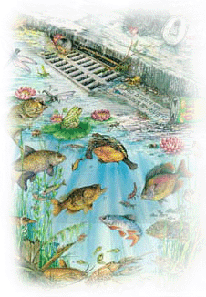
Federal Laws Designed to Improve Water Quality in The United States
1975 Safe Drinking Water Act (SDWA), amended 1996
The act introduced programs to protect groundwater and surface water from pollution.
The act emphasized sound science and risk-based standards for water quality.
The act also empowered communities in the protection of source water, strengthened public right-to-know laws, and provided water system infrastructure assistance.

Slide 24
Federal Laws Designed to Improve Water Quality in The United States
1980 Comprehensive Environmental Response Compensation and Liability Act (CERCLA)
AKA the Superfund Act
Hazardous Waste

Slide 25
Federal Laws Designed to Improve Water Quality in The United States
1987 Water Quality Act
This act was written to support state and local efforts to clean polluted runoff.
It also established loan funds to pay for new wastewater treatment plants and created programs to protect major estuaries.

Slide 26
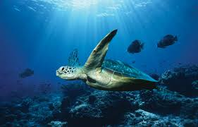
Federal Laws Designed to Improve Water Quality in The United States
2000 Oceans Act
This act created the U.S. Commission on Ocean Policy to develop recommendations for a new coordinated and comprehensive national ocean policy.
Protection of life and property;
Stewardship of ocean and coastal resources;
Protection of marine environment and prevention of marine pollution;
Enhancement of maritime commerce;
Expansion of human knowledge of the marine environment;
Investments in technologies to promote energy and food security;
Close cooperation among government agencies; and
U.S. leadership in ocean and coastal activities.

