Slide 1
Water Use and Management
Gas Station
Restaurant
RG/R
Residential Area
Shopping Center
Remember the activity “Planning a community”?
When a water supply is polluted or overused, everyone living downstream can be affected.
School
Landfill

Slide 2
Global Water Use
Most of the water worldwide is used to irrigate crops.
Availability of freshwater, population size, and economic conditions affect how people use water.

Slide 3
Residential Water Use
The average person in the US uses 300L (80 gallons) of water everyday.
About half of the water used is used inside the home: washing, cooking, drinking, toilet flushing, etc.
The other half is used outdoors for watering lawns, washing cars, etc.

Slide 4
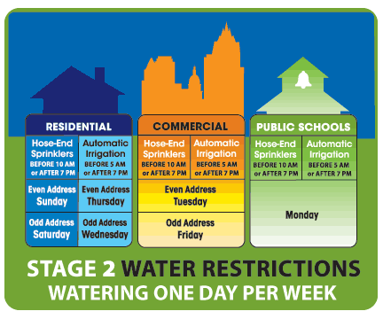
Austin, Texas
Outdoor water limited to one day per week, see chart for your day.
No washing of automobiles or other mobile equipment or vehicles except at a vehicle washing facility. Charity car washes are prohibited.
No operation of ornamental fountains with an aerial spray of water or water fall more than four inches, other than for aeration necessary to preserve habitat for aquatic life.
Patio misters at commercial facilities can only be operated between 4 pm and midnight.

Slide 5
Water Treatment
Potable – safe to drink
Water treatment removes elements such as mercury, arsenic, and lead.
Water treatment also removes pathogens. (organisms that can cause illness or disease)
Bacteria, viruses, protozoa, and parasitic worms

Slide 6
The Water Treatment Process
https://www.youtube.com/watch?v=tuYB8nMFxQA

Slide 7
Water Treatment Process
Coagulation – Bacteria and other impurities cling to floc, which settles at the bottom of the tank.
Filtration – layers of sand, gravel, and hard coal filter the remaining impurities.
Chlorination – Chlorine is added to prevent bacteria from growing in water.
Aeration – Air is forced through the water to release unwanted gases, which reduces odor and improves taste.
Addition treatments – In some communitites, fluoride may be added to prevent tooth decay. Sodium or lime may be added to soften hard water.(high mineral content)
Storage and distribution – Treated water is pumped from storage tanks to homes and businesses.

Slide 8
Industrial Water Use
Used to manufacture goods, to dispose of waste, to generate power, and to cool power plants.
It takes ~1,000 L of water to produce 1 kg of aluminum.
It takes ~ 500,000 L to manufacture a car.

Slide 9
Agricultural Water Use
Irrigation is a method of providing plants with water from sources other than direct precipitation.
High-pressure overhead sprinklers are the most common in the US.
This method is inefficient because nearly half of the water evaporates before it ever reaches the plants’ roots.

Slide 10
Water Management Projects
For thousands of years, humans have altered streams and rivers to make them more useful.

Slide 11
Water Diversion Projects
Canals can be used to divert water from rivers or streams across great distances.
Diverting too much water for drinking, irrigation, etc., can cause a river to run dry.

Slide 12
Dams and Reservoirs
Dams are built across rivers to control the rivers’ flow.
The water behind the dam forms a reservoir. (Artificial lake)
Reservoirs are used for
Flood control
Drinking water
Irrigation
Recreation
Electricity

Slide 13
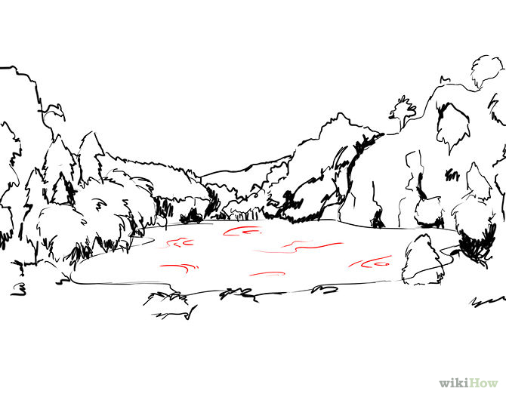
Dams and Resevoirs
Disrupting a river’s flow can cause problems…
Flooding
Displacement of ecosystems
Sediment build up
The City Of Rocksburg
Est. 1847

Slide 14
Water Conservation in Agriculture
Most water loss in agriculture is a result of evaporation and runoff.
Drip Irrigation Systems are one alternative.
Small amounts of water are delivered to the roots by perforated tubing.

Slide 15
Water Conservation in Industry
Use of salt water instead of fresh water.
Recycling of waste water and cooling water.
http://www.mnn.com/green-tech/gadgets-electronics/sponsorvideo/cooling-towers-101-at-ts-pilot-program-cuts-water-usage

Slide 16
Water Conservation at Home
Low Flow toilets and shower heads
Take shorter showers – time yourself
Don’t let the water run while you brush your teeth
Fill up the tub/sink instead of letting the water run while you shave
Only wash full loads of clothes or dishes
Xeriscaping- designing a landscape that requires minimal water usage
Water your lawn sparingly.
Reuse towels more than once
Check for and repair leaks
Collect rain water
Pick one day a week to be a vegetarian! ☺
Use one cup a day
Re-wear clothing like jeans and jackets between washes
Other ideas????
What does your family do to conserve water?

Slide 17
Solutions for the Future
We must find long term solutions that balance the needs of people and ecosystems, while taking into consideration climate change.

Slide 18
Desalination
Desalination is the process of removing salt from salt water.
Most desalination plants heat salt water and collect fresh water that evaporates.
Why is this inefficient?

Slide 19
Transporting Water
Where fresh water resources are inadequate, water can be transported from other regions.
How?
Efficiency?

Slide 20
Low-Cost Solutions
In many arid regions, ground water cannot be reached without great effort and expense.
Provide/construct wells and pumps for economically- disadvantaged communities.

