Slide 1
BEFORE CLASS STARTS!
One/two people from each table needs to get out a netbook and start it booting up! (1 computer/2 students)
Open up an internet browser
Get out your field journal for
notes

Slide 2
WHO: Countries with the worst air pollution

Slide 3
WHO: Countries with the worst air pollution
1.Pakistan

Slide 4
WHO: Countries with the worst air pollution
1.Pakistan
2. Qatar

Slide 5
WHO: Countries with the worst air pollution
1.Pakistan
2. Qatar
3. Afghanistan

Slide 6
WHO: Countries with the worst air pollution
1.Pakistan
2. Qatar
3. Afghanistan
4. Bangladesh

Slide 7
WHO: Countries with the worst air pollution
1.Pakistan
2. Qatar
3. Afghanistan
4. Bangladesh
5. Iran

Slide 8
WHO: Countries with the worst air pollution
1.Pakistan
2. Qatar
3. Afghanistan
4. Bangladesh
5. Iran
6. Egypt

Slide 9
WHO: Countries with the worst air pollution
1.Pakistan
2. Qatar
3. Afghanistan
4. Bangladesh
5. Iran
6. Egypt
7. Mongolia

Slide 10
WHO: Countries with the worst air pollution
1.Pakistan
2. Qatar
3. Afghanistan
4. Bangladesh
5. Iran
6. Egypt
7. Mongolia
8. United Arab Emirates

Slide 11
WHO: Countries with the worst air pollution
1.Pakistan
2. Qatar
3. Afghanistan
4. Bangladesh
5. Iran
6. Egypt
7. Mongolia
8. United Arab Emirates
9. India

Slide 12
WHO: Countries with the worst air pollution
1.Pakistan
2. Qatar
3. Afghanistan
4. Bangladesh
5. Iran
6. Egypt
7. Mongolia
8. United Arab Emirates
9. India
10. Bahrain

Slide 13
Most Polluted US Cities Measured by Ozone

Slide 14
Most Polluted US Cities Measured by Ozone
Los Angeles, CA

Slide 15
Most Polluted US Cities Measured by Ozone
Los Angeles, CA
7. Houston, TX

Slide 16
Most Polluted US Cities Measured by Ozone
Los Angeles, CA
7. Houston, TX
8. Dallas, TX

Slide 17
Most Polluted US Cities Measured by Ozone
Los Angeles, CA
7. Houston, TX
8. Dallas, TX
9. Washington DC

Slide 18
Most Polluted US Cities Measured by Ozone
Los Angeles, CA
7. Houston, TX
8. Dallas, TX
9. Washington DC
14. Birmingham, AL

Slide 19
Most Polluted US Cities Measured by Ozone
Los Angeles, CA
7. Houston, TX
8. Dallas, TX
9. Washington DC
14. Birmingham, AL
14. Cincinnati, OH

Slide 20
Most Polluted US Cities Measured by Ozone
Los Angeles, CA
7. Houston, TX
8. Dallas, TX
9. Washington DC
14. Birmingham, AL
14. Cincinnati, OH
16. Las Vegas, NV

Slide 21
Most Polluted US Cities Measured by Ozone
Los Angeles, CA
7. Houston, TX
8. Dallas, TX
9. Washington DC
14. Birmingham, AL
14. Cincinnati, OH
16. Las Vegas, NV
17. New York, NY

Slide 22
Most Polluted US Cities Measured by Ozone
Los Angeles, CA
7. Houston, TX
8. Dallas, TX
9. Washington DC
14. Birmingham, AL
14. Cincinnati, OH
16. Las Vegas, NV
17. New York, NY
20. Oklahoma City, OK

Slide 23
Most Polluted US Cities Measured by Ozone
Los Angeles, CA
7. Houston, TX
8. Dallas, TX
9. Washington DC
14. Birmingham, AL
14. Cincinnati, OH
16. Las Vegas, NV
17. New York, NY
20. Oklahoma, OK
23. Phoenix, AZ

Slide 24
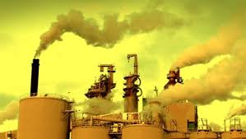
What Causes Air Pollution?

Slide 25
“I thought I saw a blue jay this morning. But the smog was so bad, that it turned out to be a cardinal holding it’s breath.”
“You know the air is polluted when…”

Slide 26
Personal Experience
Can you recall a time that you could tell that the air around you was polluted?
Turn and Talk!

Slide 27
“World Health Organization Says Lima has Worst Air Pollution in LatAm” – Peruvian Times May 2014
Coach Hall’s Personal Experience:
“Admiring” Lima’s grey winter skies.

Slide 28
Air Unit Essential Questions:
How is human health impacted by the air quality in indoor environments?
How do plants impact the quality of air in indoor spaces?
How can design impact indoor air quality, and what factors have to be considered.

Slide 29
“Not So Fun Facts”

Slide 30
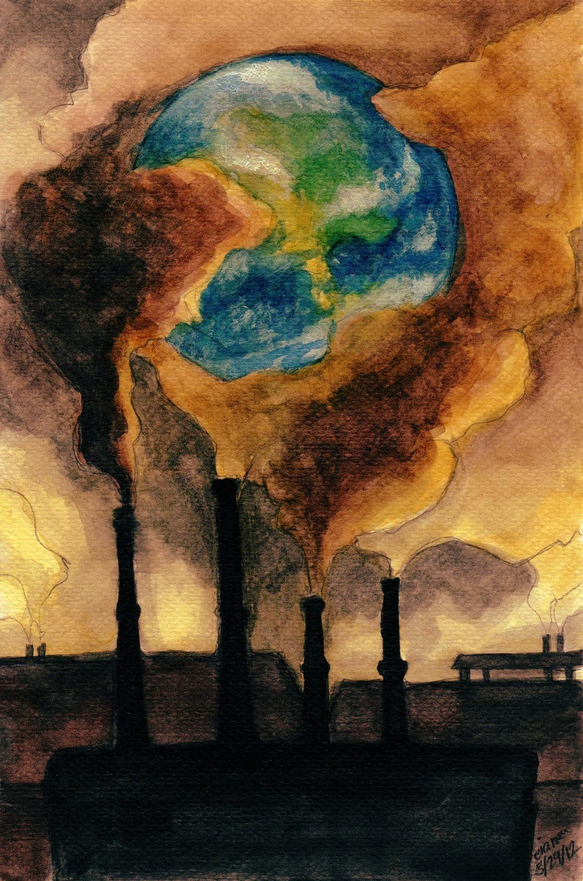
Air Pollution
When harmful substances build up in the air, the result is air pollution.

Slide 31
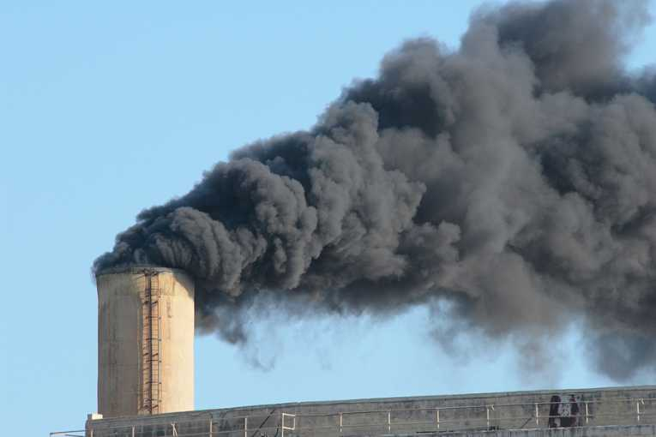
Primary and Secondary Pollutants
A primary pollutant is a pollutant put directly in the air by human activity.
Example: Soot from smoke
A secondary pollutant is when primary pollutants react with each other or with naturally occurring substances.
Example: Ground level ozone
(Ultraviolet rays + emissions from cars + oxygen = ozone.)
http://www.airinfonow.com/html/makingozone/o3play.htm

Slide 32
Sources of Primary Air Pollutants
Pollutant | Primary sources | Effects
Carbon Monoxide http://www.airinfonow.com/html/lungattack/lungplay.htm | Cars, trucks, buses, small engines, and some industrial processes | Interferes with the body’s ability to carry oxygen -> drowsiness, slowing reflexes, in severe cases, death.
Nitrogen oxides | Burning fossil fuels in vehicles, power plants, and industries. | Respiratory infections, lung disease, and cancer. Contributes to acid precipitation
Sulfur dioxide | Burning fossil fuels | Contributes to acid precipitation.
Volatile Organic Compounds (VOCs) | Burning fuels | Contributes to smog formation, and health problems.
Particulate Matter | Construction, agriculture, forestry, fires, vehicles. | Reduce visibility, cause respiratory problems.

Slide 33
The Clean Air Act
A US federal law designed to control air pollution on a national level.
It requires the EPA to develop and enforce regulations to protect the public from airborne contaminants known to be hazardous to human health.

Slide 34
Motor Vehicle Emissions
1/3 of air pollution comes from gasoline burned by vehicles.
The Clean Air Act allows EPA to regulate vehicle emissions in the US.
Example: catalytic converters are required in vehicles to clean exhaust.

Slide 35
Smog
When air pollution hangs over urban areas and reduces visibility .

Slide 36
Industrial Air Pollution
Industries and power plants burn fossil fuels for energy.
Burning fossil fuel releases SO₂ and NO_{x}
Industries, like dry cleaners, produce VOCs (volatile organic compounds)

Slide 37
Temperature Inversions
The atmospheric condition in which warm air traps cooler air near Earth’s surface.
Pollutants are trapped below with the cooler air.

Slide 38
Regulating Air Pollution from Industry
The Clean Air Act requires many industries to use scrubbers.
A scrubber is a machine that moves gas through a spray of water that dissolves many pollutants.
Scrubbers are installed on external exhaust pipes.

Slide 39
EPA Allowance Trading System
The EPA allows a limited number of sulfur dioxide allowances each year of 1 ton each.
Companies can buy, sell, or trade their allowances freely, but if they exceed their allowance, they must pay a fine.
Private citizens, schools, and community and environmental organizations can buy allowances to reduce emissions.

Slide 40
Check for Understanding
Post it Note Quiz:
What is the difference between a primary and secondary pollution?
Suggest one or more topics you think we ought to discuss/learn about in this unit.

Slide 41
GO TO: http://airquality.weather.gov/

