Slide 1
What’s The Matter?
Intro to Chemistry
The study of matter!

Slide 2
What is matter?
Anything that has mass AND takes up space.
All solids, liquids, and gases are classified as matter.

Slide 3
DEFINE
Atom
The smallest distinct units in a sample of matter
All matter is composed of atoms
Atoms cannot be broken down into smaller pieces
Molecule
A group of atoms bonded together, which represents the smallest unit that still has the physical and chemical characteristics of the substance

Slide 4
How do scientists classify matter?
Different kinds of matter have different characteristics
Matter can be distinguished by its physical properties.
Physical Properties are things that can be observed and measured without changing the identity of the substance.
Like…
“Next Slide please!”

Slide 5
Color
Density
Buoyancy
Boiling Point
Freezing Point
Conductivity
Viscosity

Slide 6
Chemical properties?
Flammability
Reactivity
toxicity
Enthalpy of formation
Heat of combustion
Oxidation states
Chemical stability
Types of chemical bonds that will form

Slide 7
Classes of matter
Elements
Compounds
Mixtures
Solutions

Slide 8
Pure Substances
Pure Substances cannot be separated into different kinds of matter.
All samples of a pure substance have exactly the same characteristic properties.
Substances with only one kind of matter are elements.
Substances that are made up of two or more elements are called compounds.

Slide 9
Elements
Substances with only one kind of matter are elements.
Elements are made up of the same atoms.
Elements cannot be decomposed into other substances.
Building blocks for all other substances.
Represented by a one- or two-letter chemical symbol.
Examples:
Al – Aluminum
Cu – Copper
Aluminum foil
Copper Wire

Slide 10
Compounds
Substances that are made up of two or more elements are called compounds.
Examples:
Table Salt
NaCl
Sodium Chloride

Slide 11
Add 2 or more elements = Compound

Slide 12
Mixtures
Mixtures are two or more substance that are not chemically combined. Components retain their characteristic properties
May be separated into pure substances by physical methods
Components retain their characteristic properties

Slide 13
Types of Mixtures
Homogeneous mixtures/Solutions
Same throughout
Examples?
Heterogeneous mixtures
Different throughout
Examples?
All mixtures can be separated into different types of matter

Slide 14
Homogeneous Mixtures/Solutions
Tea
Milk
Blood

Slide 15
Heterogeneous Mixture
Trail Mix
Italian Dressing
Cereal and Milk

Slide 16
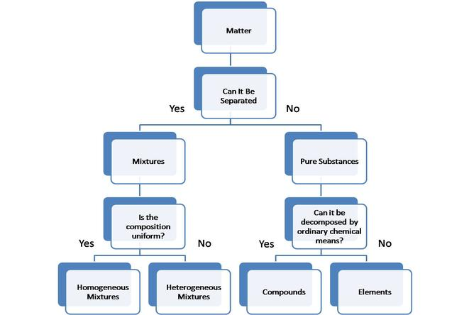

Slide 17
Type of Matter | Definition | Examples
Homogeneous Mixture | A mixture that contains more than one type of matter and is the same throughout. | Soda, air, vanilla ice cream
Heterogeneous Mixture | A mixture that contains more than one type of matter and is not the same throughout. | Chicken soup, soil, rocky road ice cream
Element | A substance that contains only one type of atom. | Copper metal, oxygen gas, liquid nitrogen
Compound | A substance that contains more than one type of atom. | Table salt, rust (iron oxide), carbon dioxide gas

